Slide 1
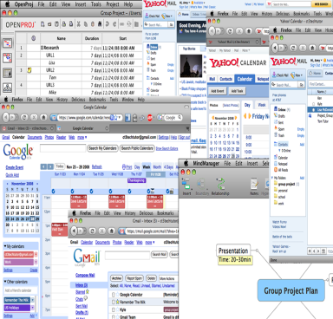
Management Skills
Management skills include managing your time and resources with project management software, as well as managing personal information.
In this section:
Project Management
Personal Information Management
Skills > Management Skills

Slide 2
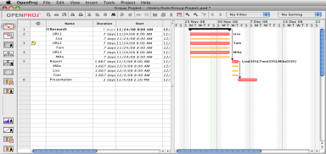
Project Management
Project management skills include the ability to use project management applications (e.g., OpenProj) to help manage your time and resources.
Skills > Management Skills > Project Management

Slide 3
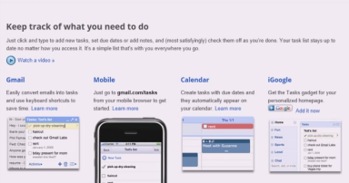
Personal Information Management
Personal information management (PIM) encompasses e-mail, contacts, tasks, and traditional calendars.
In this section: | Contacts
The Value of Personal Information Management | Calendars
Email | Tasks
Skills > Management Skills > Personal Information Management

Slide 4
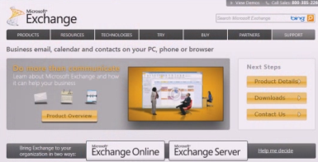
The Value of Personal Information Management
Online digital storage, called “the cloud,” makes it easy to manage personal information online, with any type of digital device, and share contents with anyone or everyone.
Skills > Management Skills > Personal Information Management > The Value of Personal Information Management

Slide 5
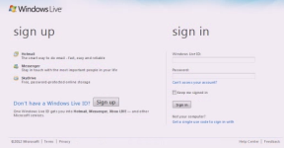
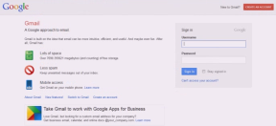
Email
Many Web users have migrated to Web-based mail (Webmail).
Webmail messages are available through a Web browser – wherever there’s an Internet connection – and offer tremendous flexibility and accessibility.
Skills > Management Skills > Personal Information Management > Email

Slide 6
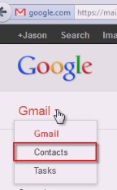
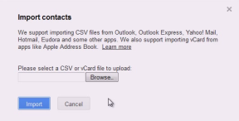
Contacts
Contacts are an essential part of personal information management. They hold basic data such as e-mail addresses, phone and fax numbers, and physical addresses, and can even track events such as birthdays, holidays, and anniversaries.
Skills > Management Skills > Personal Information Management > Contacts

Slide 7
Calendars
Time management is a key piece of personal information management.
Cloud-based calendar features provide a convenient way to schedule, track and view activities on the Web, making it easy to check and update even if you are away from school, home or work.
Skills > Management Skills > Personal Information Management > Calendars

Slide 8
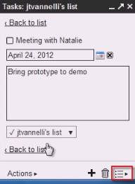
Tasks
The final area of managing personal information online is managing tasks, also known as a “to-do” list.
Web-based task management applications give you the option of setting up a personal task list that’s available on your computer desktop or mobile device.
Skills > Management Skills > Personal Information Management > Tasks

