Slide 1
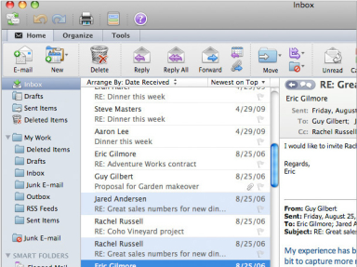
Other Office for Mac 2011 Applications
In this section:
Outlook for Mac 2011
Skills > Other Office for Mac 2011 Applications

Slide 2
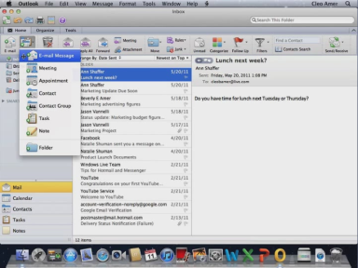
Outlook for Mac 2011
Outlook has the same general layout as other Office applications, with a ribbon containing multiple tabs at the top.
In this section:
E-mail
Calendaring & Tasks
Skills > Other Office for Mac 2011 Applications > Outlook for Mac 2011

Slide 3
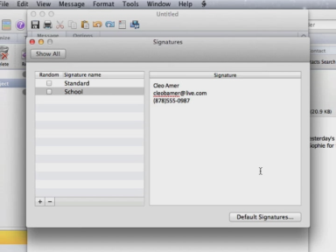
E-mail
Components of e-mail messages include: Recipient (To), Carbon copy (Cc), Subject, Body, Attach, and Priority.
Manage your incoming and outgoing messages using folders.
A signature block includes your name, address, phone number, or any other personal information that might be useful to a recipient without having to type it each time.
Skills > Other Office for Mac 2011 Applications > Outlook for Mac 2011 > E-mail

Slide 4
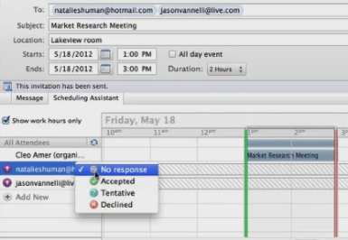
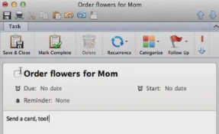
Calendaring & Tasks
Outlook allows you to schedule appointments, which are personal activities that involve only one person. To schedule an activity that involves others, you can schedule a meeting instead so everyone’s calendars reflect the shared activity.
You can also keep your to-do list in Outlook.
Skills > Other Office for Mac 2011 Applications > Outlook for Mac 2011 > Calendaring & Tasks

