Slide 1
Microsoft Office for Mac 2011
In this section:
Common Application Components | Working with Tables
Working with Files and Documents | Printing and Publishing
Common Editing Functions | Sharing Content Between Applications
Common Formatting Functions | Collaborating with Office for Mac 2011
Working with Graphics | Customizing Office Applications
Skills > Microsoft Office for Mac 2011

Slide 2
Common Application Components
Components to be familiar with:
Command button Launchpad
Desktop Menu
Dock Ribbon
Finder Tab
In this section:
Launching Applications | Ribbons and Tabs
Application Components | Getting Help
Skills > Microsoft Office for Mac 2011 > Common Application Components

Slide 3
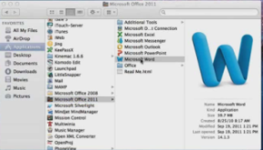
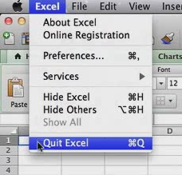
Launching Applications
To launch an application, either:
Click the Launchpad icon on the left side of the Dock, find and click application’s icon.
Click the Finder icon on the left side of the Dock, find and double-click the application.
Add an application shortcut to the Dock using click-and-drag.
Quit application choosing Quit from application menu or Command-Q.
Remove application shortcut from Dock using click-and-drag to Desktop – icon disappears in poof of smoke.
Skills > Microsoft Office for Mac 2011 > Common Application Components > Launching Applications
Notes:
Bullet 2 modified

Slide 4
Application Components
Menu bar at top.
Standard toolbar below Menu bar.
Minimize/expand Ribbon button on right edge of Ribbon.
Ribbon below Menu bar.
Close (red), Minimize (yellow), and Zoom (green) buttons at top-left.
View buttons at bottom-left.
The Zoom slider at bottom-right.
Status bar at bottom of screen.
Skills > Microsoft Office for Mac 2011 > Common Application Components > Application Components
Notes:
Bullet 2 modified

Slide 5
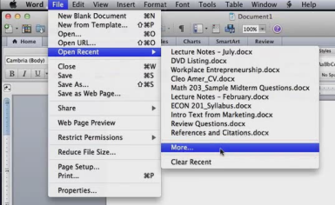
Ribbons and Tabs
Navigate the Ribbon by clicking tabs to display sets/groups of tools.
More options in Menu bar. Submenus on Menu bar open a dialog box, where you can adjust settings related to that option.
The File menu gives access to commands/options related to working with files (e.g., creating or opening a document, closing and saving a document, other file options like sharing and printing).
Clicking More… brings up Word Document Gallery window.
Skills > Microsoft Office for Mac 2011 > Common Application Components > Ribbons and Tabs
Notes:
Bullet 2 modified

Slide 6
Getting Help
ScreenTips appear when you hold mouse pointer over most elements and include an explanation of how to use the button.
The Help button (purple question mark on right end of Standard toolbar) opens the Help Center window, which provides access to information installed on your computer as well as to information available online, if connected to the Internet.
Skills > Microsoft Office for Mac 2011 > Common Application Components > Getting Help
Notes:
Bullet 2 modified

Slide 7
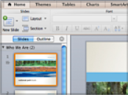
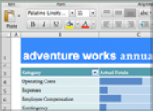
Working with Files and Documents
In this section: | Navigating in a Document
Creating New Files from Scratch or Templates | Document Views and Zoom Switching Between Open Documents
Opening an Existing File | Saving and Closing Documents
Skills > Microsoft Office for Mac 2011 > Working with Files and Documents

Slide 8
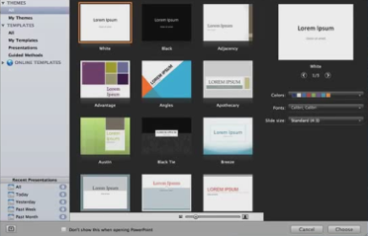
Creating New Files from Scratch or Templates
To create a new, blank document, click New Blank Document on File menu.
To create a new document based on a template, click New from Template on File menu to open the Gallery and view template options.
Skills > Microsoft Office for Mac 2011 > Working with Files and Documents > Creating New Files from Scratch or Templates
Notes:
Bullet 2 modified

Slide 9
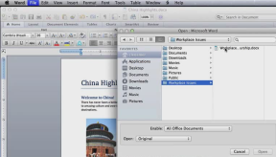
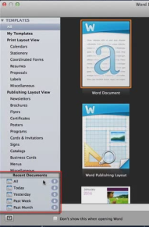
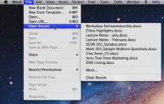
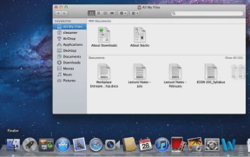
Opening an Existing File
Options to open existing file:
Launch desired application, browse Recent Documents in Gallery.
Choose File menu, Open, click folder where stored, double-click file.
Choose File menu, Open Recent, click file.
Open Finder window, click folder where stored, double-click file.
Skills > Microsoft Office for Mac 2011 > Working with Files and Documents > Opening an Existing File
Notes:
Bullet 2 modified

Slide 10
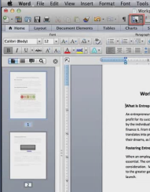
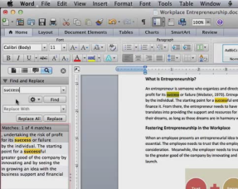
Navigating in a Document
Click Sidebar button on Standard Toolbar OR click View menu, point to Sidebar, then select option. Sidebar pane tabs include: Thumbnail, Document Map, Reviewing, and Find and Replace.
To search within a document, type text or number in Search Document box. Additional options can refine search.
Skills > Microsoft Office for Mac 2011 > Working with Files and Documents > Navigating in a Document
Notes:
Bullet 2 modified

Slide 11
Document Views and Zoom
To change the view, use view buttons in the lower-left corner of the Status Bar: Draft, Outline, Publishing Layout, Print Layout, Notebook Layout, Full Screen, or Web Layout.
Zoom level and Zoom slider are in the lower-right corner of the Status Bar.
Skills > Microsoft Office for Mac 2011 > Working with Files and Documents > Document Views and Zoom
Notes:
Bullet 2 modified

Slide 12
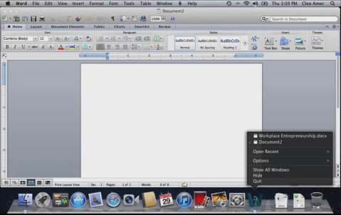
Switching Between Open Documents
To see a listing of all open documents, click and hold the application icon in the Dock. Move the mouse pointer over a listing and click it to switch to that document.
Skills > Microsoft Office for Mac 2011 > Working with Files and Documents > Switching Between Open Documents
Notes:
Bullet 2 modified

Slide 13
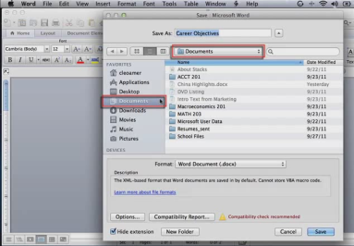
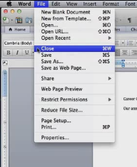
Saving and Closing Documents
To save document first time (or as you work on it), click Save button on Standard toolbar. In the Save dialog box, specify name and location for file.
To save document with new name or in new location, choose File menu, then Save As. Provide new name and/or location.
To close document, choose File menu, then Close.
Skills > Microsoft Office for Mac 2011 > Working with Files and Documents > Saving and Closing Documents
Notes:
Bullet 2 modified

Slide 14
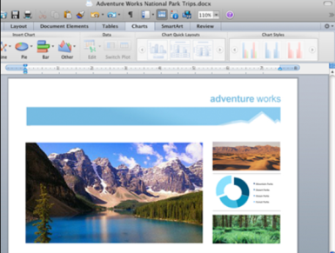
Common Editing Functions
In this section: | Using Copy/Cut/Paste
Selecting, Inserting, and Deleting Text | Find and Replace
Inserting and Editing Hyperlinks | Spelling and Grammar Check
Skills > Microsoft Office for Mac 2011 > Common Editing Functions

Slide 15
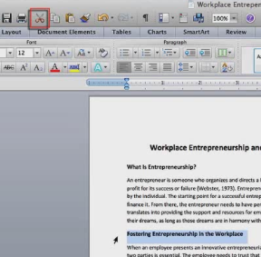
Selecting, Inserting, and Deleting Text
To select text, move cursor/insertion point to text to work on. Press and hold down mouse button, drag pointer over text, then release mouse button.
To deselect selected text, click anywhere in document.
To replace text, select text and type.
To insert text, move cursor/insertion point, click, then type.
To delete text, select text, then click Cut button on Standard Toolbar OR press Delete key on keyboard.
Skills > Microsoft Office for Mac 2011 > Common Editing Functions > Selecting, Inserting, and Deleting Text
Notes:
Bullet 2 modified

Slide 16
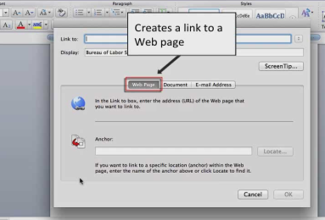
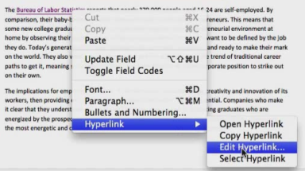
Inserting and Editing Hyperlinks
Type hyperlink directly in document OR format existing text as hyperlink by selecting text, clicking Insert menu, then clicking Hyperlink option. Dialog box allows three kinds of links: Web Page, another file, or e-mail address.
To edit hyperlink, Control-click to open Shortcut menu, point to hyperlink, click Edit Hyperlink. Dialog box allows you to edit link, edit text in hyperlink ScreenTip, or remove hyperlink.
Skills > Microsoft Office for Mac 2011 > Common Editing Functions > Inserting and Editing Hyperlinks
Notes:
Bullet 2 modified

Slide 17
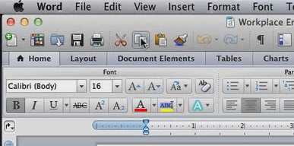
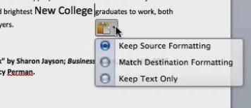
Using Copy/Cut/Paste
To copy text, select word, phrase, or paragraph to be copied. Click Copy button in Standard toolbar.
To cut text/object, select text/object to be removed, click Cut button in Standard toolbar.
To paste text/object following either Copy or Cut, position insertion point in document. Click Paste button in Standard toolbar. Paste Options button includes options to Keep Source Formatting, Match Destination Formatting, or Paste Special.
Skills > Microsoft Office for Mac 2011 > Common Editing Functions > Using Copy/Cut/Paste
Notes:
Bullet 2 modified

Slide 18
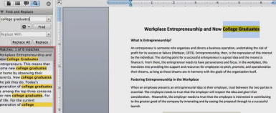
Find and Replace
To locate text without replacing it, click Sidebar list arrow, then click Search Pane. Sidebar opens on the left. Type phrase to find it, then the Sidebar pane displays all instances of phrase and highlights phrase in document.
To both find and replace text, click Search Pane, type replacement text in Replace With box. Then either choose Replace All or use Find through document to decide if you want to replace individual occurrences.
Skills > Microsoft Office for Mac 2011 > Common Editing Functions > Find and Replace
Notes:
Bullet 2 modified

Slide 19
Spelling and Grammar Check
Spelling error indicated by wavy red underline.
Grammatical and contextual spelling errors indicated by wavy green underline
Correct errors by deleting, retyping, or secondary-clicking/right-clicking/control-clicking on error.
To check entire document at once, place insertion point at beginning of document, click Spelling and Grammar tool in Tools menu.
Skills > Microsoft Office for Mac 2011 > Common Editing Functions > Spelling and Grammar Check
Notes:
Bullet 2 modified

Slide 20
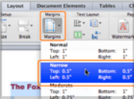
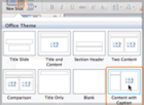
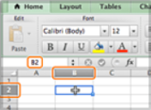
Common Formatting Functions
In this section: | Paragraph Formatting
Galleries with Preview | Working with Lists
Working with Fonts | Using the Format Painter
Skills > Microsoft Office for Mac 2011 > Common Formatting Functions

Slide 21
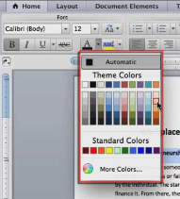
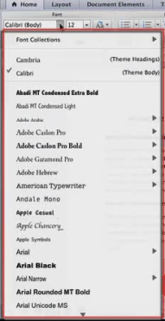
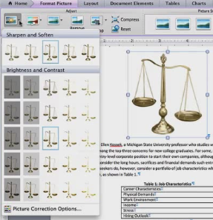
Galleries with Preview
Galleries are menus that show examples of options.
Palettes are grids of color options.
Previews show you how your document would look if you select that formatting.
Skills > Microsoft Office for Mac 2011 > Common Formatting Functions > Galleries with Preview
Notes:
Bullet 2 modified

Slide 22
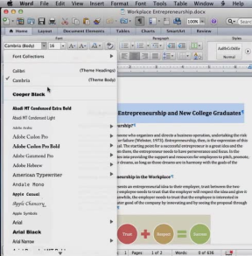
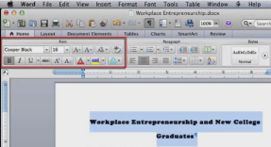
Working with Fonts
To format text font, select text, then click Font arrow to open Font gallery.
Additional formatting choice(s), include: font style, size, bold, italic, underline, color, and highlight color.
Skills > Microsoft Office for Mac 2011 > Common Formatting Functions > Working with Fonts
Notes:
Bullet 2 modified

Slide 23
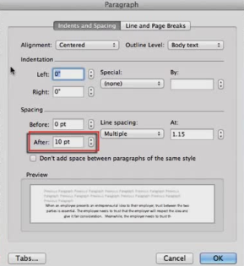
Paragraph Formatting
Options included in Paragraph group on Home tab:
Align text: left, center, right, or justify.
Line spacing: 0.5 to 3.0, or Line Spacing Options.
Indents: increase or decrease.
Spacing: before or after paragraphs.
Skills > Microsoft Office for Mac 2011 > Common Formatting Functions > Paragraph Formatting
Notes:
Bullet 2 modified

Slide 24
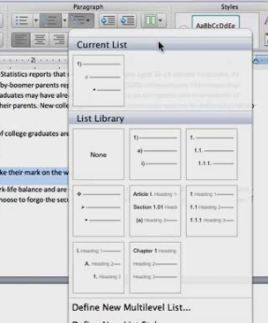
Working with Lists
Three types of lists in Paragraph group:
Bulleted List button allows you to choose bullet style.
Numbered List button allows you to choose numbering option.
Multilevel List button offers more complex indented list options. Use with Tab key to increase or Shift+Tab to decrease indent.
Skills > Microsoft Office for Mac 2011 > Common Formatting Functions > Working with Lists
Notes:
Bullet 2 modified

Slide 25
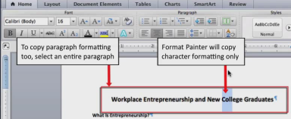
Using the Format Painter
First, select text. Click Format Painter button in Standard toolbar to copy formatting:
Single-click Format Painter button to format one occurrence of text.
Double-click Format Painter button to format multiple occurrences of text.
Then to apply formatting, drag I-beam pointer over text.
Skills > Microsoft Office for Mac 2011 > Common Formatting Functions > Using the Format Painter
Notes:
Bullet 2 modified

Slide 26
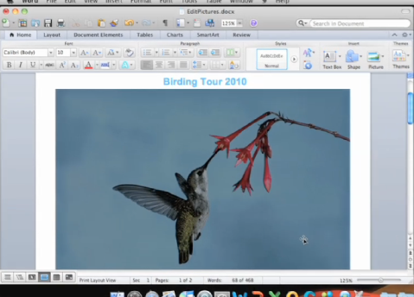
Working with Graphics
In this section:
Inserting Clip Art and Photos | Applying Graphics Effects
Inserting Shapes and WordArt | Editing Photos
Skills > Microsoft Office for Mac 2011 > Working with Graphics

Slide 27
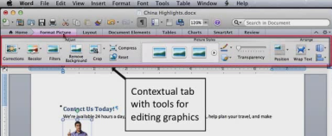
Inserting Clip Art and Photos
First, click where you want to insert image.
To insert image, use Insert menu, then Clip Art Gallery or Media Browser, search for image, then click Insert button.
To resize, click image to select it, drag corner handle. You can also modify using Format contextual tab, which appears when image is selected.
To wrap text around image, click Wrap Text button in Arrange group on Format Picture tab.
Skills > Microsoft Office for Mac 2011 > Working with Graphics > Inserting Clip Art and Photos
Notes:
Bullet 2 modified

Slide 28
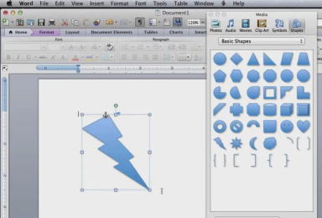
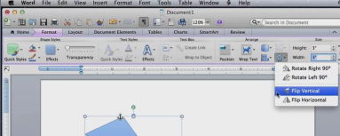
Inserting Shapes and WordArt
To insert a shape, position insertion point, click Shape command on Insert menu to launch Media Browser (Shapes tab selected). Select desired shape, hold down mouse button, drag to draw.
To insert WordArt, click Insert menu, click WordArt, type text. Fine-tune with Text Styles group on Format tab.
To modify shape or WordArt, click to select. Then resize/rotate/flip, align, apply Style, or use contextual tab to modify. For WordArt, modify size on Home tab.
Skills > Microsoft Office for Mac 2011 > Working with Graphics > Inserting Shapes and WordArt
Notes:
Bullet 2 modified

Slide 29
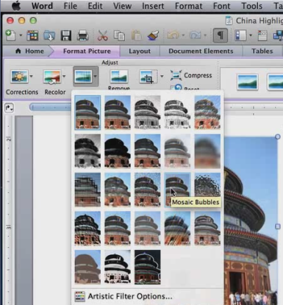
Applying Graphics Effects
Hold mouse pointer over an Effect for a ScreenTip and preview.
Picture Adjustments change the image itself with the Filters tool.
Picture Styles change the edges. See a preview by hovering over options in gallery tool of Picture Styles Group.
Apply Picture Border with Border tool in Picture Styles group.
Reset button restores picture to original state.
Skills > Microsoft Office for Mac 2011 > Working with Graphics > Applying Graphics Effects
Notes:
Bullet 2 modified

Slide 30
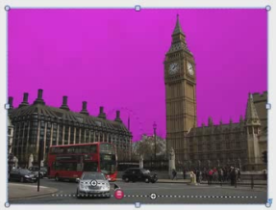
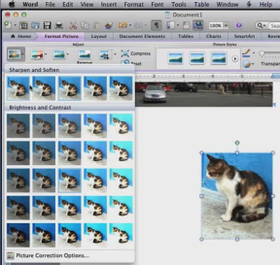
Editing Photos
Remove picture background with Remove Background button in Adjust group.
To use Crop button in the Adjust group, drag any of the black handles to eliminate unwanted portion.
Corrections gallery tool allows you to adjust the focus, contrast, or brightness.
Recolor tool allows you to adjust color saturation, color tone, or apply new color.
Skills > Microsoft Office for Mac 2011 > Working with Graphics > Editing Photos
Notes:
Bullet 2 modified

Slide 31
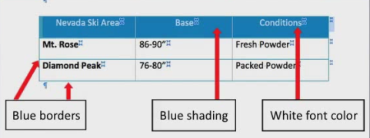
Working with Tables
In this section:
Creating a Table
Adjusting Rows, Columns, and Cells
Formatting Tables
Skills > Microsoft Office for Mac 2011 > Working with Tables

Slide 32
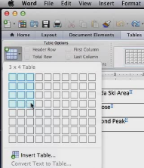
Creating a Table
Create by clicking Table option on Insert menu and selecting dimension with grid OR clicking Insert Table to open dialog box and supply dimensions.
Add text by typing in cells, moving forward (Tab) or backward (Shift+Tab).
To convert text to table, select text, click Tables tab, click New tool, then Convert Text to Table.
Delete table by clicking Table Select handle and pressing Delete button.
Skills > Microsoft Office for Mac 2011 > Working with Tables > Creating a Table
Notes:
Bullet 2 modified

Slide 33
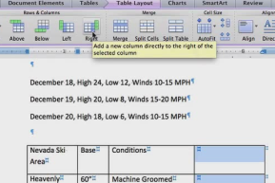
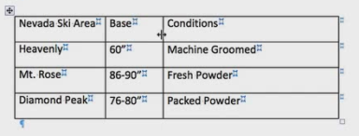
Adjusting Rows, Columns, and Cells
Insert a row/column by positioning cursor, clicking Below, Above, Left, or Right button in Rows and Columns group on Table Layout contextual tab.
Adjust column widths and row heights by dragging edge with cursor OR placing cursor on border between columns or rows and double-clicking for auto-sizing.
Combine (Merge) or divide (Split Cells) in Merge group on Table Layout tab.
Skills > Microsoft Office for Mac 2011 > Working with Tables > Adjusting Rows, Columns, and Cells
Notes:
Bullet 2 modified

Slide 34
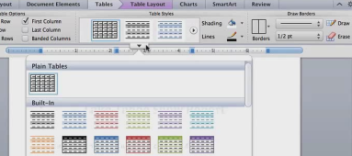
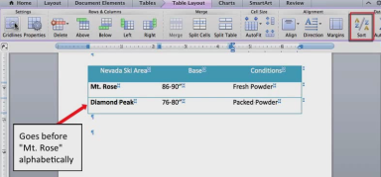
Formatting Tables
Format header or rows of table manually by changing font format OR by choosing formatting option on Tables tab (includes gallery of Table Styles, shading, borders, and gridlines).
Sort rows of table by positioning cursor in table, click Sort button on Table Layout tab. Choose which column(s) you wish to sort on.
Skills > Microsoft Office for Mac 2011 > Working with Tables > Formatting Tables
Notes:
Bullet 2 modified

Slide 35
Printing and Publishing
In this section:
Formatting Documents for Printing | Managing Print Jobs
Previewing Documents | Printing to PDF
Specifying Print Options | Emailing or Faxing Documents
Skills > Microsoft Office for Mac 2011 > Printing and Publishing

Slide 36
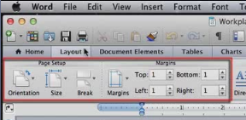
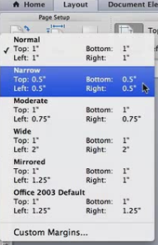
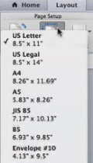
Formatting Documents for Printing
The Layout tab allows you to make adjustments to documents for printing:
To adjust page margins, click the Margins button in the Margins group.
To change page orientation, click the Orientation button.
To select a new paper size, click the Size button.
Skills > Microsoft Office for Mac 2011 > Printing and Publishing > Formatting Documents for Printing
Notes:
Bullet 2 modified

Slide 37
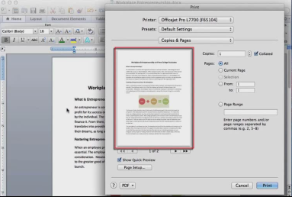
Previewing Documents
Click the File menu, then click Print to see the Print dialog box, which includes a preview of the printed document. Flip through the pages using the left and right arrow buttons under the quick preview. On the right side are the currently selected print options, which you can modify.
Skills > Microsoft Office for Mac 2011 > Printing and Publishing > Previewing Documents
Notes:
Bullet 2 modified

Slide 38
Specifying Print Options
To choose from options when printing, click the File menu, then click Print. From Print dialog box:
Select number of copies to print by clicking up and down arrows.
Select a printer from Printer menu.
Print all pages (default) or specify specific pages to print.
Select two-sided printing, if supported.
Collate pages, if printing multiple copies.
Skills > Microsoft Office for Mac 2011 > Printing and Publishing > Specifying Print Options
Notes:
Bullet 2 modified

Slide 39
Managing Print Jobs
Also in the Print dialog box, you can manage printer properties by using the dropdown settings menu.
Depending on your printer, options may include paper type/quality where you can choose between color or grayscale output.
When you send documents to print, they are managed through the printer queue. Click the printer icon on the Dock to see a dialog box showing the current document printing. To pause or cancel print job(s), click print job, then choose option in toolbar.
Skills > Microsoft Office for Mac 2011 > Printing and Publishing > Managing Print Jobs
Notes:
Bullet 2 modified

Slide 40
Printing to PDF
Saving a file to a PDF (also known as “printing” a file to PDF), creates a picture of the document that can be opened in many applications.
First, click the File menu, then click Save As. In the dialog box, drop-down the file format option, select PDF, then click Save.
Skills > Microsoft Office for Mac 2011 > Printing and Publishing > Printing to PDF
Notes:
Bullet 2 modified

Slide 41
Emailing or Faxing Documents
To send document as an email attachment, first compose your message, then click Attach (location of this button will depend on your email client). Browse or use Finder to locate the document, then double-click to attach. Complete and send your message.
To send document as an Internet fax, you must first install a fax modem. Then click the Fax PDF option in the PDF menu on the Print dialog box.
Skills > Microsoft Office for Mac 2011 > Printing and Publishing > Emailing or Faxing Documents
Notes:
Bullet 2 modified

Slide 42
Sharing Content Between Applications
In this section:
Copying Content Between Applications
Object Linking and Embedding
Skills > Microsoft Office for Mac 2011 > Sharing Content Between Applications

Slide 43
Copying Content Between Applications
To copy an Excel chart into a Word document, click to select the chart. Click the Copy button on Standard toolbar. Position insertion point in Word document. Click Paste button.
To copy a Word table into an Excel workbook, click to select the table. Click the Copy button on Standard toolbar. Position insertion point in Excel workbook. Click Paste button.
Skills > Microsoft Office for Mac 2011 > Sharing Content Between Applications > Copying Content Between Applications
Notes:
Bullet 2 modified

Slide 44
Object Linking and Embedding
For OLE, start by copying information in source file and pasting into destination file.
To link, after Paste, click the Paste Options button. Options will vary, such as “Chart (linked to Excel data)” and “Use Destination Theme.” Future changes in source will be reflected in destination!
To embed, simply Paste. To modify later, make changes in destination file – there is no link/connection between source and destination!
Skills > Microsoft Office for Mac 2011 > Sharing Content Between Applications > Object Linking and Embedding
Notes:
Bullet 2 modified

Slide 45
Collaborating with Office for Mac 2011
In this section:
Sharing Documents | Accepting or Rejecting Changes
Adding Comments | Comparing and Merging Documents
Tracking Changes | Protecting Documents
Skills > Microsoft Office for Mac 2011 > Collaborating with Office for Mac 2011

Slide 46
Sharing Documents
Windows Live SkyDrive (www.live.com) is available free to everyone!
Create an account or sign-in. To begin working, click “SkyDrive” on Menu bar at top of screen.
Documents folder is private; Public folder is open to everyone. Create new folders, which can be private, shared by invitation, or public.
Options for adding new files is similar to using Finder.
Skills > Microsoft Office for Mac 2011 > Collaborating with Office for Mac 2011 > Sharing Documents
Notes:
Bullet 2 modified

Slide 47
Adding Comments
Buttons are located in Comments group on Review tab:
Select where you want to insert a comment.
Click the New button.
Type your comment(s).
Click in the document to exit comment box.
Scroll through comments using the Previous and Next buttons.
To delete comments, click comment box, click Delete button.
Skills > Microsoft Office for Mac 2011 > Collaborating with Office for Mac 2011 > Adding Comments
Notes:
Bullet 2 modified

Slide 48
Tracking Changes
Buttons are located in Tracking group on Review tab:
To turn on track changes feature, click Track Changes button to slide it “ON.”
Additions are shown in a different color with an underline
Deletions are displayed in “Deleted” comments.
To review a list of changes, click the Review Pane button in the Changes group on Review tab.
Skills > Microsoft Office for Mac 2011 > Collaborating with Office for Mac 2011 > Tracking Changes
Notes:
Bullet 2 modified

Slide 49
Accepting or Rejecting Changes
Buttons are located in Changes group on Review tab:
First, move insertion point to beginning of document.
Scroll through changes by clicking Next/Previous buttons.
To accept or reject a highlighted change and move to the next, click the Accept or Reject button.
Other options are available on the Accept and Reject button arrows.
Skills > Microsoft Office for Mac 2011 > Collaborating with Office for Mac 2011 > Accepting or Rejecting Changes
Notes:
Bullet 2 modified

Slide 50
Comparing and Merging Documents
To compare documents, click Tools menu, Track Changes, Compare Documents.
Open both documents, click OK. New document opens with combined version.
Click Review Pane button on Review tab to see summary of differences.
Accept or reject changes in Changes group on Review tab.
To combine documents, click Merge Documents in Tools menu.
Skills > Microsoft Office for Mac 2011 > Collaborating with Office for Mac 2011 > Comparing and Merging Documents
Notes:
Bullet 2 modified

Slide 51
Protecting Documents
To restrict access to an entire document, require a password to open it. First click the Word menu, Preferences. Click the Security button in the Personal Settings row.
To restrict editing of a document, require a password to modify the document.
To protect a document, but still allow certain functionality, click the Protect Document button.
Skills > Microsoft Office for Mac 2011 > Collaborating with Office for Mac 2011 > Protecting Documents
Notes:
Bullet 2 modified

Slide 52
Customizing Office Applications
In this section:
Customizing the Ribbon and Tabs
Application Options
Skills > Microsoft Office for Mac 2011 > Customizing Office Applications

Slide 53
Customizing the Ribbon and Tabs
Start by clicking application menu (e.g., Word), then Preferences.
In Personal Settings row, click Ribbon icon to customize Ribbon:
General section options relate to Ribbon as a whole, such as Ribbon On/Off.
Customize section options change appearance of Ribbon, tabs, and groups.
Skills > Microsoft Office for Mac 2011 > Customizing Office Applications > Customizing the Ribbon and Tabs
Notes:
Bullet 2 modified

Slide 54
Application Options
Each Office application has a Preferences dialog box; options vary by application. Word includes three categories:
Authoring and Proofing Tools (e.g., View, Spelling and Grammar, AutoCorrect).
Output and Sharing (e.g., Save preferences, AutoRecover, Compatibility).
Personal Settings (e.g., user information and file locations).
Skills > Microsoft Office for Mac 2011 > Customizing Office Applications > Application Options
Notes:
Bullet 2 modified

