Slide 1
Access 2013
Microsoft Access 2013 is a database application that is ideal for gathering and understanding data that’s been collected on just about anything – from customers and employees, to inventory, services, and events.
In this section:
Overview of Databases
Database Tables
Datasheets and Forms
Queries and Reports
Skills > Access 2013

Slide 2
Overview of Databases
Access is Microsoft’s relational database management program. It’s designed to help users create databases – collections of data – for later retrieval, manipulation, and reporting of that data to support problem-solving and decision making activities. To use a database, though, you don’t have to be its creator. In fact, most of the time we aren’t even aware that we are using a database when we search for something online, ask a store clerk to check the status of an out-of-stock item, use library resources to find books, or buy an airline ticket.
In this section:
Database Management Tools and Features
Effective Database Management
Database Uses
Creating and Saving Databases
Skills > Access 2013 > Overview of Databases

Slide 3
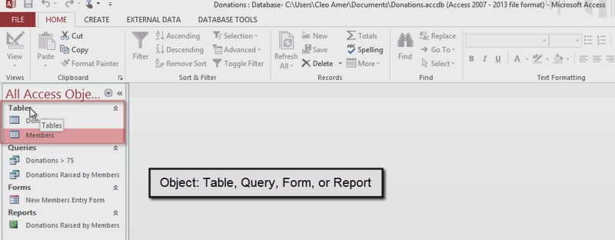
Database Management Tools and Features
Navigation Pane includes Database Objects: Tables, Queries, Forms, and Reports
Skills > Access 2013 > Overview of Databases > Database Management Tools and Features
Notes:
Bullet 2 modified

Slide 4
Effective Database Management
Rows are called records; columns are called fields.
All records in a table are related, and you will work with multiple tables in a single database.
“Primary key” field contains a unique identifier for each record.
Tables are connected to each other via a shared, or common, field.
In a well-designed database, you can easily:
Add new records, change the field values in existing records, and delete field values from records.
Get answers to questions about the data.
Skills > Access 2013 > Overview of Databases > Effective Database Management
Notes:
Bullet 2 modified

Slide 5
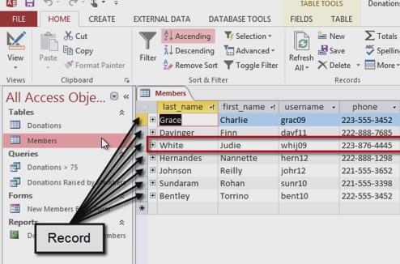
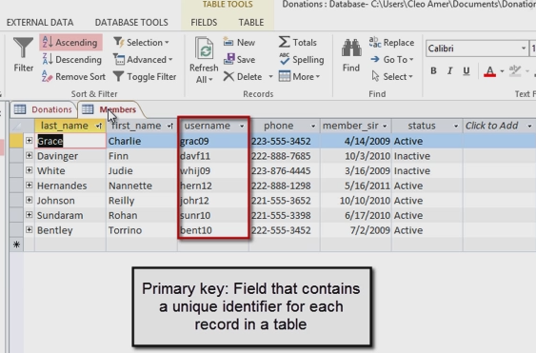
Effective Database Management
Skills > Access 2013 > Overview of Databases > Effective Database Management
Notes:
Bullet 2 modified

Slide 6
Database Uses
Businesses use databases to track and manage: Customers, Advertising and Sales, Employees, Inventory, Suppliers, Operations, and more.
Educational institutions rely on databases to track and manage: Libraries, Housing, Class scheduling, Financial aid, Loans and scholarships, Grades and transcripts, Athletics and clubs, Alumni contact, and more.
Non-profit organizations use databases to track donors, fundraising events, activities, and more.
Skills > Access 2013 > Overview of Databases > Database Uses
Notes:
Bullet 2 modified

Slide 7
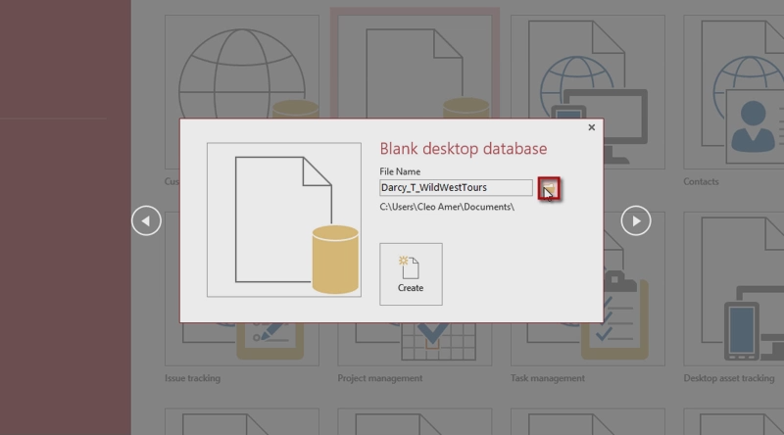
Creating and Saving Databases
Access requires you to create and name a new database first, before you start any work – and there is limited Undo ability!
Skills > Access 2013 > Overview of Databases > Creating and Saving Databases
Notes:
Bullet 2 modified

Slide 8
Database Tables
Before you can use a database for problem-solving and decision making, the database needs to be populated with data. The data in any database also have to be arranged in a logical manner to make it easy to add, change, delete, and create information based on the data. The videos in this section show you all the different ways you can structure the data in a database, and then enter data into it, from typing it yourself by hand to importing it from a variety of external sources.
In this section:
Creating a Table in Datasheet View
Creating a Table in Design View
Primary Keys
Adding Fields Using the Data Type Gallery
Importing Data from a Text File
Table Relationships
Skills > Access 2013 > Database Tables

Slide 9
Creating a Table in Datasheet View
To create a table, click the Create tab, and then click the Table button in the Tables group.
Like the other Office applications, Access allows you to display your work in different views.
Before you can enter any data into records, you have to create the fields that will contain this data.
By default, every new table contains a field called “ID.”
Skills > Access 2013 > Database Tables > Creating a Table in Datasheet View
Notes:
Bullet 2 modified

Slide 10
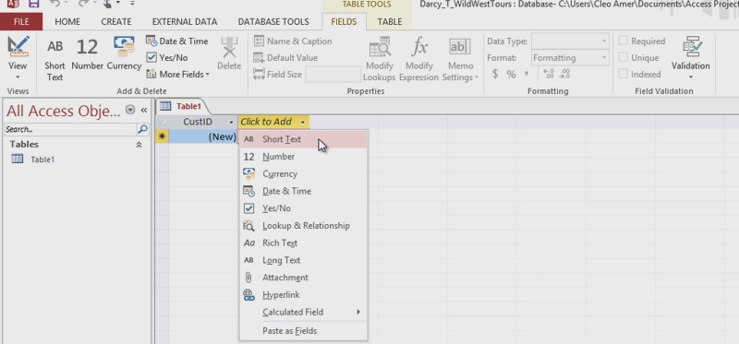
Creating a Table in Datasheet View
Skills > Access 2013 > Database Tables > Creating a Table in Datasheet View
Notes:
Bullet 2 modified

Slide 11
Creating a Table in Design View
To create a table, click the Create tab, and then click the Table button in the Tables group.
The View button allows you to select from two different views: Datasheet (default) and Design.
Table Design grid includes Field Name, Type of Field, and optional Description.
A database works more efficiently if you limit a field’s size to the number of characters you expect to store in that field.
Skills > Access 2013 > Database Tables > Creating a Table in Design View
Notes:
Bullet 2 modified

Slide 12
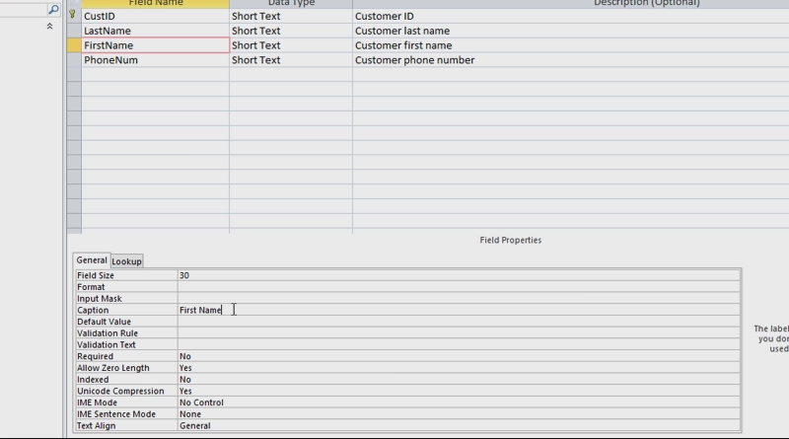
Creating a Table in Design View
Skills > Access 2013 > Database Tables > Creating a Table in Design View
Notes:
Bullet 2 modified

Slide 13
Primary Keys
A primary key is used to uniquely identify each record in a database table.
When a field is a primary key in one table, and is also included as a field in another table, it’s called a “foreign key” in the second table.
Skills > Access 2013 > Database Tables > Primary Keys
Notes:
Bullet 2 modified

Slide 14
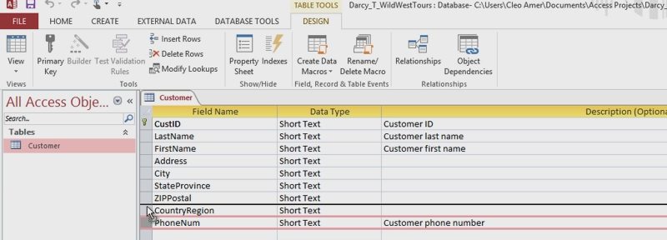
Adding Fields Using the Data Type Gallery
Data Type Gallery allows you to quickly add a group of related fields to a table.
It’s easy to move fields around in Design view.
Skills > Access 2013 > Database Tables > Adding Fields Using the Data Type Gallery
Notes:
Bullet 2 modified

Slide 15
Importing Data from a Text File
To import data from a text file, use External Data tab, Import & Link group, Text File button to open the Get External Data dialog box.
Delimited text is “delimited,” or separated, by a character.
Skills > Access 2013 > Database Tables > Importing Data from a Text File
Notes:
Bullet 2 modified

Slide 16
Table Relationships
Tools for setting up relationships are on Database Tools tab.
Process of setting up a relationship in the Show Table dialog box between the tables that share a common field is known as a “join.”
Once tables are joined, you can extract the data from two or more tables at once by using a query, form or report.
Without relationships between tables, the amount of meaningful data extracted from the database is limited.
Skills > Access 2013 > Database Tables > Table Relationships
Notes:
Bullet 2 modified

Slide 17
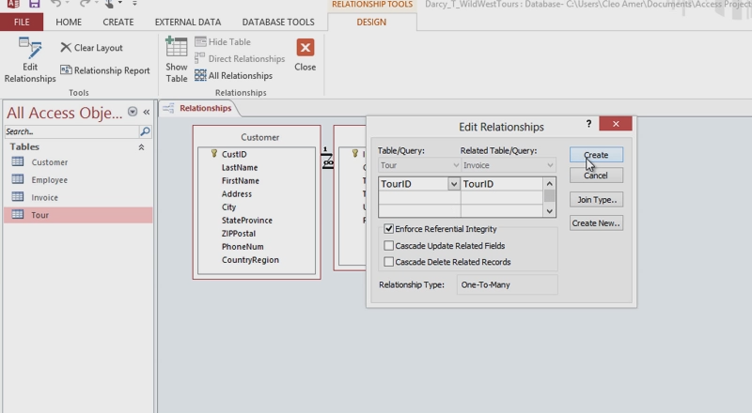
Table Relationships
Skills > Access 2013 > Database Tables > Table Relationships
Notes:
Bullet 2 modified

Slide 18
Datasheets and Forms
The data in an Access database is organized into tables that are joined together through key fields. Data may be entered directly into tables or through forms that you can create to simplify and control the data entry process. Additionally, Access provides tools for sorting, filtering, and performing calculations on the data that make the task of extracting and reporting that data much easier.
In this section:
Entering Data in Datasheets
Subdatasheets & Lookup Fields
Sort & Filter
Calculating
Using Forms
Designing Forms
Creating a Form with a Subform
Skills > Access 2013 > Datasheets and Forms

Slide 19
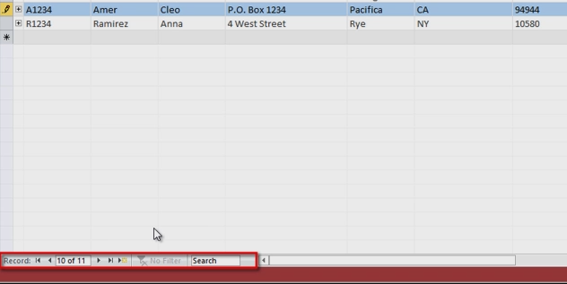
Entering Data in Datasheets
Once tables and relationships are set up, there are a few ways to work with data stored in tables.
Tools at the bottom of Datasheet view allow searching for any data in any field.
Skills > Access 2013 > Datasheets and Forms > Entering Data in Datasheets
Notes:
Bullet 2 modified

Slide 20
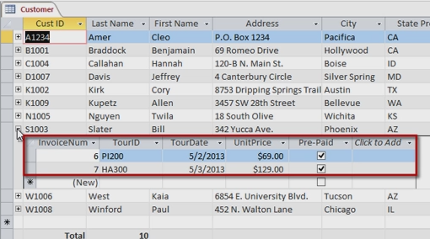
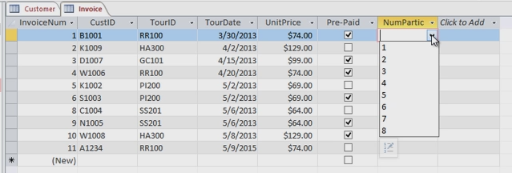
Subdatasheets & Lookup Fields
Access automatically sorts the records by primary key.
A subdatasheet shows records related to current record.
A lookup field makes it easy to enter new data and minimizes the risk of incorrect data being introduced into a field when new records are created.
Skills > Access 2013 > Datasheets and Forms > Subdatasheets & Lookup Fields
Notes:
Bullet 2 modified

Slide 21
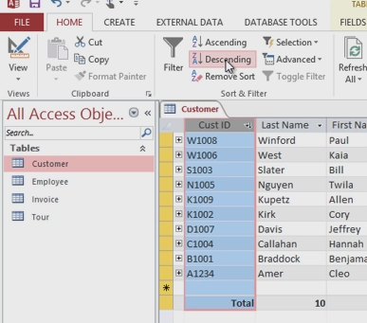
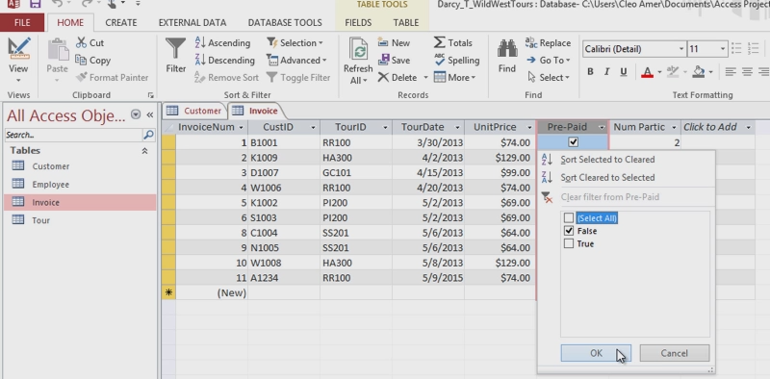
Sort & Filter
Sort & Filter group, Home Filters display only records
tab, contains tools for that match a set of criteria.
sorting.
Skills > Access 2013 > Datasheets and Forms > Sort & Filter
Notes:
Bullet 2 modified

Slide 22
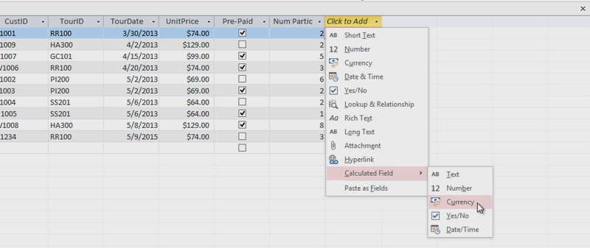
Calculating
In datasheet view, the arrow next to “Click to Add” field name reveals a drop-down menu that includes an option to create a calculated field.
Skills > Access 2013 > Datasheets and Forms > Calculating
Notes:
Bullet 2 modified

Slide 23
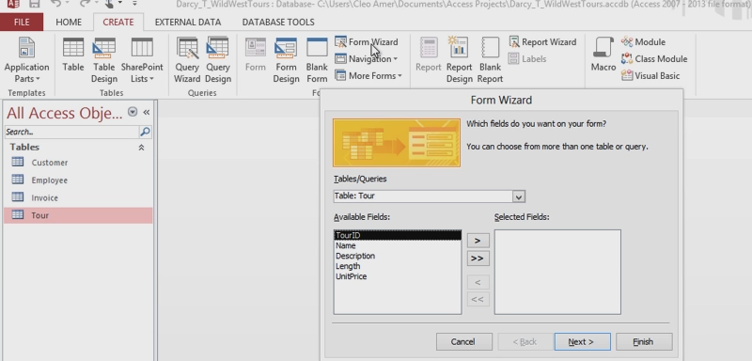
Using Forms
A form is a database object used to add, maintain, view and print records. A quick way to create a form is the Form Wizard.
Skills > Access 2013 > Datasheets and Forms > Using Forms
Notes:
Bullet 2 modified

Slide 24
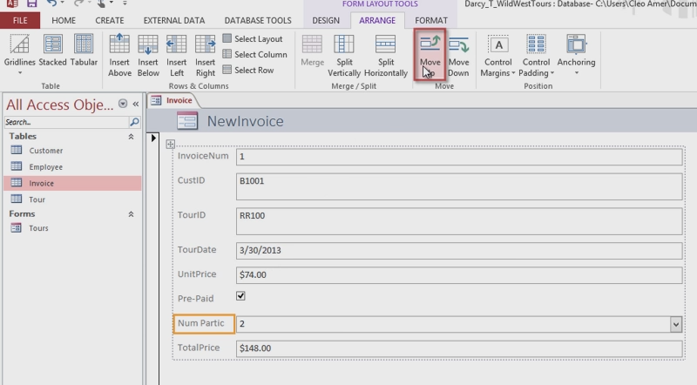
Designing Forms
The Form button, Create tab, can also create a form.
Arrange tab rearranges the appearance of the form without affecting the underlying table.
Skills > Access 2013 > Datasheets and Forms > Designing Forms
Notes:
Bullet 2 modified

Slide 25
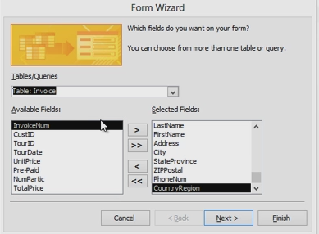
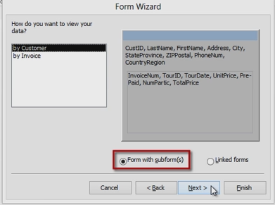
Creating a Form with a Subform
A subform (“form within a form”) contains data from a related table.
Skills > Access 2013 > Datasheets and Forms > Creating a Form with a Subform
Notes:
Bullet 2 modified

Slide 26
Queries and Reports
These video lessons will help you better understand how to structure your queries to get answers, and create reports that can be shared with others who might also need the answers to questions. You’ve done the work of setting everything up; now enjoy making use of your database’s contents!
In this section:
Simple Queries
Querying Joined Tables
Calculating Values
Reports
Skills > Access 2013 > Queries and Reports

Slide 27
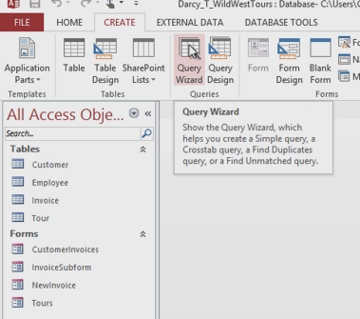
Simple Queries
The real power of a database is found in its queries – questions you ask about the contents of a database.
Queries are used to extract data from the database.
Query answers are subsets of records that meet a certain set of criteria.
To create a query, click the Create tab, and then, in the Queries group, click the Query Wizard button.
Skills > Access 2013 > Queries and Reports > Simple Queries
Notes:
Bullet 2 modified

Slide 28
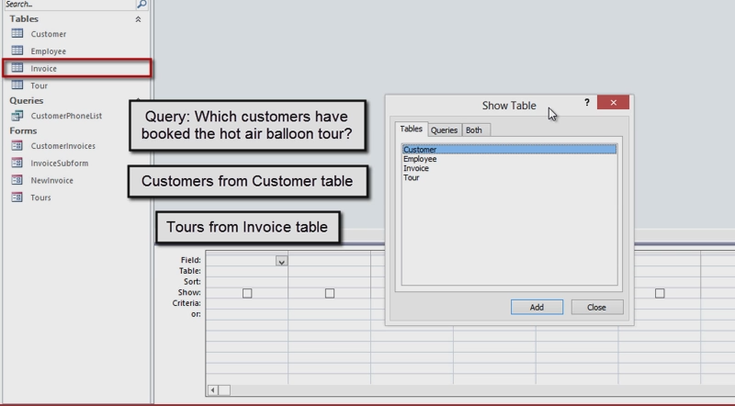
Querying Joined Tables
The Query Design tool is in Queries group, Create tab.
Skills > Access 2013 > Queries and Reports > Querying Joined Tables
Notes:
Bullet 2 modified

Slide 29
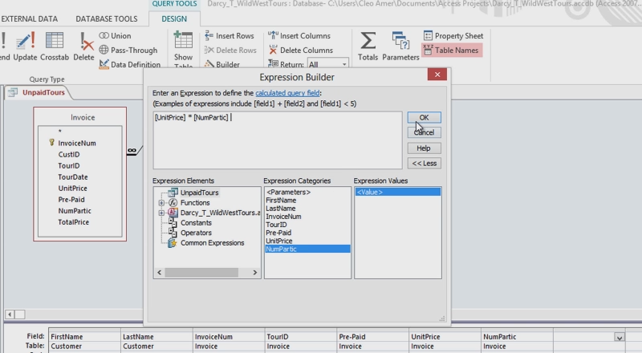
Calculating Values
Setting up a calculation in a query.
Skills > Access 2013 > Queries and Reports > Calculating Values
Notes:
Bullet 2 modified

Slide 30
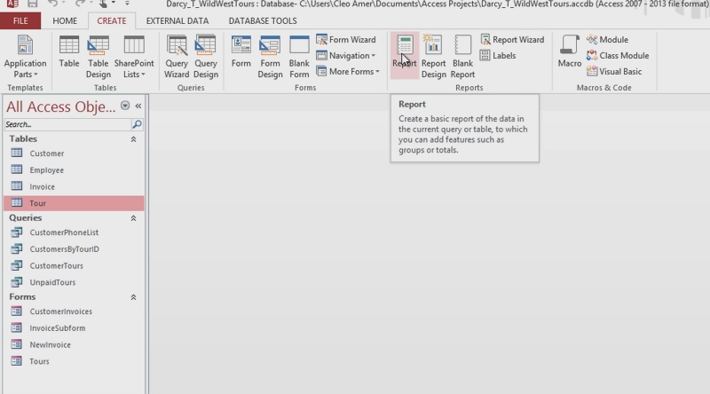
Reports
Create reports with Report Tool or Report Wizard.
Skills > Access 2013 > Queries and Reports > Reports
Notes:
Bullet 2 modified

