Slide 1
Excel 2013
Microsoft Excel 2013 is a spreadsheet application that is ideal for collecting, analyzing, reporting, and sharing both qualitative and quantitative data and information. Everything from personal household budgets to large corporate financial plans are created and used in Excel every day around the world. The software makes it easy to create graphics for quick visualization of historical data patterns, current organizational activity, and future data trend predictions, making it the “go-to” program for serious business professionals.
In this section:
Overview of Spreadsheets
Cells and Cell Data
Formulas
Functions
Formatting Spreadsheets
Spreadsheet Graphics
Advanced Spreadsheet Tools
Skills > Excel 2013

Slide 2
Overview of Spreadsheets
In these Excel lessons, you’ll learn what types of situations are best suited for using spreadsheets, and how to structure your own spreadsheets for easier and faster data analysis when changes are required.
In this section:
Spreadsheet Tools and Features
Well-Formed Spreadsheets
Spreadsheet Uses
Skills > Excel 2013 > Overview of Spreadsheets

Slide 3
Spreadsheet Tools and Features
A worksheet is essentially a grid, with rows and columns.
Rows are numbered, starting with 1.
Columns are named with letters, starting with A.
The intersection of a row and column is called a cell, and is referred to by its column and row intersection.
Formula tab tools use pre-made functions to generate formulas efficiently and accurately.
Insert tab contains tools for displaying information graphically through illustrations, charts, and sparklines.
Home tab tools enhance worksheet formatting.
Skills > Excel 2013 > Overview of Spreadsheets > Spreadsheet Tools and Features
Notes:
Bullet 2 modified

Slide 4
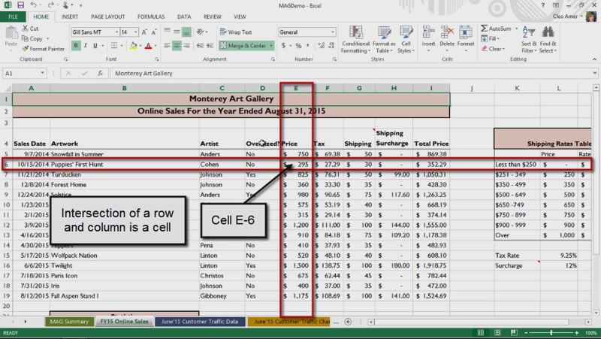
Spreadsheet Tools and Features
Skills > Excel 2013 > Overview of Spreadsheets > Spreadsheet Tools and Features
Notes:
Bullet 2 modified

Slide 5
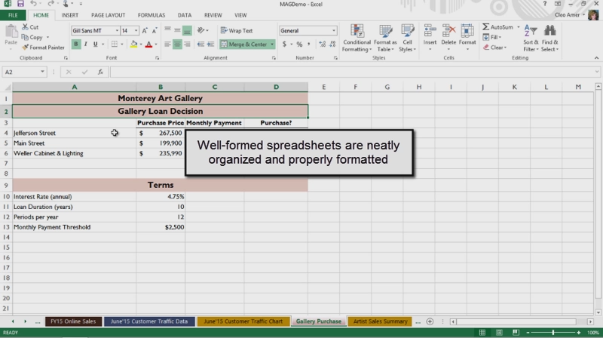
Well-Formed Spreadsheets
Four steps to planning a spreadsheet:
Identify the problem
Gather the relevant data
Determine the needed calculations
Prepare an easy-to-read design
Skills > Excel 2013 > Overview of Spreadsheets > Well-Formed Spreadsheets
Notes:
Bullet 2 modified

Slide 6
Spreadsheet Uses
Spreadsheets are best suited for decisions that need quantitative support.
Common business uses:
Financial statements
Budgets
Inventory management reports
Sales reports
Financial decision support
Personal and academic uses:
Home budgets
School grade books
Investment portfolios
Skills > Excel 2013 > Overview of Spreadsheets > Spreadsheet Uses
Notes:
Bullet 2 modified

Slide 7
Cells and Cell Data
The video lessons in this section are designed to help you understand how to enter data into a spreadsheet, copy cell data quickly, and do a better job of creating accurate and efficient formulas to work with those data so you don’t experience “garbage in, garbage out.”
In this section:
Creating and Editing Spreadsheets
Selecting Objects
Entering and Editing Data
Adjusting Rows and Columns
Grouping Rows and Columns
Copying Cell Data
Using the Fill Handle and Flash Fill
Inserting and Deleting
Skills > Excel 2013 > Cells and Cell Data

Slide 8
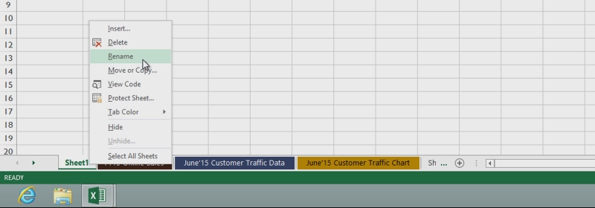
Creating and Editing Spreadsheets
You can use the tabs at the bottom of a worksheet to create, name, rearrange and delete individual worksheets.
Skills > Excel 2013 > Cells and Cell Data > Creating and Editing Spreadsheets
Notes:
Bullet 2 modified

Slide 9
Selecting Objects
In Microsoft Office apps, an object is anything that appears on screen that can be selected, edited, or manipulated.
The Picture Tools Format tab contains options for manipulating picture objects.
Skills > Excel 2013 > Cells and Cell Data > Selecting Objects
Notes:
Bullet 2 modified

Slide 10
Entering and Editing Data
You enter and edit data in worksheet cells.
To finish entering text or data in a cell, you have to click outside the cell.
To completely replace the cell contents, just start typing.
Skills > Excel 2013 > Cells and Cell Data > Entering and Editing Data
Notes:
Bullet 2 modified

Slide 11
Adjusting Rows and Columns
Adjust a column’s width with the AutoFit feature or click and drag the mouse pointer.
Adjusting row heights works the same way, except row heights are measured in points, not characters.
To adjust a group of rows:
First select by clicking and dragging in row headers.
Then click Format button in Cells group, Home tab.
In the menu, click Row Height.
In the Row Height box, enter the height you want in points.
Skills > Excel 2013 > Cells and Cell Data > Adjusting Rows and Columns
Notes:
Bullet 2 modified

Slide 12
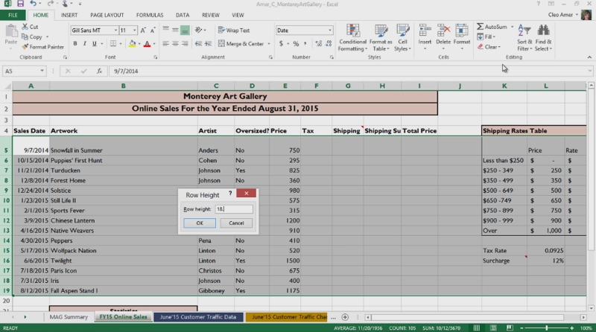
Adjusting Rows and Columns
Skills > Excel 2013 > Cells and Cell Data > Adjusting Rows and Columns
Notes:
Bullet 2 modified

Slide 13
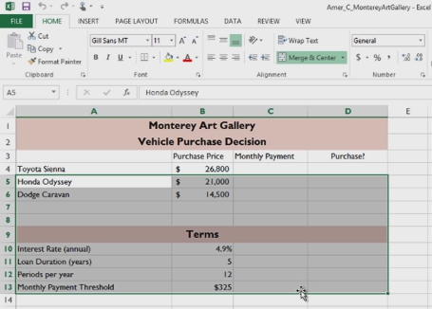
Grouping Rows and Columns
A group of specific cells in a worksheet is called a range.
To select a range of adjacent cells, click in a cell, and then hold down and drag the mouse pointer to select additional cells. The selected cells are highlighted.
You can also select a range of non-adjacent cells by pressing and holding the Control key, and then clicking the other cells.
Skills > Excel 2013 > Cells and Cell Data > Grouping Rows and Columns
Notes:
Bullet 2 modified

Slide 14
Copying Cell Data
One of the most common tasks in Excel is copying and pasting cell data. You can copy the contents of a single cell, or the contents of an entire range of cells.
To copy cell data, click the Copy button in the Clipboard group on the Home tab.
Skills > Excel 2013 > Cells and Cell Data > Copying Cell Data
Notes:
Bullet 2 modified

Slide 15
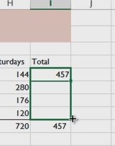
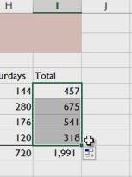
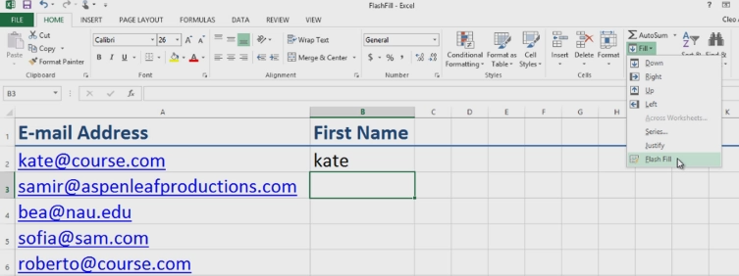
Using the Fill Handle and Flash Fill
The fill handle (small green box in lower-right corner of cell) is the fastest way to copy and paste content, including formulas, from one cell or range to another.
Flash Fill automatically fills in values for you, based on a pattern Excel detects in your data.
Skills > Excel 2013 > Cells and Cell Data > Using the Fill Handle and Flash Fill
Notes:
Bullet 2 modified

Slide 16
Inserting and Deleting
To insert a row, select the row below where you want to insert a row then click Insert button, Cells group, Home tab.
To insert a column, select the column to the right of where you want to insert a column then click Insert button, Cells group.
To delete a row or column, select it then click Delete button (Cells group, Home tab) and choose Delete Cells.
To insert a line break in a cell, press and hold the ALT key then press the Enter key.
Skills > Excel 2013 > Cells and Cell Data > Inserting and Deleting
Notes:
Bullet 2 modified

Slide 17
Formulas
The video lessons in this section are designed to strengthen your ability to understand arithmetic formulas and to successfully debug them to remove errors when they don’t provide correct results. You’ll also see how to name a range of cells, and then use that named range as a reference in cell formulas and functions. It’s one thing to know how to set up a formula, but quite another to figure out how to fix one with errors in it. Being able to do this efficiently is a great problem-solving skill to possess.
In this section:
Using Arithmetic Formulas
Formula Auditing
Using Named Ranges
Skills > Excel 2013 > Formulas

Slide 18
Using Arithmetic Formulas
A formula is an expression that, in most cases, results in a numerical value.
Every Excel formula starts with an equal sign, followed by the expression needed to calculate the value.
Formulas are written using operators, most of which are arithmetic (+, -, *, /), with the same order of precedence you’ve seen in math classes.
Most Excel formulas contain cell references, instead of specific values, because when new values are entered in cells, the formula updates to display the new result.
Skills > Excel 2013 > Formulas > Using Arithmetic Formulas
Notes:
Bullet 2 modified

Slide 19
Formula Auditing
Formula auditing is analyzing formulas that don’t seem to work properly or that contain errors.
Formula auditing can range from a simple examination of a formula’s parts to advanced use of special Excel tools on the Formulas tab to help identify and correct errors.
Skills > Excel 2013 > Formulas > Formula Auditing
Notes:
Bullet 2 modified

Slide 20
Using Named Ranges
To make formulas easier to read, assign names to specific cells or ranges of cells, and then use those names instead of cell addresses.
A name assigned to a cell or range is called a “defined name.”
When creating defined names, it’s important to pick a simple naming convention, and then use it throughout the workbook.
Defined names work just like cell addresses in formulas.
Skills > Excel 2013 > Formulas > Using Named Ranges
Notes:
Bullet 2 modified

Slide 21
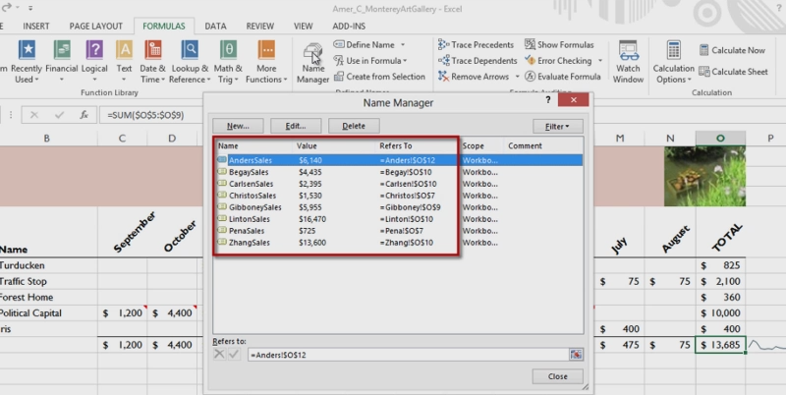
Using Named Ranges
Skills > Excel 2013 > Formulas > Using Named Ranges
Notes:
Bullet 2 modified

Slide 22
Functions
In the lessons on this page, you’ll see how pre-made formulas, called functions, can speed up creation of more complex formulas and add powerful decision making tools to your work.
In this section:
Using Functions
Copying Functions
3D References
Absolute References
Using Logical Functions (IF)
Advanced Functions (VLOOKUP and PMT)
Function and Formula Troubleshooting
Skills > Excel 2013 > Functions

Slide 23
Using Functions
A function is a pre-made formula that computes a value.
Functions are the fastest and most accurate way to include formulas in a spreadsheet.
One of the most popular functions is the SUM function, which adds the values found in a specified range.
To make it easier to find the function you need, they are divided into a categories with names like Financial, Database, and Statistical.
Skills > Excel 2013 > Functions > Using Functions
Notes:
Bullet 2 modified

Slide 24
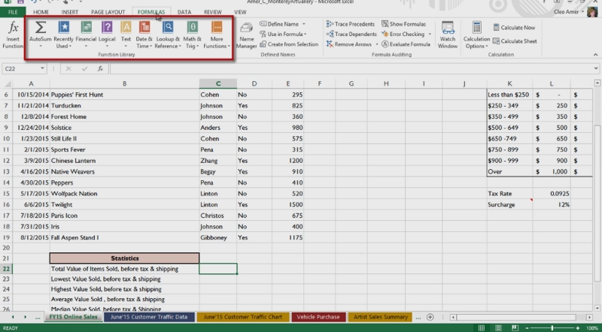
Using Functions
Skills > Excel 2013 > Functions > Using Functions
Notes:
Bullet 2 modified

Slide 25
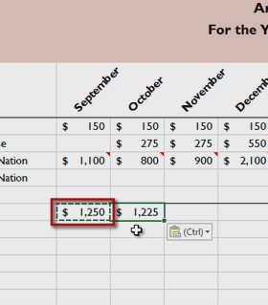
Copying Functions
Copying a formula is just like copying a number or value.
Skills > Excel 2013 > Functions > Copying Functions
Notes:
Bullet 2 modified

Slide 26
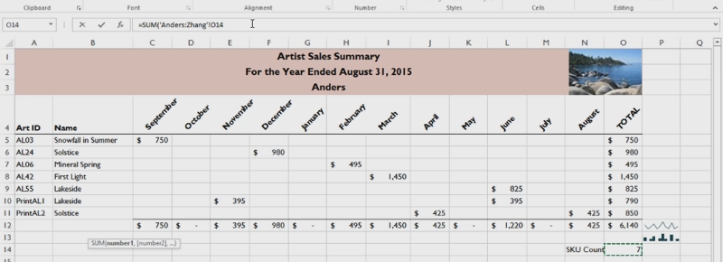
3D References
A 3-D reference refers to the same cell or range of cells on multiple worksheets.
In addition to summing, you can use 3-D references to compute statistics, such as averages and much more.
Skills > Excel 2013 > Functions > 3D References
Notes:
Bullet 2 modified

Slide 27
Absolute References
A relative reference changes when a formula is copied to a new cell, because the reference is interpreted in relation to the location of the cell holding the formula.
An absolute reference doesn’t change when the formula referencing it is copied to another cell.
An absolute cell reference uses a dollar sign in front of the column letter or row number to tell Excel to always go to the same column letter or row number listed.
Skills > Excel 2013 > Functions > Absolute References
Notes:
Bullet 2 modified

Slide 28
Using Logical Functions (IF)
A logical function is a formula that tests a condition that can either be true or false, and then returns a value based on the result of the condition.
The most commonly used logical function is the IF function. It returns one value if the condition is true, and another if the condition is false.
In the Function Arguments dialog box:
First line = logical text or condition
Second line = Value_if_true box
Third line = Value_if_false box
Skills > Excel 2013 > Functions > Using Logical Functions (IF)
Notes:
Bullet 2 modified

Slide 29
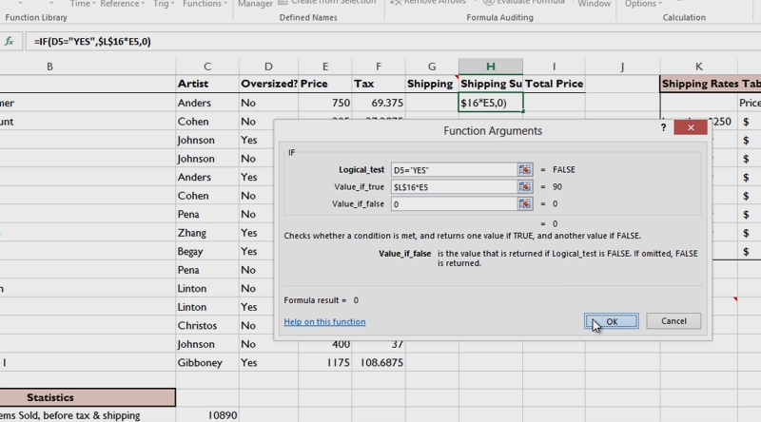
Using Logical Functions (IF)
Skills > Excel 2013 > Functions > Using Logical Functions (IF)
Notes:
Bullet 2 modified

Slide 30
Advanced Functions: VLOOKUP
One of the more advanced functions in Excel is the VLOOKUP, or “vertical lookup,” function.
This function looks up values in a table of data and then inserts those values in another location in a worksheet.
The VLOOKUP function requires three pieces of information:
Value you want to look up.
Range of cells where the lookup table is located.
Column in the table that holds the value you want.
Skills > Excel 2013 > Functions > Advanced Functions: VLOOKUP
Notes:
Bullet 2 modified

Slide 31
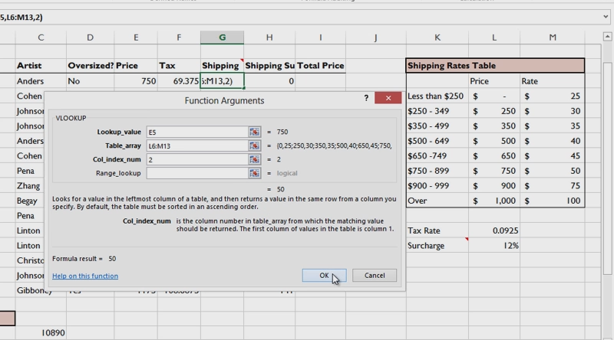
Advanced Functions: VLOOKUP
Skills > Excel 2013 > Functions > Advanced Functions: VLOOKUP
Notes:
Bullet 2 modified

Slide 32
Advanced Functions: PMT
When making a purchase decision that involves a series of loan payments, it’s helpful to calculate what those payments will be before committing to the decision.
Excel has a PMT, or Payment function, to help figure it out.
Three pieces of information are needed:
Amount to be borrowed.
Annual interest rate.
Duration of the loan.
Using absolute values in the formula makes it easy to copy the formula.
Skills > Excel 2013 > Functions > Advanced Functions: PMT
Notes:
Bullet 2 modified

Slide 33
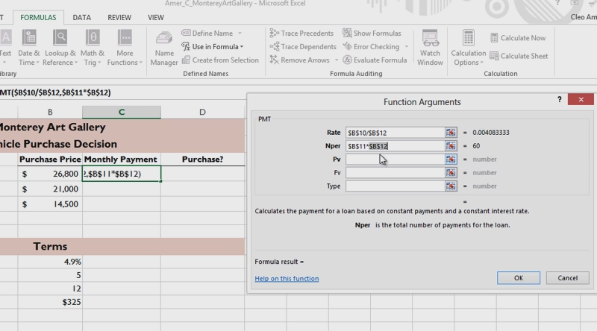
Advanced Functions: PMT
Skills > Excel 2013 > Functions > Advanced Functions: PMT
Notes:
Bullet 2 modified

Slide 34
Function and Formula Troubleshooting
When working with more advanced functions and formulas, you may occasionally encounter errors—sometimes called bugs—that prevent the calculation from working correctly.
To see information about an error, click one of the cells with a green triangle. This displays an information icon to the left. Holding the mouse pointer over the icon displays a ScreenTip explaining the nature of the error. You can also use the Error Checking button in the Formula Auditing group.
Skills > Excel 2013 > Functions > Function and Formula Troubleshooting
Notes:
Bullet 2 modified

Slide 35
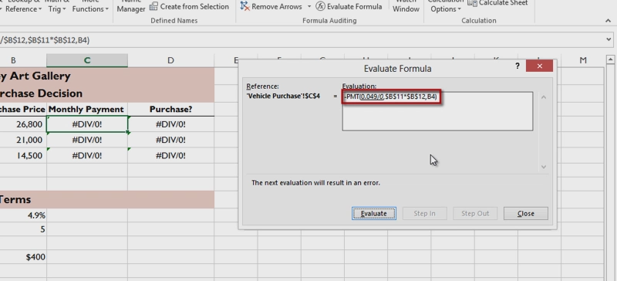
Function and Formula Troubleshooting
Skills > Excel 2013 > Functions > Function and Formula Troubleshooting
Notes:
Bullet 2 modified

Slide 36
Formatting Spreadsheets
The video lessons in this section are designed to help you format your spreadsheet contents for better readability, and create different versions of that data using sorting, filtering, and conditional formatting tools.
In this section:
Number Formats
Aligning Cell Contents
Sorting and Filtering Data
Working with Tables
Applying Borders and Shading
Applying Conditional Formatting
Skills > Excel 2013 > Formatting Spreadsheets

Slide 37
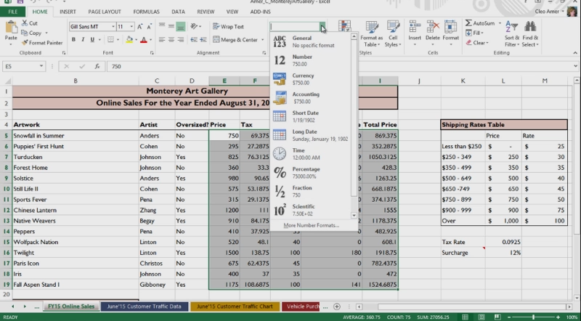
Number Formats
In the Number group, on the Home tab, are several formatting options.
Skills > Excel 2013 > Formatting Spreadsheets > Number Formats
Notes:
Bullet 2 modified

Slide 38
Aligning Cell Contents
Improve the look of a worksheet by aligning the contents of cells, indenting text, or adding borders and colors.
The cell aligns both text and number contents vertically at the bottom of the cell.
The general rule for formatting is to center column headings, keep text left-aligned, and keep numbers right-aligned, with decimal places aligned.
Skills > Excel 2013 > Formatting Spreadsheets > Aligning Cell Contents
Notes:
Bullet 2 modified

Slide 39
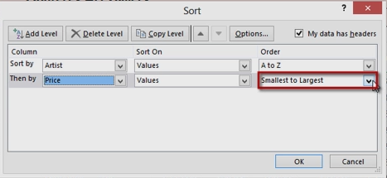
Sorting and Filtering Data
When working with large sets of data, it can be useful to sort, or rearrange, the data to make it easier to read.
Filter data to show only the data you need at the moment.
Tools needed are in Editing group on Home tab.
Skills > Excel 2013 > Formatting Spreadsheets > Sorting and Filtering Data
Notes:
Bullet 2 modified

Slide 40
Working with Tables
Within an Excel worksheet, you can designate a range of cells as an Excel table by applying a table style.
A table style gives the range a coherent look, with coordinated font colors, fill colors, and more. This formatting makes a table easier to read and work with.
But more importantly, a range designated as an Excel table can be analyzed, sorted, transferred, filtered, and otherwise treated as separate from the rest of the Excel worksheet.
Skills > Excel 2013 > Formatting Spreadsheets > Working with Tables
Notes:
Bullet 2 modified

Slide 41
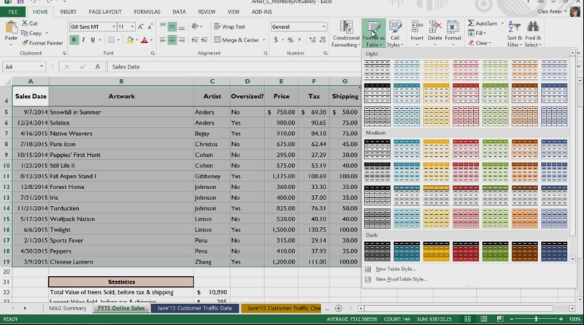
Working with Tables
Skills > Excel 2013 > Formatting Spreadsheets > Working with Tables
Notes:
Bullet 2 modified

Slide 42
Applying Borders and Shading
One way to draw attention to the contents of a cell or range is to add a border – to a cell’s top, left, bottom, or right sides, or you can add borders to all of the sides at once.
You can add borders to one cell at a time, or to a range of cells.
The Font group on the Home tab contains the button you need to add borders. The name and appearance of this button varies, depending on what type of border is selected.
Skills > Excel 2013 > Formatting Spreadsheets > Applying Borders and Shading
Notes:
Bullet 2 modified

Slide 43
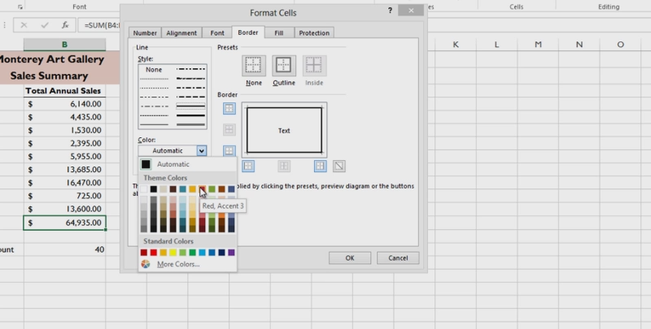
Applying Borders and Shading
Skills > Excel 2013 > Formatting Spreadsheets > Applying Borders and Shading
Notes:
Bullet 2 modified

Slide 44
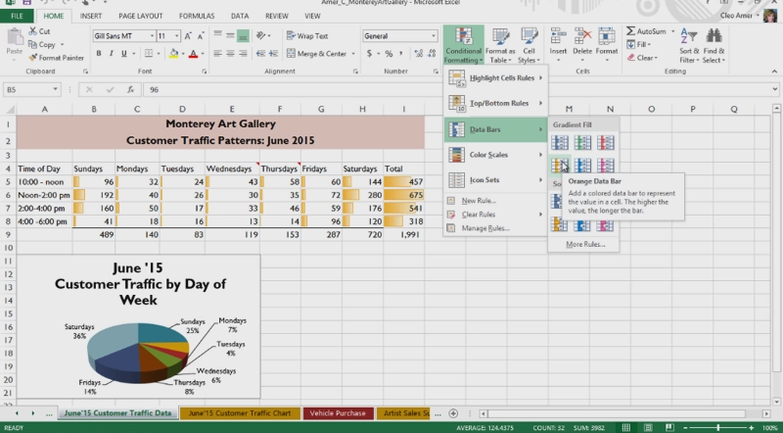
Applying Conditional Formatting
Conditional formatting is useful for highlighting trends in data that might otherwise be difficult to see.
Skills > Excel 2013 > Formatting Spreadsheets > Applying Condition Formatting
Notes:
Bullet 2 modified

Slide 45
Spreadsheet Graphics
Spreadsheets often contain vast quantities of numeric and text data that can be difficult to quickly sort through in search of patterns or answers to questions about the data. Creating charts based upon that data is the simple solution, and can make the daunting task of interpreting the data a simple matter of reading a chart or graph. Even if you have created charts before in Excel, there are new tools and techniques in the latest version that are sure to spark your creativity.
In this section:
Creating Charts
Chart Types
Creating Sparklines
Inserting Pictures
Adjusting Page Layout
Printing Spreadsheets
Skills > Excel 2013 > Spreadsheet Graphics

Slide 46
Creating Charts
Charts add visual interest to data- and text-intensive worksheets.
They show trends and relationships in the data that may not be easily seen by simply reading the numbers.
There are four steps to creating charts in Excel:
Select the range of cells containing the data to be charted.
Choose a chart style that suits the data.
Modify the selected chart’s formatting and titles.
Position the finished chart on the worksheet or move it to a new sheet.
Skills > Excel 2013 > Spreadsheet Graphics > Creating Charts
Notes:
Bullet 2 modified

Slide 47
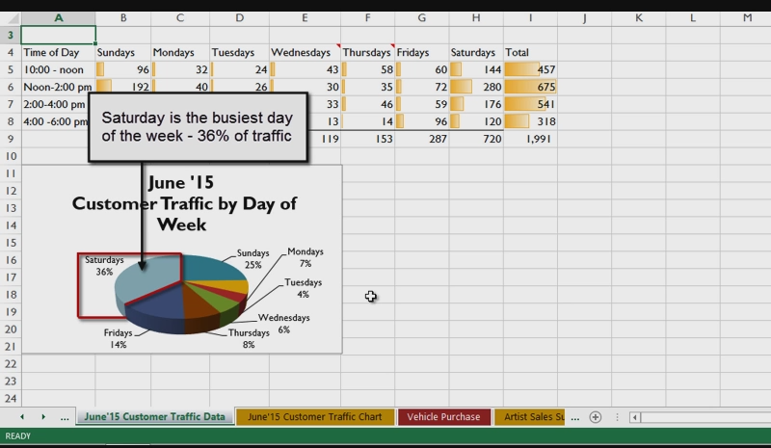
Creating Charts
Skills > Excel 2013 > Spreadsheet Graphics > Creating Charts
Notes:
Bullet 2 modified

Slide 48
Chart Types
Chart tools are located in Charts group, Insert tab.
Excel allows you to create many different types of charts, but the best type depends on the data to illustrate.
To see the full range of chart types available in Excel, click the See All Charts dialog box launcher, Charts group – names of chart types listed on the left, thumbnails on right.
To add a chart title and labels, use a layout in the Chart Layouts group.
In the Chart Tools Design tab ribbon, the Move Chart button allows you to move the chart to a new location.
Skills > Excel 2013 > Spreadsheet Graphics > Chart Types
Notes:
Bullet 2 modified

Slide 49
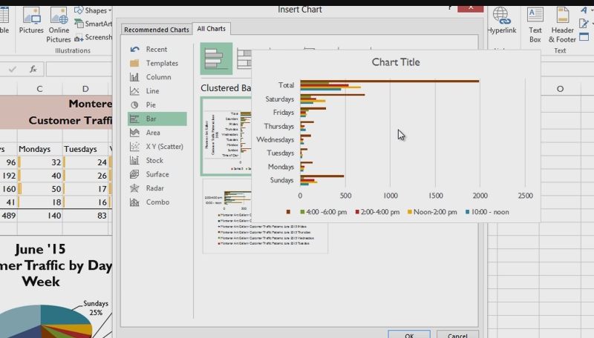
Chart Types
Skills > Excel 2013 > Spreadsheet Graphics > Chart Types
Notes:
Bullet 2 modified

Slide 50
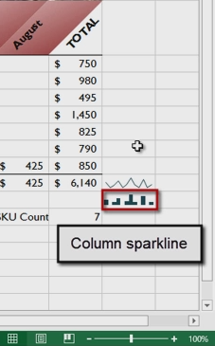
Creating Sparklines
A sparkline is a mini-chart within an Excel worksheet cell.
Sparklines are meant to show a large amount of graphical information in limited space so the chart doesn’t overwhelm the rest of the information in the sheet.
The tools to create sparklines are in Sparklines group, Insert tab, or embed them on a summary sheet.
Skills > Excel 2013 > Spreadsheet Graphics > Creating Sparklines
Notes:
Bullet 2 modified

Slide 51
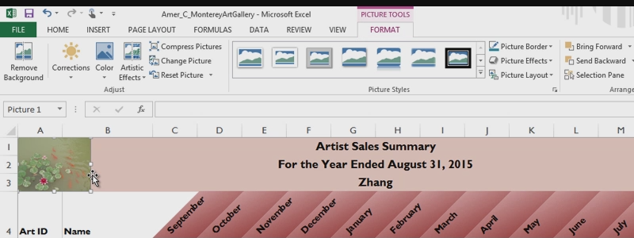
Inserting Pictures
It’s easy to add visual interest to your spreadsheets by inserting a picture (or two) that supports the data.
When a picture is selected, the Picture Tools Format tab is visible, providing options for formatting the picture.
Skills > Excel 2013 > Spreadsheet Graphics > Inserting Pictures
Notes:
Bullet 2 modified

Slide 52
Adjusting Page Layout
In addition to displaying or hiding gridlines, adjust the orientation of the worksheets to view and print properly.
The option for changing orientation is on Page Layout tab.
Orientation offers two choices: Portrait and Landscape.
Skills > Excel 2013 > Spreadsheet Graphics > Adjusting Page Layout
Notes:
Bullet 2 modified

Slide 53
Printing Spreadsheets
To control the way data flows from one page to another, add page breaks (Breaks button, Page Setup group, Page Layout tab).
To see page breaks, click Page Layout button and zoom out so you can see a full page at a time.
To print only a portion of a sheet, set a print area.
To add print titles to sheets with multiple pages, click Print Titles button, Page Setup group.
Scaling lets you adjust the height and width of a printout’s contents in order to fit more data on a single worksheet.
Skills > Excel 2013 > Spreadsheet Graphics > Printing Spreadsheets
Notes:
Bullet 2 modified

Slide 54
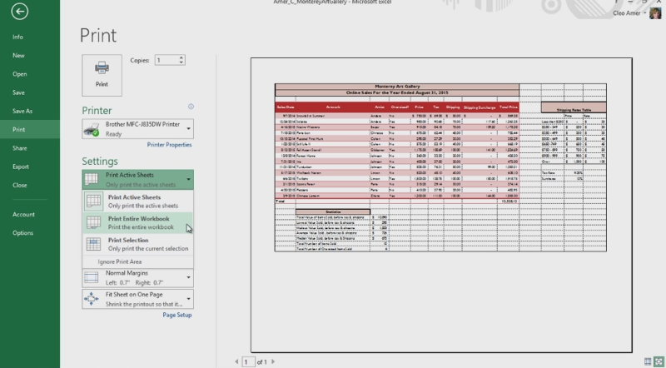
Printing Spreadsheets
Skills > Excel 2013 > Spreadsheet Graphics > Printing Spreadsheets
Notes:
Bullet 2 modified

Slide 55
Advanced Spreadsheet Tools
There are more advanced features and tools available to help you take data-intensive worksheets and summarize them into meaningful form for a wide variety of readers, perform sensitivity and what-if analyses on data, and apply add-in tools to extend the statistical analysis and reporting abilities of the software. These features include PivotTable, PivotChart, a filtering tool called “the Slicer,” and add-in programs such as the Excel Analysis ToolPak and Solver.
In this section:
Pivot Tables, Pivot Charts and the Slicer
Using Data Tools
Using Add-Ins
Skills > Excel 2013 > Advanced Spreadsheet Tools

Slide 56
Pivot Tables, Pivot Charts and the Slicer
A PivotTable is an interactive Excel table that’s used to summarize a range of data for easy reporting and analysis.
A chart derived from the data in a PivotTable is called a PivotChart. It’s a graphical representation of the data in the report.
A slicer is a tool that lets you filter, or “slice,” the contents of a table by clicking a button.
Skills > Excel 2013 > Advanced Spreadsheet Tools > Pivot Tables, Pivot Charts and the Slicer
Notes:
Bullet 2 modified

Slide 57
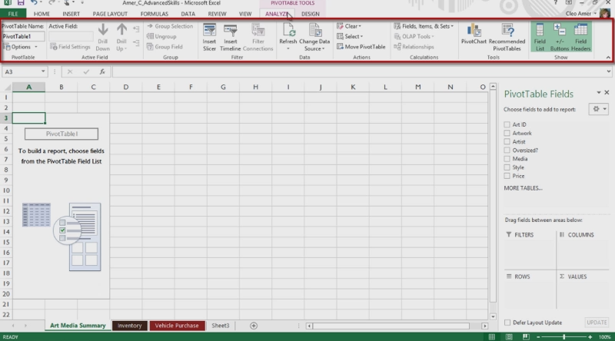
Pivot Tables, Pivot Charts and the Slicer
Skills > Excel 2013 > Advanced Spreadsheet Tools > Pivot Tables, Pivot Charts and the Slicer
Notes:
Bullet 2 modified

Slide 58
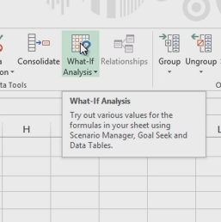
Using Data Tools
In addition to PivotTable, PivotChart and slicers, you can also use options on Data tab to analyze data.
“What-if analysis” means trying different values to see how the formula results change.
“Goal Seek” is used when the target result is known.
Skills > Excel 2013 > Advanced Spreadsheet Tools < Using Data Tools
Notes:
Bullet 2 modified

Slide 59
Using Add-Ins
“Solver” is used for solving linear programming types of problems. Business managers use Solver for problems like setting optimal product mix, figuring out best shipping routes, scheduling employees, determining what products to manufacture given raw materials constraints, maximizing profit, and more.
Analysis Toolpak includes data analysis tools for developing complex statistical models used for analyzing results of experiments, checking quality control processes, determining correlations/relationships between variables, predicting future sales based on past performance, testing scientific hypotheses, and much more.
Skills > Excel 2013 > Advanced Spreadsheet Tools > Using Add-Ins
Notes:
Bullet 2 modified

Slide 60
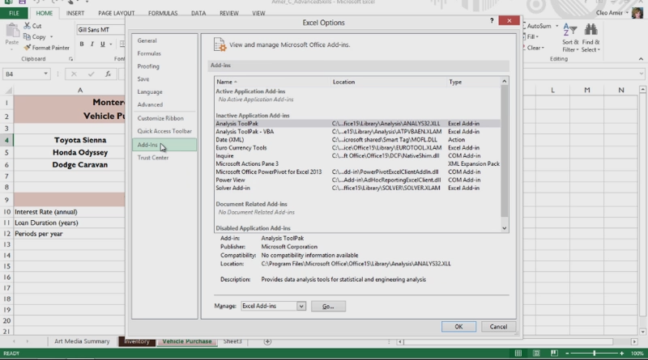
Using Add-Ins
Skills > Excel 2013 > Advanced Spreadsheet Tools > Using Add-Ins
Notes:
Bullet 2 modified

