Slide 1
Word 2013
Microsoft Word 2013 is word processing software included in Microsoft Office 2013.
In this section:
Overview of Word Processing
Document Formatting Techniques
Academic Publishing Tools
Skills > Word 2013

Slide 2
Overview of Word Processing
The video lessons in this section are designed to motivate you to spend time learning how to prepare documents that are both well-organized and easy to read. Through the project case study featuring Dr. Staci Chen and her new physical therapy clinic business plan, you’ll get the chance to practice the fundamental word processing techniques expected of every computer-literate college graduate.
In this section:
Word Processing Tools and Features
Word Processing Case Study
Well-Formed Documents
Word Processing Uses
Skills > Word 2013 > Overview of Word Processing

Slide 3
Word Processing Tools and Features
Word has many built-in tools and features to help you communicate effectively and impress your readers.
The Navigation Pane, which you can access via a button in the Show group on the View tab, makes it easy to change headings and rearrange text.
For academic reports and research papers, Word contains reference tools for adding a table of contents, footnotes and endnotes, citations and bibliographies, captions for figures, and more.
Skills > Word 2013 > Overview of Word Processing > Word Processing Tools and Features
Notes:
Bullet 2 modified

Slide 4
Word Processing Tools and Features
Skills > Word 2013 > Overview of Word Processing > Word Processing Tools and Features
Notes:
Bullet 2 modified

Slide 5
Well-Formed Documents
Well-formed documents are neatly organized, properly formatted to efficiently and effectively communicate.
Good organization, formatting help the reader focus on content without getting distracted.
Skills > Word 2013 > Overview of Word Processing > Well-Formed Documents

Slide 6
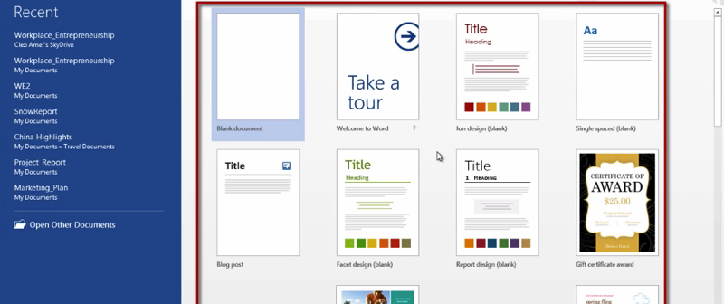
Word Processing Uses
Types of business documents most often created include:
Reports
Letters
Memos
Newsletters
Brochures
Technical documents
Skills > Word 2013 > Overview of Word Processing > Word Processing Uses

Slide 7
Document Formatting Techniques
The video lessons on this page are designed to help you create better-looking documents through the use of common formatting techniques. You’ll learn how to apply different document styles and themes to make your written work appear more professional, and see how to add page numbers and meaningful headers and footers.
In this section:
Creating and Editing Documents
Applying Styles
Working with Themes
Headers and Footers
Tabs and Indents
Setting Document Margins
Working with Columns
Inserting Page and Section Breaks
Skills > Word 2013 > Document Formatting Techniques

Slide 8
Creating and Editing Documents
Create a new document from scratch (Blank document) or using a template.
To edit an existing document, navigate to where it’s saved and double-click to open.
If a document is in Protected View – and you trust the original source – click “Enable Editing” button.
Skills > Word 2013 > Document Formatting Techniques > Creating and Editing Documents

Slide 9
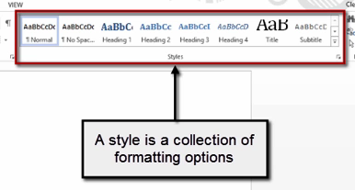
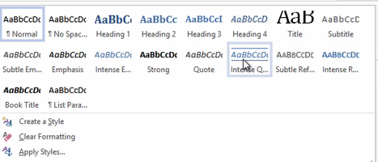
Applying Styles
A style is a collection of formatting options that you can apply with a single click in the gallery in Styles group, Home tab.
Skills > Word 2013 > Document Formatting Techniques > Applying Styles

Slide 10
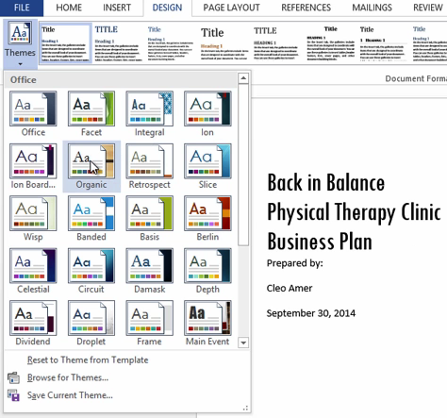
Working with Themes
A theme is a set of formatting choices, including fonts, colors, and other visual effects.
Themes can give a polished and consistent look.
Screen tips provide additional information about the chosen theme.
Skills > Word 2013 > Document Formatting Techniques > Working with Themes

Slide 11
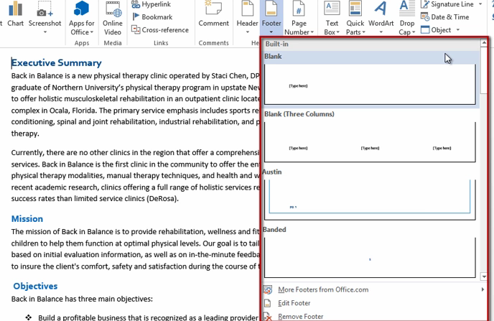
Headers and Footers
Adding content to either the header or the footer can only be done in the Header and Footer View in Header & Footer group on Home tab.
Skills > Word 2013 > Document Formatting Techniques > Headers and Footers

Slide 12
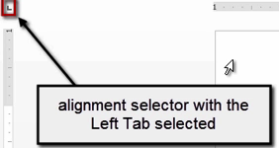
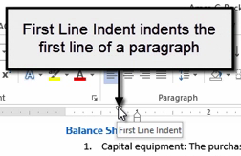
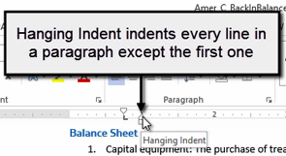
Tabs and Indents
When you press the Tab key, the insertion point moves to the next tab location, which is also called a tab stop.
Skills > Word 2013 > Document Formatting Techniques > Tabs and Indents

Slide 13
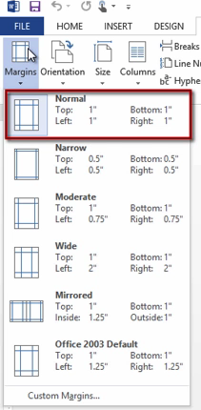
Setting Document Margins
One-inch margins are required for MLA, or Modern Language Association, formatted documents, such as research papers.
Margin settings are located in the Page Setup group on the Page Layout tab.
Skills > Word 2013 > Document Formatting Techniques > Setting Document Margins

Slide 14
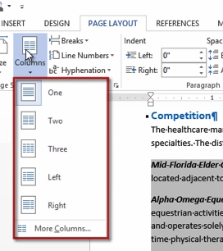
Working with Columns
Columns are a common formatting feature found in newspapers, newsletters, and many other documents.
The Columns feature in Word lets you arrange text in two or more vertical columns.
Skills > Word 2013 > Document Formatting Techniques > Working with Columns

Slide 15
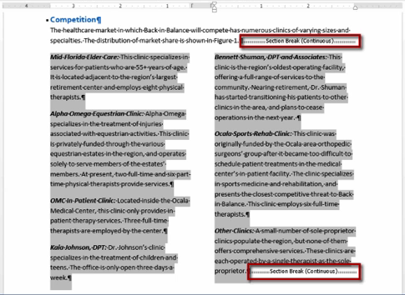
Working with Columns
Document with two columns.
Skills > Word 2013 > Document Formatting Techniques > Working with Columns

Slide 16
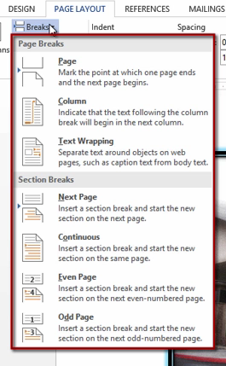
Inserting Page and Section Breaks
You can make documents with multiple sections or headings easier to read by inserting manual page breaks so that each section or major heading starts on a new page.
To insert a manual page break, press Ctrl+Enter.
To insert a section break, click the Breaks button in Page Setup group on Page Layout tab.
Skills > Word 2013 > Document Formatting Techniques > Inserting Page and Section Breaks

Slide 17
Academic Publishing Tools
The video lessons in this section are designed to help you acquire word processing skills you can use right now in your college career. College-level research papers often call for the inclusion of figures with captions, footnotes, citations, statistics, bibliographies, tables of contents, and more.
In this section:
Inserting Figures with Captions
Thesaurus, Define Tool, and Document Statistics
Footnotes and Endnotes
Citations and Bibliography
Table of Contents
Symbols and Equations
Skills > Word 2013 > Academic Publishing Tools

Slide 18
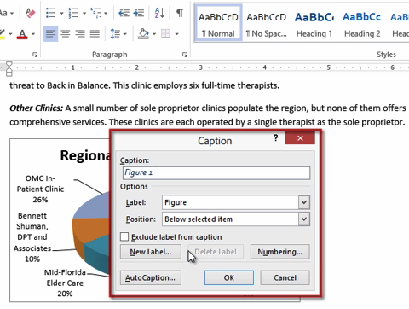
Inserting Figures with Captions
Figures are illustrations that support text.
Many types of documents can benefit from using figures.
To insert a caption, right-click figure to display a menu, which has an Insert Caption option.
Skills > Word 2013 > Academic Publishing Tools > Inserting Figures with Captions

Slide 19
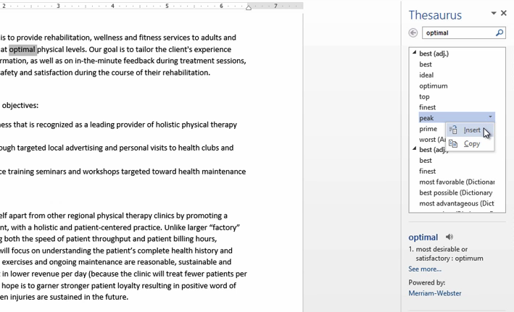
Thesaurus, Define Tool, and Document Statistics
Thesaurus suggests words with similar meaning.
Define connects to the Merriam-Webster dictionary.
Word Count finds the number of words, characters, and lines in a document.
Skills > Word 2013 > Academic Publishing Tools > Thesaurus, Define Tool, and Document Statistics

Slide 20
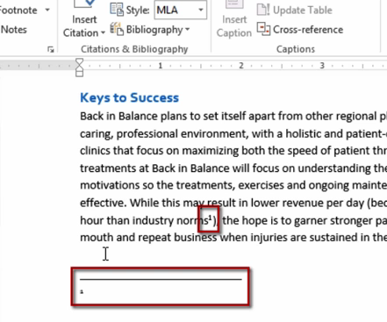
Footnotes and Endnotes
A footnote is a short comment that appears at the bottom of a document page.
An endnote is a comment that appears at the end of a document or section.
Skills > Word 2013 > Academic Publishing Tools > Footnotes and Endnotes

Slide 21
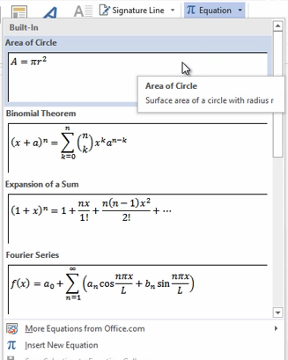
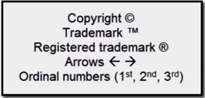
Symbols and Equations
Examples of symbols include:
The Equation button arrow allows you to create your own formula (e.g., area of a circle).
Skills > Word 2013 > Academic Publishing Tools > Symbols and Equations

Slide 22
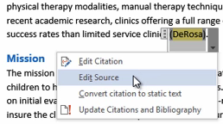
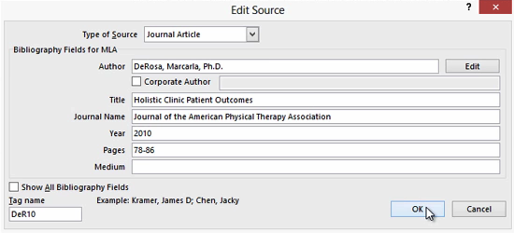
Citations and Bibliography
Citations are used to attribute information and ideas to the correct source.
Word can insert an automatic bibliography.
Skills > Word 2013 > Academic Publishing Tools > Citations and Bibliography

Slide 23
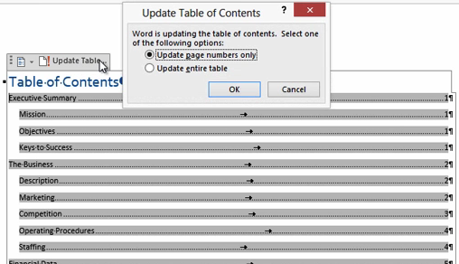
Table of Contents
A table of contents makes it easy to find contents in the body of a document.
A table of contents must be set apart as its own section.
Skills > Word 2013 > Academic Publishing Tools > Table of Contents

