Slide 1
Office 2013
Microsoft Office 2013 is a productivity suite of applications.
In this section:
Common Application Components
Working with Files and Documents
Common Editing Functions
Common Formatting Functions
Working with Graphics
Working with Tables
Printing & Publishing
Sharing Content Between Applications
Collaborating with Office 2013
Customizing Office Applications
Skills > Office 2013

Slide 2
Common Application Components
The video lessons in this section are designed to introduce you to working with Office 2013 documents and files. Important topics include getting to know the Ribbon and its tabs plus knowing how to get help when you need it.
In this section:
Launching Applications
Application Components
Ribbons and Tabs
Getting Help
Skills > Office 2013 > Common Application Components

Slide 3
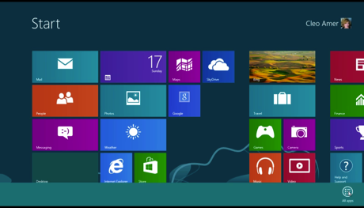
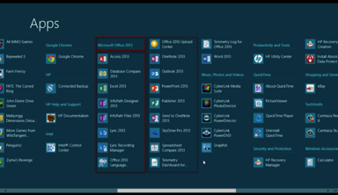
Launching Applications
To start, or launch, a Microsoft Office application, right-click any blank space on the Start screen to bring up the apps bar.
To launch any application, just point and click its icon.
Apps bar with All apps icon
Skills > Office 2013 > Common Application Components > Launching Applications
Notes:
Bullet 2 modified

Slide 4
Application Components
Quick Access Toolbar, upper left corner of all Office applications, gives easy access to frequently-used features.
Upper-right corner of Word window contains Minimize, Restore Down, and Close buttons.
Skills > Office 2013 > Common Application Components > Application Components

Slide 5
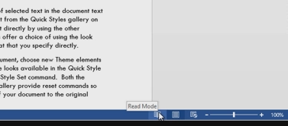
Application Components
The Zoom slider allows you to magnify or shrink the content displayed in the active window.
View buttons, left of the Zoom slider, control the way contents of your document are displayed on screen.
Skills > Office 2013 > Common Application Components > Application Components

Slide 6
Ribbons and Tabs
Every application in Office 2013 has a Ribbon across the top. You can click the tabs at the top of the Ribbon to display different sets of tools.
Clicking the File tab opens Backstage View.
Skills > Office 2013 > Common Application Components > Ribbons and Tabs

Slide 7
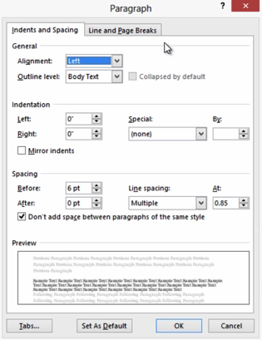
Ribbons and Tabs
You can click a group’s Dialog Box Launcher to open a smaller window, called a dialog box, where you can adjust settings related to that group.
Skills > Office 2013 > Common Application Components > Ribbons and Tabs

Slide 8
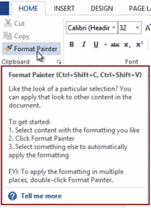
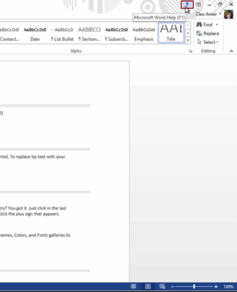
Getting Help
Built into Office 2013 are two main ways of getting information about features and tasks: ScreenTips and the Help window.
Skills > Office 2013 > Common Application Components > Getting Help

Slide 9
Working with Files and Documents
The videos in this section are designed to help you open, navigate, and save documents created in Office 2013.
In this section:
Creating New Files From Scratch or Templates
Opening an Existing File
Navigating in a Document
Document Views and Zoom
Switching Between Open Documents
Saving and Closing Documents
Skills > Office 2013 > Working with Files and Documents

Slide 10
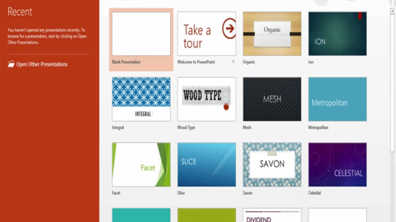
Creating New Files from Scratch or Templates
To create a new, blank document, click the button on the right.
Another option is to create a document based on a template.
A template is a file that includes predefined text and design elements.
Skills > Office 2013 > Working with Files and Documents > Creating New Files from Scratch or Templates

Slide 11
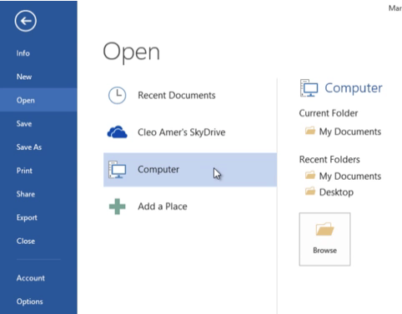
Opening an Existing File
To open existing files from the File tab, you can either:
Select recently opened documents
Open (browse) or Open Other Documents
Skills > Office 2013 > Working with Files and Documents > Opening an Existing File

Slide 12
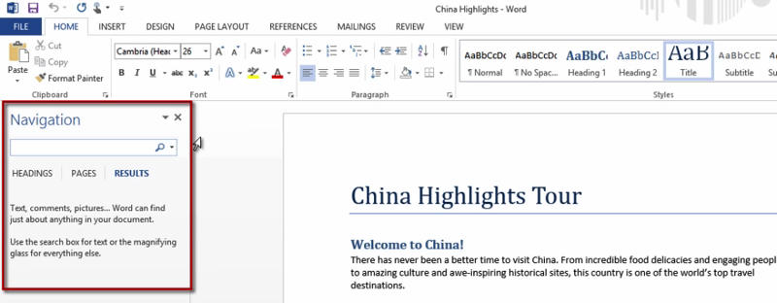
Navigating in a Document
To move around, or navigate, in a document, you can use the built-in Navigation pane.
Skills > Office 2013 > Working with Files and Documents > Navigating in a Document

Slide 13
Document Views and Zoom
Word has three views:
Read Mode
Print Layout
Web Layout
Skills > Office 2013 > Working with Files and Documents > Document Views and Zoom

Slide 14
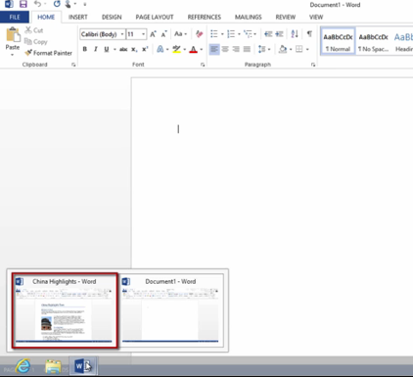
Switching Between Open Documents
To switch to a document, move the mouse over the Word 2013 icon in the bottom taskbar and click the document’s thumbnail.
Skills > Office 2013 > Working with Files and Documents > Switching Between Open Documents

Slide 15
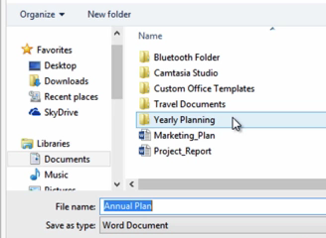
Saving and Closing Documents
To save a document that you’ve never saved before, click Save in Quick Access toolbar.
To save a file with a new name or in a new location, click File tab, and then Save As.
Skills > Office 2013 > Working with Files and Documents > Saving and Closing Documents

Slide 16
Common Editing Functions
The video lessons in this section are designed to help you better understand common editing functions in Office 2013. These functions will make it easier for you to create and edit well-written and error-free documents.
In this section:
Selecting, Inserting and Deleting Text
Mini Toolbar and Quick Access Toolbar
Inserting and Editing a Hyperlink
Using Copy/Cut/Paste
Find and Replace
Spelling and Grammar Check
Skills > Office 2013 > Common Editing Functions

Slide 17
Selecting, Inserting and Deleting Text
To select text, press and hold down the left mouse button, drag the mouse
pointer over the
text, and then
release the
mouse button.
To replace
selected text
with new text, just type.
Skills > Office 2013 > Common Editing Functions > Selecting, Inserting and Deleting Text

Slide 18
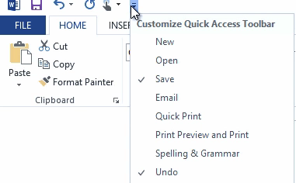
Mini Toolbar and Quick Access Toolbar
In each Office application,
the Mini toolbar contains
frequently used tools.
The Quick Access tool-bar
is located in upper left
corner of screen in all Office applications. You can customize
the Quick Access toolbar to add
buttons that are most useful for you.
Skills > Office 2013 > Common Editing Functions > Mini Toolbar and Quick Access Toolbar

Slide 19
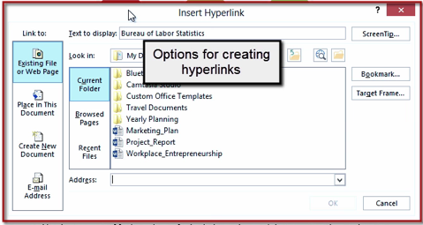
Inserting and Editing a Hyperlink
The Insert Hyperlink dialog box allows you to create different kinds of links:
Existing File or Web page
Place in This
Document
To change the web address associated with a hyperlink, right-click the hyperlink to open a Shortcut menu and then click Edit Hyperlink. In the Edit Hyperlink dialog box, you can type a different web address
Skills > Office 2013 > Common Editing Functions > Inserting and Editing a Hyperlink

Slide 20
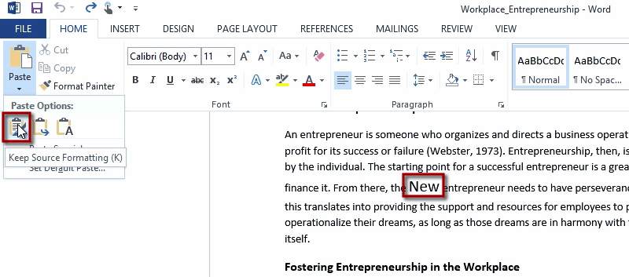
Using Copy/Cut/Paste
Skills > Office 2013 > Common Editing Functions > Using Copy/Cut/Paste

Slide 21
Find and Replace
Finding and replacing text is a timesaving skill, especially for lengthy documents. The tools you need are located in the Editing group on the Home tab.
The Navigation pane displays all instances of the phrase.
Skills > Office 2013 > Common Editing Functions > Find and Replace

Slide 22
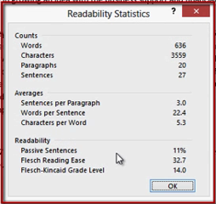
Spelling and Grammar Check
A wavy red line indicates spelling mistakes.
A wavy blue line indicates contextual spelling errors.
Readability statistics show document’s word count, words per sentence, and reading grade level.
Skills > Office 2013 > Common Editing Functions > Spelling and Grammar Check

Slide 23
Common Formatting Functions
The video lessons in this section are designed to show you how to use common Office functions to preview changes before applying them (Live Preview), change and format fonts, select line and paragraph spacing, create numbered or bulleted lists, and copy selected formats to “paint” them on other parts of your documents. These skills can help you dress up your documents so they have a consistent appearance.
In this section:
Galleries with Live Preview
Working with Fonts
Paragraph Formatting
Working with Lists
Using the Format Painter
Skills > Office 2013 > Common Formatting Functions

Slide 24
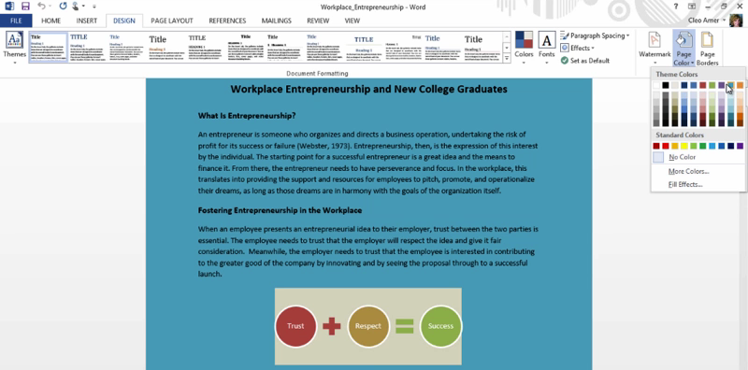
Galleries with Live Preview
In Office 2013, galleries, palettes, and live previews make it easy to see how your file will be altered by a choice you make from one of the tools in the Ribbon.
Skills > Office 2013 > Common Formatting Functions > Galleries with Live Preview

Slide 25
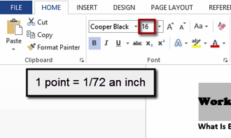
Working with Fonts
By default, when you start typing, the text or numbers are formatted in the Calibri font.
Fonts are measured in points, with one point equal to 1/72 of an inch.
You can move the mouse pointer over an option to see a live preview.
Skills > Office 2013 > Common Formatting Functions > Working with Fonts

Slide 26
Paragraph Formatting
To turn on non-printing characters, click Show/Hide button.
Choices for aligning
text in a paragraph
include Left, Center,
Right, or Justify.
The Line and Paragraph Spacing button reveals choices for spacing between lines of text and between paragraphs.
Skills > Office 2013 > Common Formatting Functions > Paragraph Formatting

Slide 27
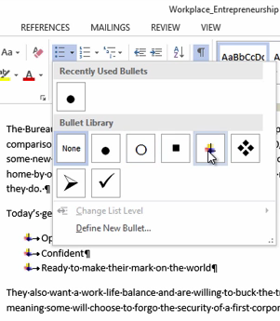
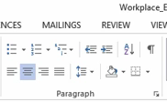
Working with Lists
The Paragraph Group on the Home tab has three options for working with lists:
Bullets
Numbering
Multilevel List
Skills > Office 2013 > Common Formatting Functions > Working with Lists

Slide 28
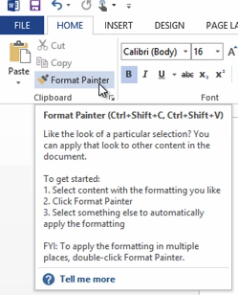
Using the Format Painter
The Format Painter is useful for copying formatting, such as bold, italics, or fonts, from one place and applying it to another.
The Format Painter button turns blue to indicate it’s selected.
To copy formatting to multiple locations, select the text with formatting to copy, double-click the Format Painter button, and then drag the paintbrush pointer as necessary.
Skills > Office 2013 > Common Formatting Functions > Using the Format Painter

Slide 29
Working with Graphics
The video lessons in this section are designed to show you how the use of clip art, photos, illustrations, and other graphics can add visual appeal to your documents. Try out the techniques shown in these videos on your own art and photos to see how well Office 2013 enhances your personal creativity.
In this section:
Inserting Pictures
Inserting Shapes and WordArt
Capturing Screenshots
Applying Graphics Effects
Editing Photos
Skills > Office 2013 > Working with Graphics

Slide 30
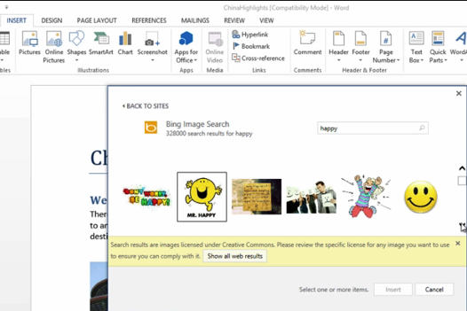
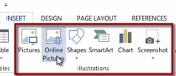
Inserting Pictures
Use the tools in the Illustrations group on the Insert tab to insert pictures from a variety of sources.
Skills > Office 2013 > Working with Graphics > Inserting Pictures

Slide 31
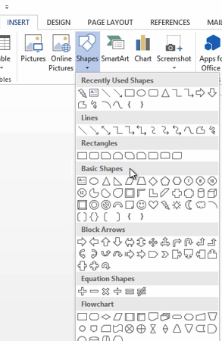
Inserting Shapes and WordArt
Use the Shapes button in the Illustrations group on the Insert tab to add shapes to an Office file. Shapes are also known as drawing objects or drawn objects.
You can modify the size, rotation, alignment, and style.
Skills > Office 2013 > Working with Graphics > Inserting Shapes and WordArt

Slide 32
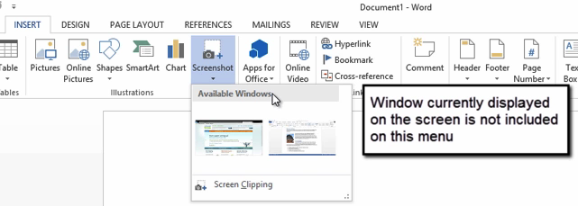
Capturing Screenshots
The Screenshot button is in the Illustration group on the Insert tab. You can modify a selected screenshot by using the buttons on the Picture Tools Format tab.
A screenshot is a picture of an application window.
Skills > Office 2013 > Working with Graphics > Capturing Screenshots

Slide 33
Applying Graphic Effects
You can enhance the appearance of a graphic by applying effects. There are two kinds of effects – picture effects, which change the edges of a picture, and artistic effects, which change the image itself.
Skills > Office 2013 > Working with Graphics > Applying Graphic Effects

Slide 34
Editing Photos
In addition to applying effects and styles to graphics, you can edit a photo in many ways: remove background; crop; adjust focus, contrast, and brightness; and adjust color.
Skills > Office 2013 > Working with Graphics > Editing Photos

Slide 35
Working with Tables
The video lessons in this section are designed to help you create and format tables within documents. Tables in Word are different from those found in Excel and Access, yet they still offer users a similar way to organize, sort, and use the contents stored in them. If you’ve never created a table inside a document before, be sure to watch these lessons.
Tables are a good way to organize text or numerical data.
In this section:
Creating a Table
Adjusting Rows, Columns, and Cells
Sorting and Formatting Tables
Skills > Office 2013 > Working with Tables

Slide 36
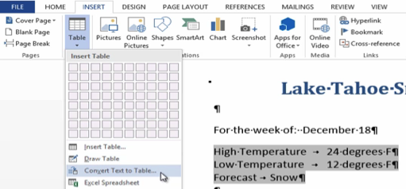
Creating a Table
Create a table
Add text to a table
Move to the next cell with the Tab key
Convert text to a table
Delete a table
Skills > Office 2013 > Working with Tables > Creating a Table

Slide 37
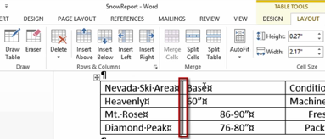
Adjusting Rows, Columns, and Cells
After you create a table, you can adjust the rows, columns and cells to better fit the data buy:
Inserting rows and columns
Adjusting column widths and row heights
Merging and splitting cells
Skills > Office 2013 > Working with Tables > Adjusting Rows, Columns, and Cells

Slide 38
Sorting and Formatting Tables
In the Sort dialog box, you can specify how you want to sort the data.
By default, Word sorts the table according to the contents of the column on the left. Also by default, it sorts the data in ascending, or alphabetical, order.
Skills > Office 2013 > Working with Tables > Sorting and Formatting Tables

Slide 39
Printing and Publishing
The video lessons in this section are designed to assist you with preparing your documents for printing. You can avoid printing unnecessary amounts of paper if you take the time to prepare your documents. If you’ve never created a PDF document from a Word document before, be sure to pay particular attention to that video lesson, especially if you’ll be sharing them with people who may not use the same version of Office or when you want to create a non-editable version of your document to print or post on a website.
In this section:
Formatting Documents for Printing
Previewing Documents
Specifying Print Options
Managing Print Jobs
Printing to PDF
Emailing or Faxing Documents
Skills > Office 2013 > Printing and Publishing

Slide 40
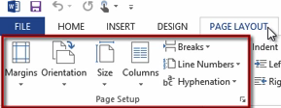
Formatting Documents for Printing
Before printing any document, it’s a good idea to use the options in the Page Layout tab to make sure the document prints the way you want it to look.
The Page Setup group on the Page Layout tab holds several tools related to formatting the entire page.
Skills > Office 2013 > Printing and Publishing > Formatting Documents for Printing

Slide 41
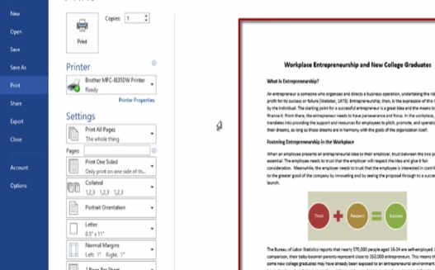
Previewing Documents
Before printing any document, it’s a good idea to preview it to confirm it appears as you intend it to look.
Click the File tab to open Backstage View. Then click Print. A preview of the printed document appears on the right.
Skills > Office 2013 > Printing and Publishing > Previewing Documents

Slide 42
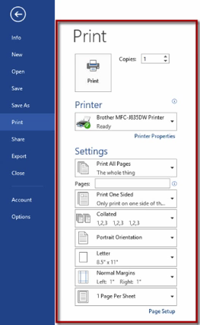
Specifying Print Options
You can specify Print options, including:
Number of copies to print
Printer to print to
Number of pages to print
Two-sided printing
Collated pages
Skills > Office 2013 > Printing and Publishing > Specifying Print Options

Slide 43
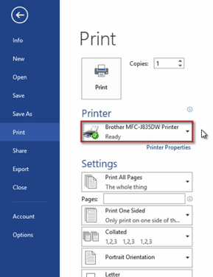
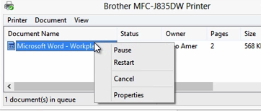
Managing Print Jobs
The Print options on the File tab offer many ways to manage print jobs.
Skills > Office 2013 > Printing and Publishing > Managing Print Jobs

Slide 44
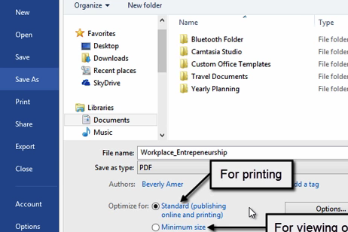
Printing to PDF
Saving a file to a PDF—also known as printing to a PDF—is a great way to package your work so it appears and prints exactly as you want it to look when others view it.
Skills > Office 2013 > Printing and Publishing > Printing to PDF

Slide 45
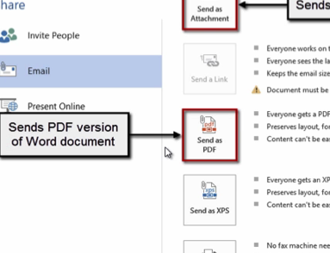
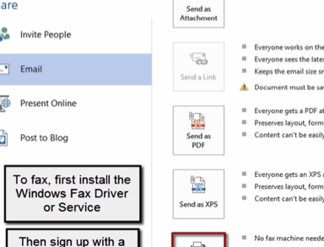
Emailing or Faxing Documents
It’s easy to send a document as an email attachment or fax.
Skills > Office 2013 > Printing and Publishing > Emailing or Faxing Documents

Slide 46
Sharing Content Between Applications
The video lessons in this section are designed to help you understand how to successfully copy content between Office 2013 applications and how to link and embed objects within documents and files. All three lessons focus on integration so you can make the most of Office’s ability to copy, link, and embed content across different software programs when creating documents for school, home, or work.
In this section:
Copying Content Between Applications
Object Linking and Embedding
Integration Examples
Skills > Office 2013 > Sharing Content Between Applications

Slide 47
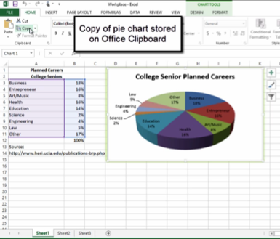
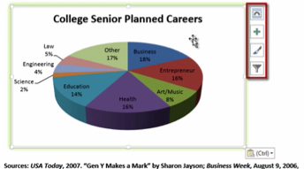
Copying Content Between Applications
Microsoft Office 2013 makes it easy to copy data in one file and paste it into another file in a different application.
Skills > Office 2013 > Sharing Content Between Applications > Copying Content Between Applications

Slide 48
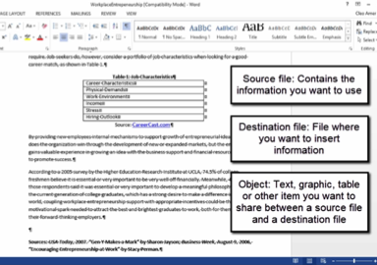
Object Linking and Embedding
When working with information that appears in two or more files, the best way to make sure the information is consistent between the files is to use Object Linking and Embedding (OLE).
Embedding:
Copy information in source file
Paste in destination file
To edit information within the destination file, double-click to display tools of source program
No connection between source file and destination file
Linking:
Creates a connection between destination and source files
Changes in source file show up in destination file
Skills > Office 2013 > Sharing Content Between Applications > Object Linking and Embedding

Slide 49
Collaborating with Office 2013
The video lessons in this section are designed to acquaint you with all the options now available for sharing files via Microsoft’s SkyDrive and a Window’s Live account, adding electronic “sticky notes,” tracking and accepting or rejecting the changes made by various users, and combining documents from different users into a single merged document.
In this section:
Sharing Documents
Adding Comments
Tracking Changes
Accepting or Rejecting Changes
Comparing and Merging Documents
Protecting Documents
Skills > Office 2013 > Collaborating with Office 2013

Slide 50
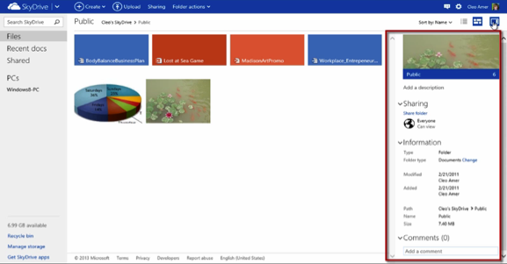
Sharing Documents
Microsoft offers a variety of cloud computing tools for helping groups collaborate, no matter where group members are located, including SharePoint and Microsoft’s live.com service.
Skills > Office 2013 > Collaborating with Office 2013 > Sharing Documents

Slide 51
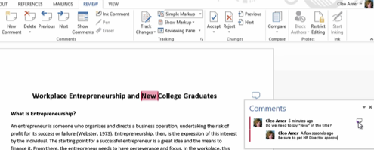
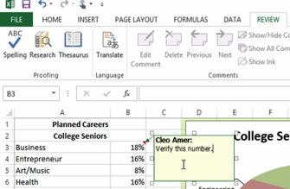
Adding Comments
When sharing documents, it’s often necessary to include notes to other readers. In Office 2013, you can do this by adding comments to a document.
Skills > Office 2013 > Collaborating with Office 2013 > Adding Comments

Slide 52
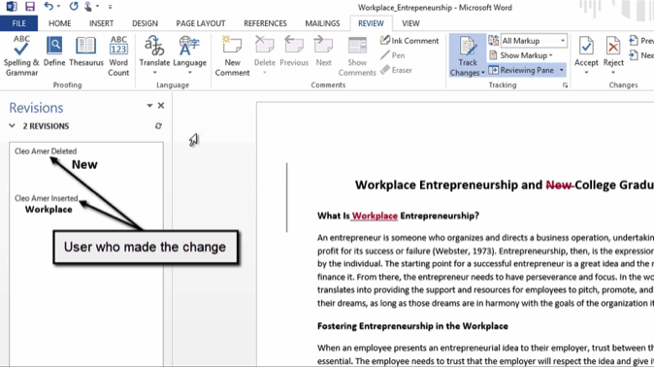
Tracking Changes
The Review tab contains options related to tracking changes. All the buttons you need are in the Tracking group.
Skills > Office 2013 > Collaborating with Office 2013 > Tracking Changes

Slide 53
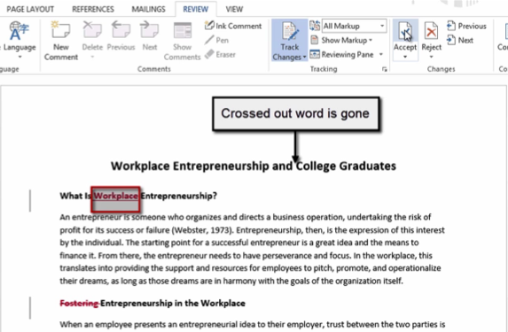
Accepting or Rejecting Changes
When you’re working on a document that contains tracked changes, you can choose to accept or reject the changes.
Skills > Office 2013 > Collaborating with Office 2013 > Accepting or Rejecting Changes

Slide 54
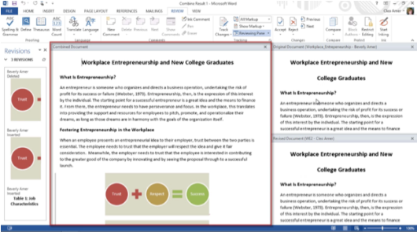
Comparing and Merging Documents
As files are revised, they often need to be compared and merged, or combined, into a single file so the most recent changes get added and saved before more changes are made.
Skills > Office 2013 > Collaborating with Office 2013 > Comparing and Merging Documents

Slide 55
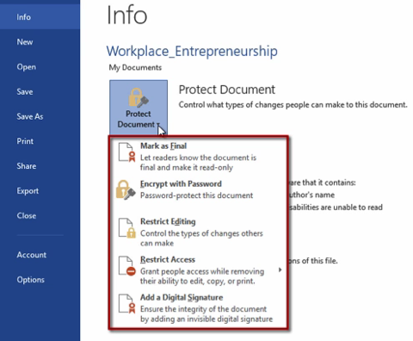
Protecting Documents
Protection settings in Backstage view include:
Mark Final
Encrypt with Password
Restrict Editing
Restrict Access
Add Digital Signature
Skills > Office 2013 > Collaborating with Office 2013 > Protecting Documents

Slide 56
Customizing Office Applications
The video lessons in this section are designed to acquaint you with the different ways you can customize the Ribbon, create your own tabs on the Ribbon, and work with the Options found in the File tab’s Backstage view.
In this section:
Customizing Ribbons, Tabs, and Toolbars
Application Options
Skills > Office 2013 > Customizing Office Applications

Slide 57
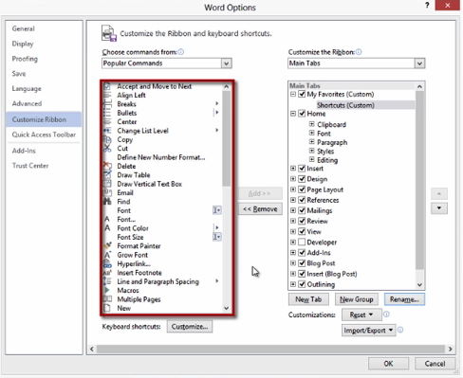
Customizing Ribbons, Tabs, and Toolbars
You can customize the Ribbon by rearranging the tab order or even creating your own new tab.
Skills > Office 2013 > Customizing Office Applications > Customizing Ribbons, Tabs, and Toolbars

Slide 58
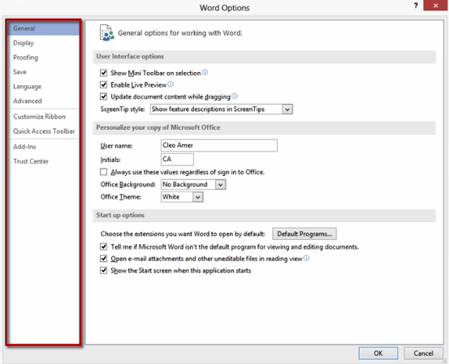
Application Options
Every Office 2013 application has an Options dialog box where you can adjust numerous settings for that application. The available options vary from one Office application to another.
Skills > Office 2013 > Customizing Office Applications > Application Options

