Slide 1
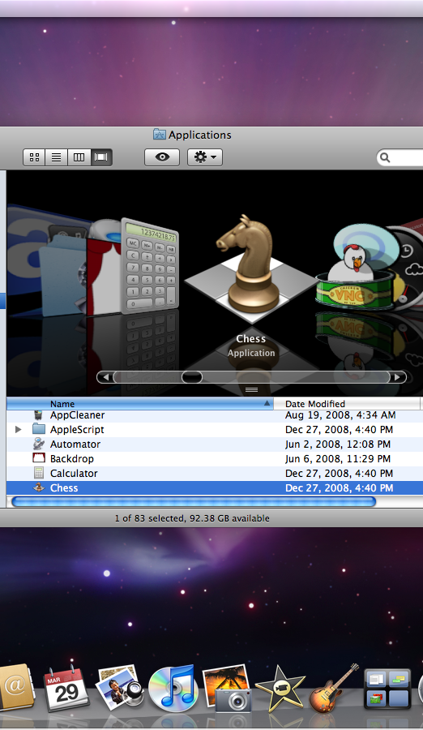
Mac OS X
Mac OS X (Mac Operating System 10) was developed by Apple Inc. in 2002. In this lesson, you will learn how to navigate, use, and manage files in Mac OS X.
In this section:
Mac OS X Layout
Mac OS X Tools
Mac OS X File Management
Skills > Mac OS X

Slide 2
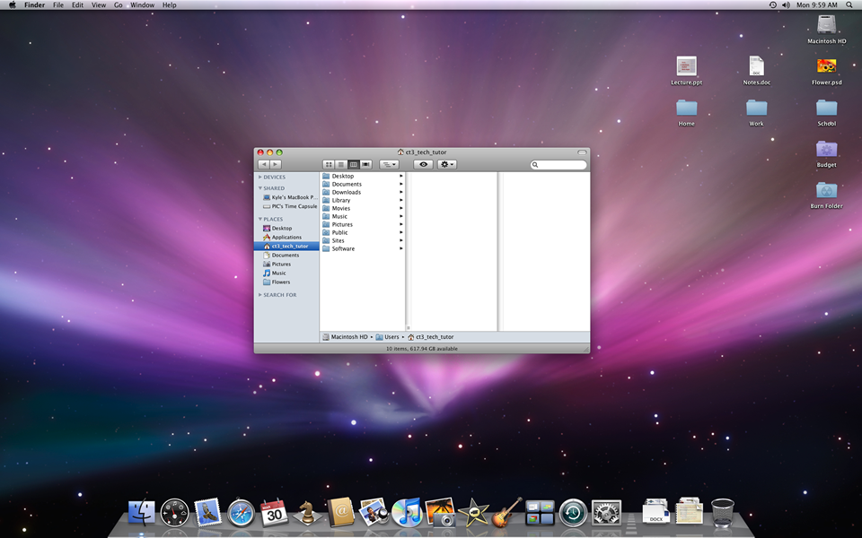
Mac OS X
Layout
The Mac OS X operating system consists of four main parts: the Desktop, the Menu Bar, the Finder, and the Dock.
In this section:
The Desktop
The Menu Bar
The Finder
The Dock
Skills > Mac OS X > Mac OS X Layout

Slide 3
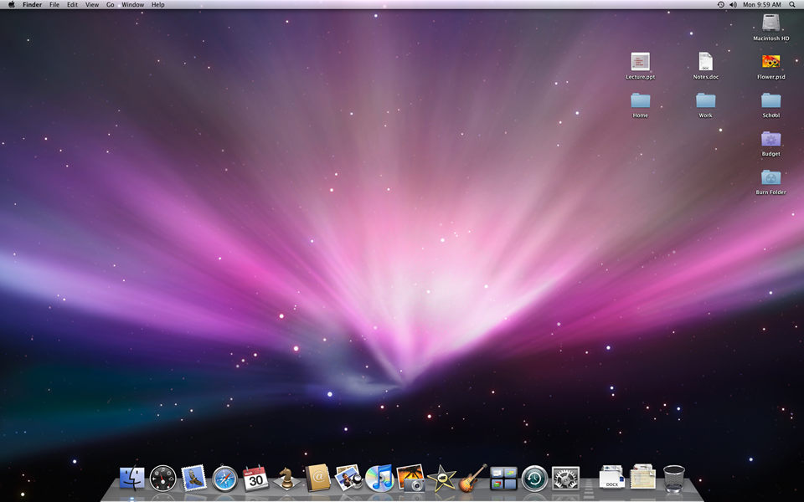
The Desktop
The Desktop is used to store frequently accessed files, folders, and applications. Think of the Desktop as your working surface.
Links:
Apple – Mac OS X Leopard
Apple Support – Mac 101: The Grand Tour
Apple Support – Switch 101: On Windows
Skills > Mac OS X > Mac OS X Layout > The Desktop

Slide 4
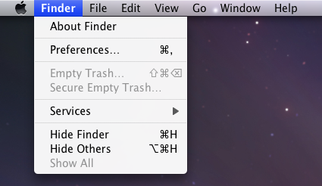
The Menu Bar
The Menu Bar is the semi-transparent bar that spans the top of the screen and holds the menu options for the active application.
Links:
Apple – Mac OS X Leopard
Apple Support – Mac 101: The Grand Tour
Apple Support – Switch 101: On Windows
Skills > Mac OS X > Mac OS X Layout > The Menu Bar

Slide 5
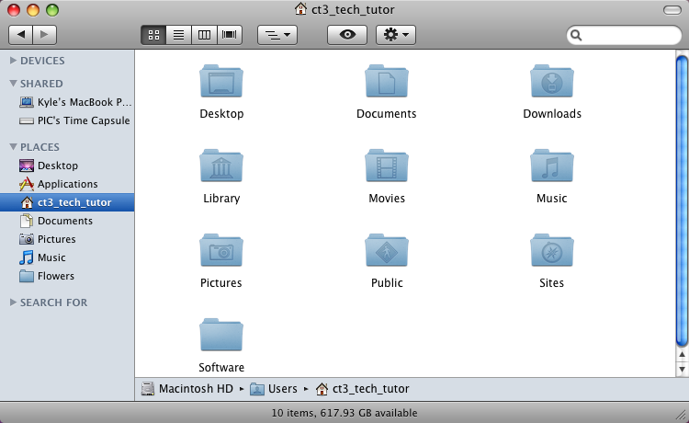
The Finder
The Finder is the “handle” that opens the digital filing cabinet of your computer. From the Finder you can access everything stored on your machine.
Links:
Apple – Mac OS X Leopard
Apple Support – Mac 101: The Grand Tour
Apple Support – Switch 101: On Windows
Skills > Mac OS X > Mac OS X Layout > The Finder

Slide 6
The Dock
The Dock is the bar of icons at the bottom or side of the screen. It holds links to commonly used and currently running applications, minimized windows, stacks of files, the Finder, and the Trash.
Links:
Apple – Mac OS X Leopard
Apple Support – Mac 101: The Grand Tour
Apple Support – Switch 101: On Windows
Skills > Mac OS X > Mac OS X Layout > The Dock

Slide 7
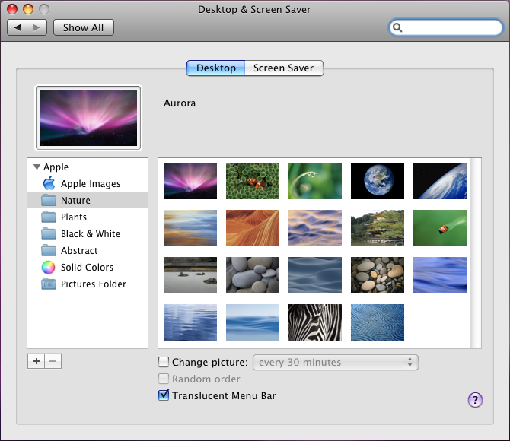
Mac OS X Tools
Mac OS X includes many tools that enable you to configure and customize your system, search for documents, get help, and more.
In this section:
System Preferences
Customize and Personalize
Exposé, Dashboard, and Spaces
Search
Help
Skills > Mac OS X > Mac OS X Tools

Slide 8
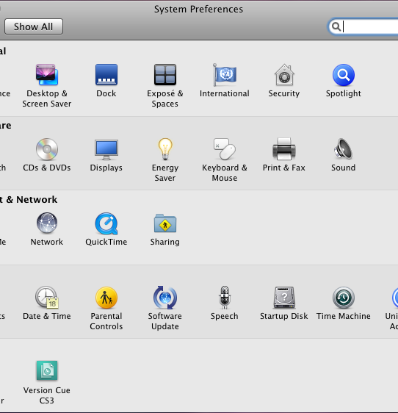
System Preferences
System Preferences is where all the settings and configurations for your computer are located.
Links:
Apple – Mac OS X Leopard: 300+ New Features
Apple – Mac OS X Leopard: A guided tour
Skills > Mac OS X > Mac OS X Tools > System Preferences

Slide 9
Customize and Personalize
Mac OS X is highly configurable and can easily be customized for your personal computing experience.
Links:
Apple – Mac OS X Leopard: 300+ New Features
Apple – Mac OS X Leopard: A guided tour
Skills > Mac OS X > Mac OS X Tools > Customize and personalize

Slide 10
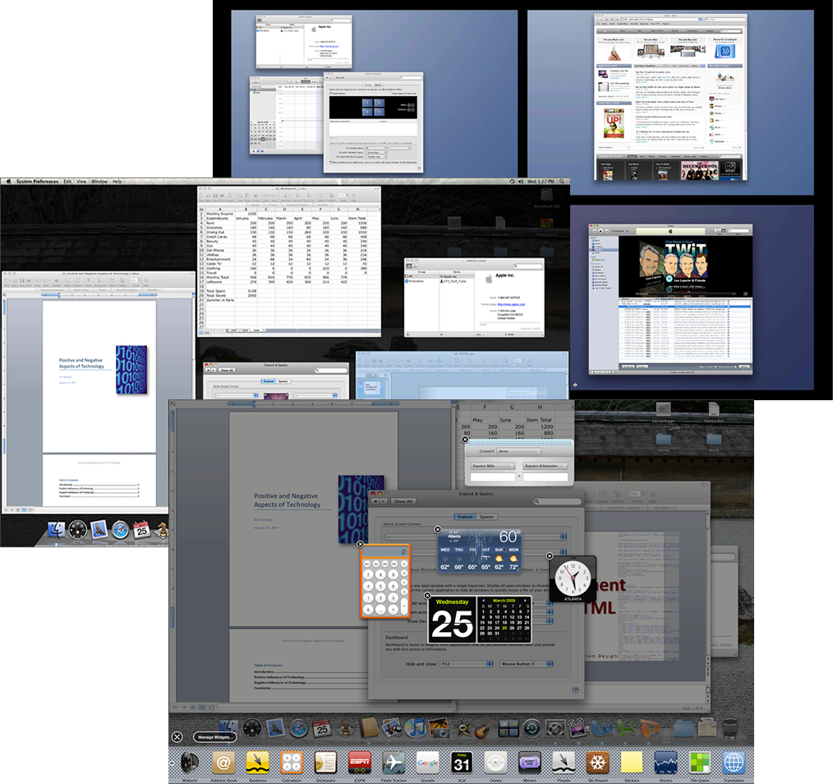
Exposé, Dashboard, and Spaces
Exposé reveals all the open applications and windows currently on the Desktop. It is ideal for getting a bird’s-eye view of everything and finding the window you want.
Links:
Apple – Mac OS X Leopard: 300+ New Features
Apple – Mac OS X Leopard: A guided tour
Skills > Mac OS X > Mac OS X Tools > Exposé, Dashboard, and Spaces

Slide 11
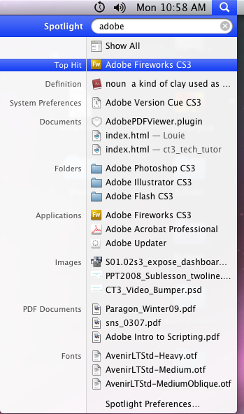
Search
Entering text into Spotlight will initiate a search of the entire hard drive, or you can refine your search using the search bar in the Spotlight window.
Links:
Apple – Mac OS X Leopard: 300+ New Features
Apple – Mac OS X Leopard: A guided tour
Skills > Mac OS X > Mac OS X Tools > Search

Slide 12
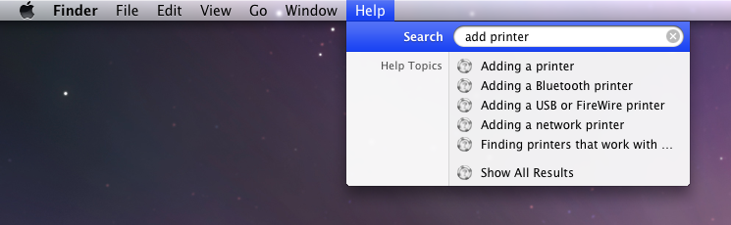
Help
Help is a resource for finding answers about Mac OS X, from the most basic questions to complicated troubleshooting.
Links:
Apple – Mac OS X Leopard: 300+ New Features
Apple – Mac OS X Leopard: A guided tour
Skills > Mac OS X > Mac OS X Tools > Help

Slide 13
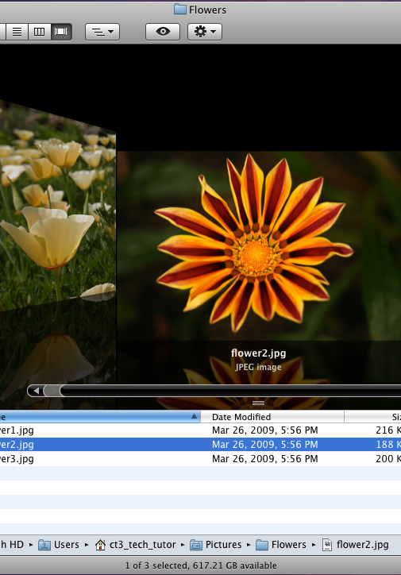
Mac OS X File
Management
Mac OS X includes many features that enable you to manage and organize files and folders.
In this section:
File and Folder Organization
Creating and Moving
Copying, Pasting, and Deleting
Quick Look and Open With
Saving Files
Skills > Mac OS X > Mac OS X File Management

Slide 14
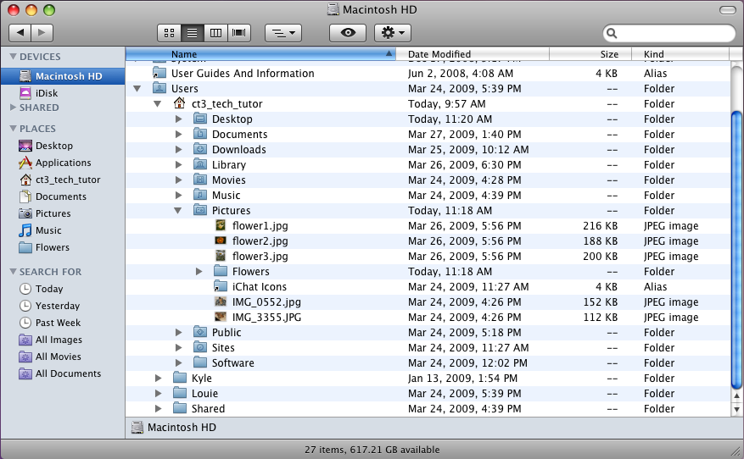
File and Folder Organization
Using the analogy of a filing cabinet, the files and folders on your computer are the digital equivalents of paper documents and folders in filing cabinet drawers
Links:
Apple – Mac OS X 10.5 Help
Skills > Mac OS X > Mac OS X File Management > File and Folder Organization
Notes:
Bullet 2 modified

Slide 15
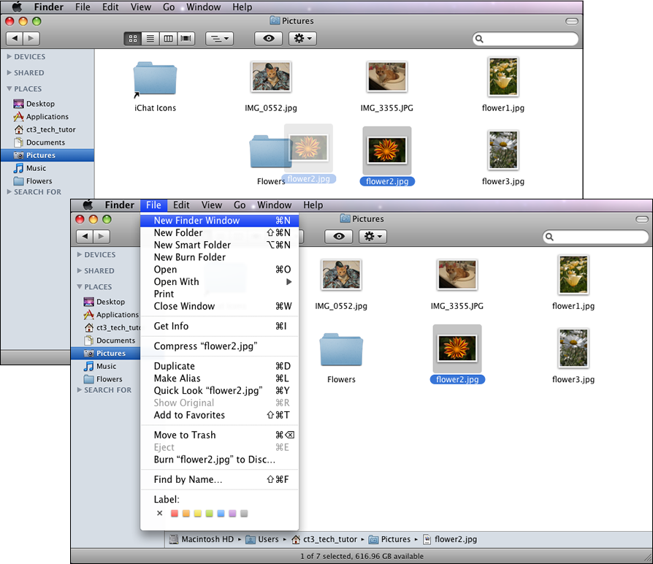
Creating and Moving
Folders typically hold related files. Files can be moved (dragged) from one folder into another folder, and from Finder window to Finder window.
Links:
Apple – Mac OS X 10.5 Help
Skills > Mac OS X > Mac OS X File Management > Creating and Moving

Slide 16
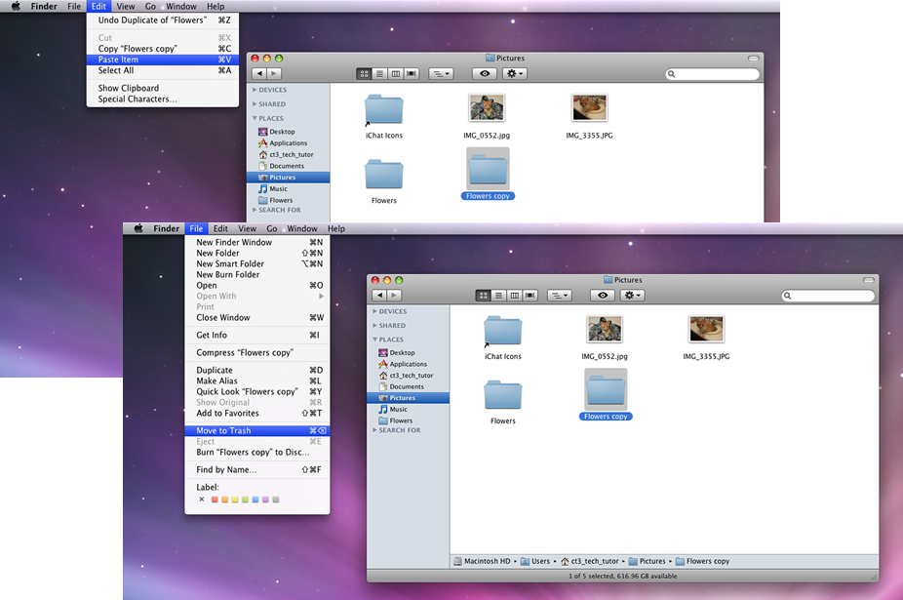
Copying, Pasting and Deleting
Files and folders can be duplicated by copying and pasting. Copying a file or folder does not affect the original, but makes an identical digital copy. When a file or folder is deleted, it is not truly gone until the Trash is emptied.
Links:
Apple – Mac OS X 10.5 Help
Skills > Mac OS X > Mac OS X File Management > Copying, Pasting and Deleting

Slide 17
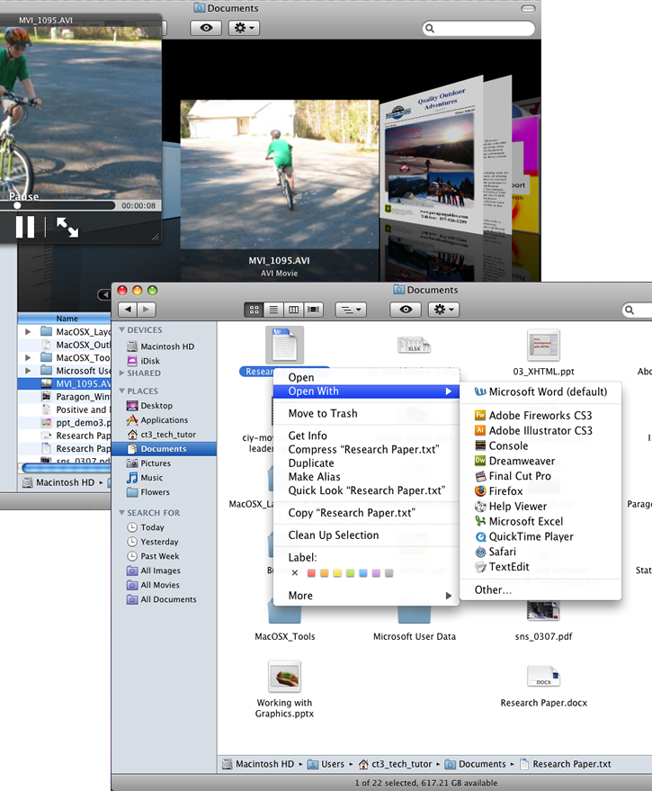
Quick Look and Open With
A file’s content can be scanned with Quick Look in the Finder without opening the file. But when a file is to be opened, you can select the program with which to open the file using the Open With option.
Links:
Apple – Mac OS X 10.5 Help
Skills > Mac OS X > Mac OS X File Management > Quick Look and Open With

Slide 18
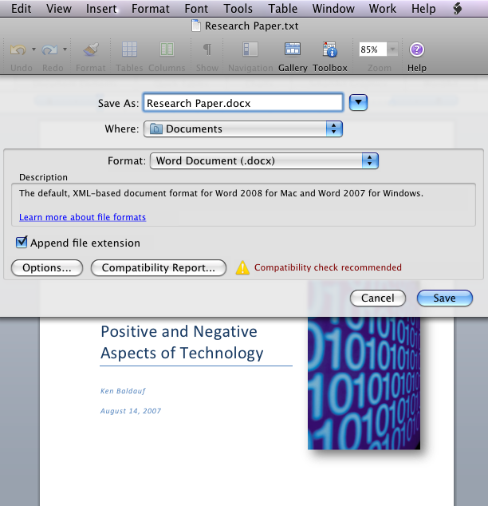
Saving
Files can be saved into existing folders, or they can be placed into a new folder at the time they are saved.
Links:
Apple – Mac OS X 10.5 Help
Skills > Mac OS X > Mac OS X File Management > Saving

