Slide 1
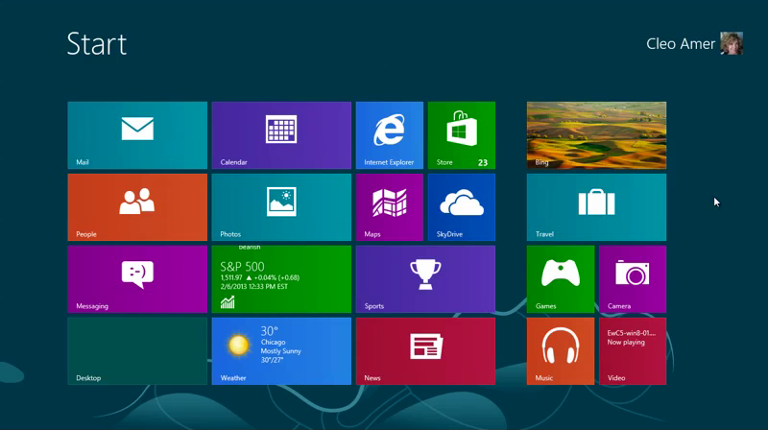
Windows 8
Windows 8 looks unlike any operating system Microsoft has created to date. In this lesson, you will learn how to navigate and manage files in the Windows 8 operating system.
In this section:
Windows 8 Navigating
Windows 8 File Management
Skills > Windows 8

Slide 2
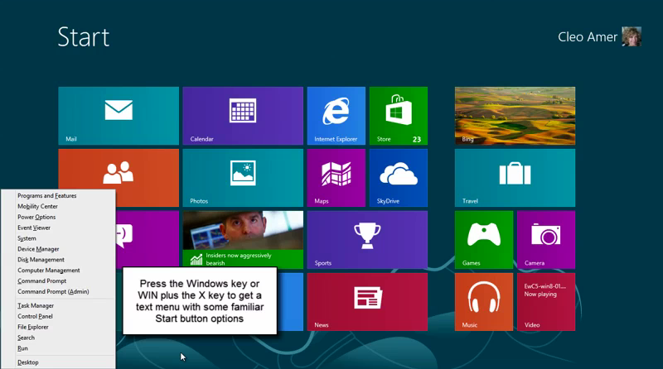
Windows 8 Navigating
Windows 8 works with a keyboard, tablet, or touch screen. Instead of icons, you click on a series of colorful, rectangular “tiles” to launch an “app,” or click the Desktop tile for the old Windows desktop …
In this section:
Windows 8 Layout
Working With Apps
Charms and Settings
Internet Explorer 10
Windows 8 Shortcuts
Getting Help
Skills > Windows 8 > Windows 8 Navigating

Slide 3
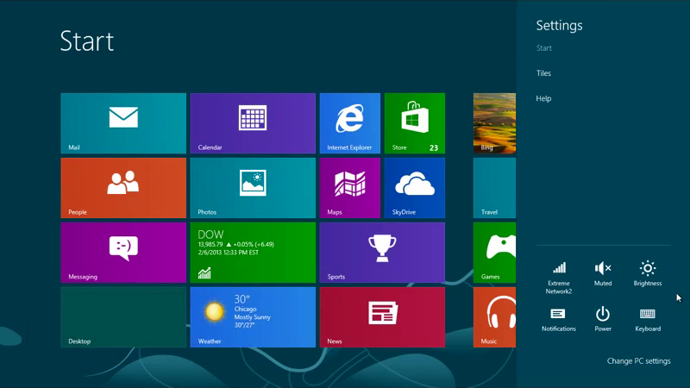
Windows 8 Layout
Easy ways to access often-used actions:
Start (WIN+X)
Lock (WIN+L)
Unlock (spacebar or mouse wheel)
Shut Down (Charms bar → Settings → Power)
Skills > Windows 8 > Windows 8 Navigating > Windows 8 Layout
Notes:
Bullet 2 modified

Slide 4
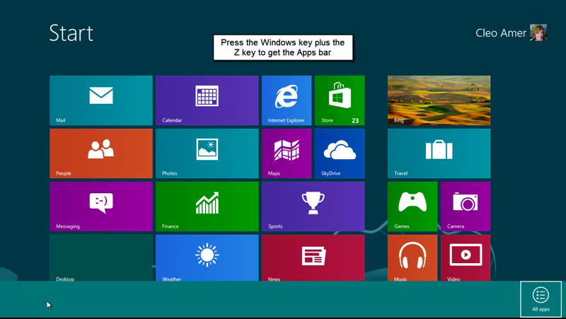
Working With Apps
Launch apps
List apps
Close apps
Pin apps
Group apps
Run apps side-by-side
Skills > Windows 8 > Windows 8 Navigating > Working With Apps

Slide 5
Charms & Settings
Charms Bar
Settings Charm
Devices Charm
Start Charm
Share Charm
Search Charm
Skills > Windows 8 > Windows 8 Navigating > Charms & Settings

Slide 6
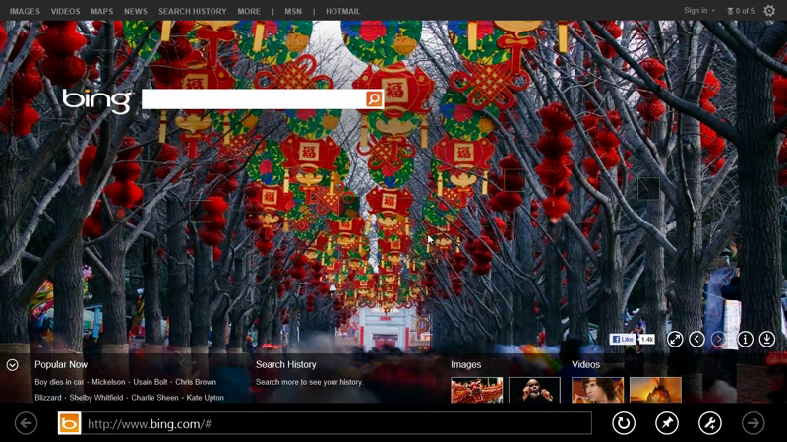
Internet Explorer 10
Launch from Start
Open multiple browser windows
Search
Pin search page
Return to Start
Skills > Windows 8 > Windows 8 Navigating > Internet Explorer 10

Slide 7
Windows 8 Shortcuts
Windows key (WIN)
Switching
Charms bar (C)
Desktop (D)
File Explorer (E)
Search files (F)
Settings (I)
Search pane (Q)
Tools (X)
Apps bar (Z)
Screenshot (Print Screen)
Skills > Windows 8 > Windows 8 Navigating > Windows 8 Shortcuts

Slide 8
Getting Help
Settings charm
Search charm
Pin to Start
Desktop view
Skills > Windows 8 > Windows 8 Navigating > Getting Help

Slide 9
Windows 8 File Management
Many Windows users depend on File Explorer to locate folders, files, and other content on their computer.
In this section:
Using Search
Working with Folders and Files
Using SkyDrive
File Explorer Ribbon
File History
Skills > Windows 8 > Windows 8 File Management

Slide 10
File Explorer Ribbon
Home tab
Share tab
View tab
Customize Quick Access Toolbar
Skills > Windows 8 > Windows 8 File Management > File Explorer Ribbon
Notes:
Bullet 2 modified

Slide 11
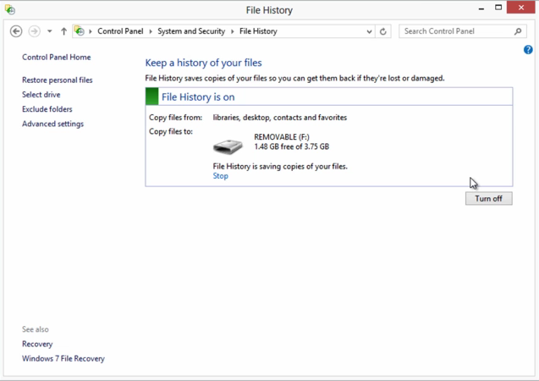
File History
Locate File History
Set up File History to save copies of files automatically
Skills > Windows 8 > Windows 8 File Management > File History

Slide 12
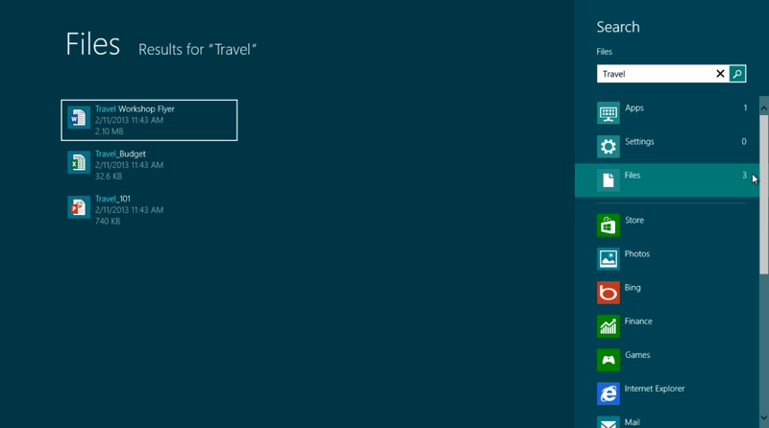
Using Search
Charms bar/Search charm
Results tell how many items match search term
Skills > Windows 8 > Windows 8 File Management > Using Search

Slide 13
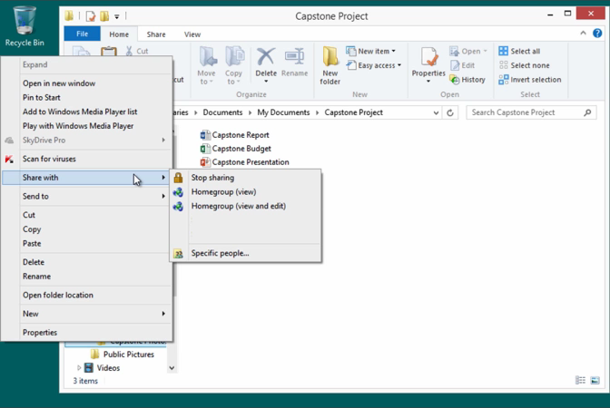
Working with Folders and Files
Libraries:
Create
Move
Copy
Rename
Delete
Share
Pin/Unpin
Recover
Skills > Windows 8 > Windows 8 File Management > Working with Folders and Files

Slide 14
Using SkyDrive
live.com = Microsoft’s cloud storage
25 gigabytes FREE!
Skills > Windows 8 > Windows 8 File Management > Using SkyDrive

