Slide 1
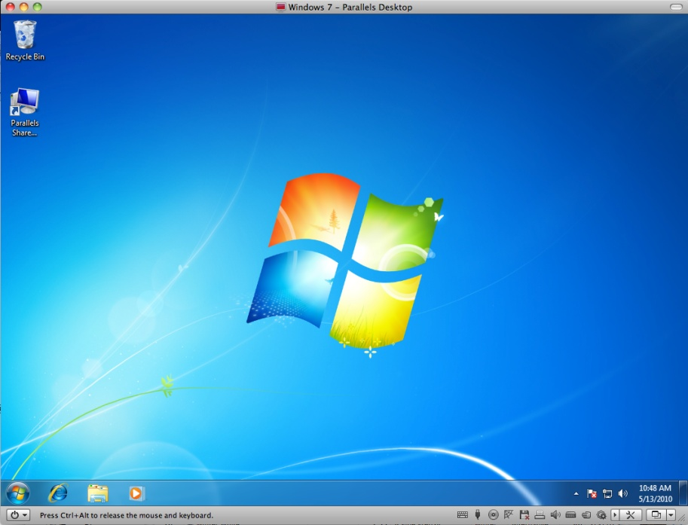
Windows 7
Microsoft Windows is the dominant operating system on computers around the world. In this lesson, you will learn how to navigate and manage files in the Windows 7 operating system.
In this section:
Navigating in Windows 7
Windows 7 File Management
Skills > Windows 7

Slide 2
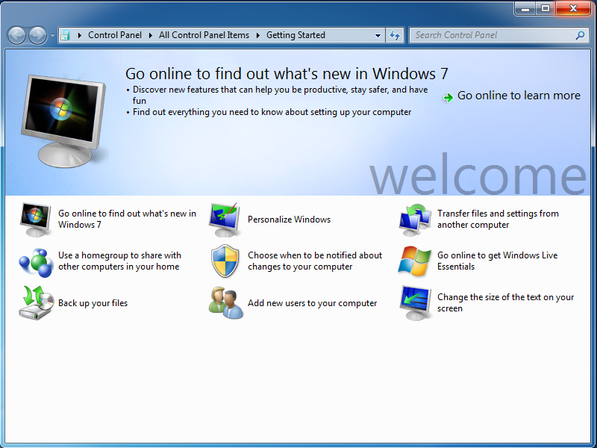
Navigating in
Windows 7
With Windows 7, you can perform a wide variety of tasks such as basic navigation, customizing and personalizing the interface, changing settings, searching for files and folders, and getting help.
In this section:
Windows 7 Layout
Working with Programs, Windows, and the Taskbar
The Windows 7 Taskbar
Gadgets
The Control Panel
Appearance and Personalization
Help and Support
Skills > Windows 7 > Navigating in Windows 7

Slide 3
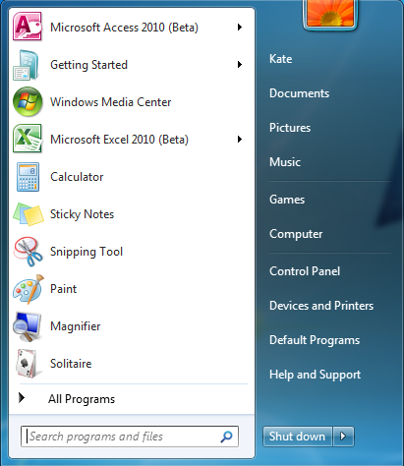
Windows 7 Layout
Windows 7 consists of three main areas: the Desktop, the Taskbar, and the Start menu. Each area can be customized and configured for personal use.
Skills > Navigating in Windows 7 > Windows 7 Layout
Notes:
Bullet 2 modified

Slide 4
Working with Programs, Windows, and the Taskbar
There are several methods for launching a program in Windows 7.
Skills > Windows 7 > Navigating in Windows 7 > Working with Programs, Windows, and the Taskbar

Slide 5
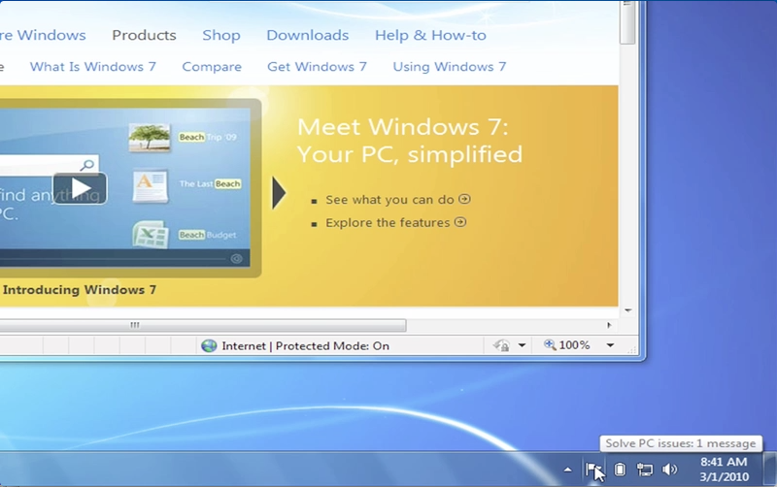
The Windows 7 Taskbar
The Windows 7 Taskbar includes a notification area that displays the time and date as well as icons for system settings and applications. Occasionally notifications will be displayed here.
Skills > Windows 7 > Navigating in Windows 7 > The Windows 7 Taskbar

Slide 6
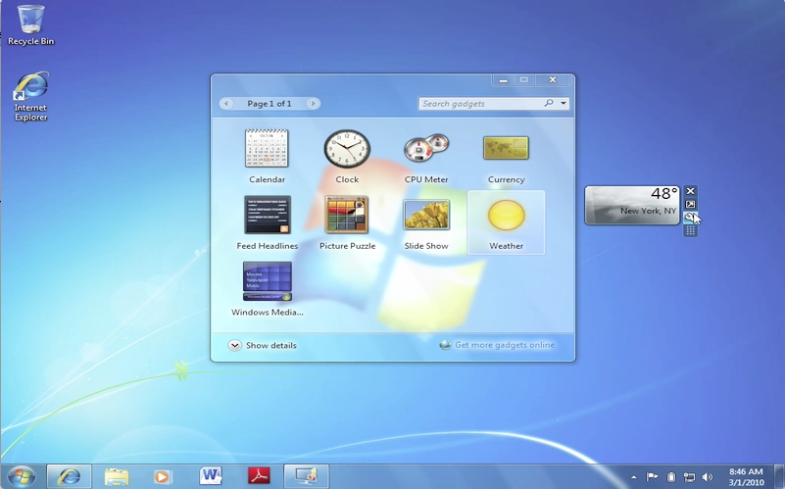
Gadgets
Gadgets are small useful programs that run on the desktop. Hundreds of gadgets are available online. Click and drag gadgets to place them where you want on the desktop.
Skills > Windows 7 > Navigating in Windows 7 > Gadgets

Slide 7
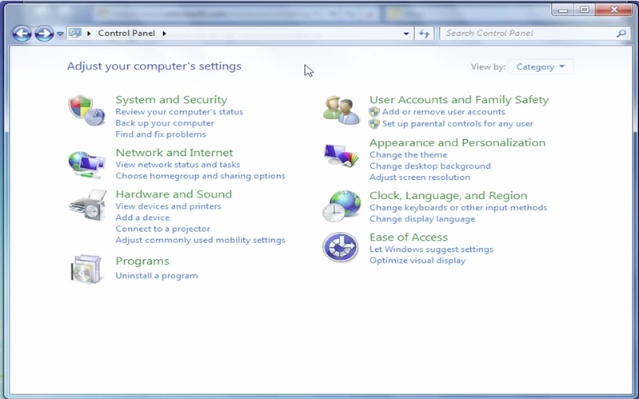
The Control Panel
The Control Panel is where all the operating systems settings and configurations for your computer are located.
Skills > Windows 7 > Navigating in Windows 7 > The Control Panel

Slide 8
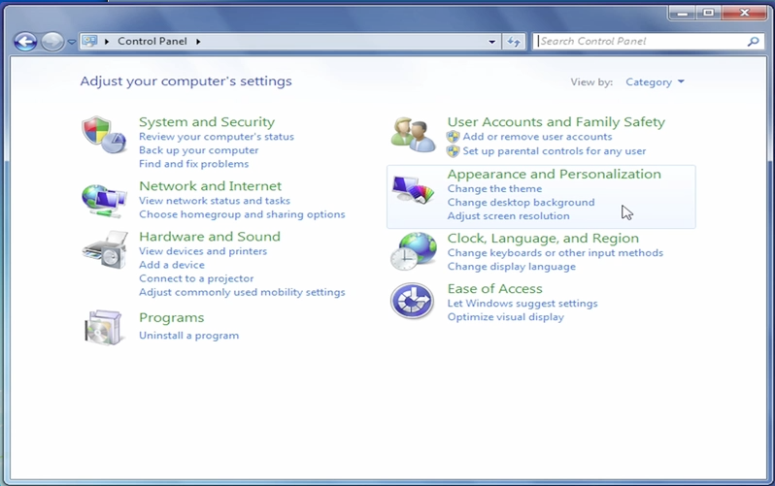
Appearance and Personalization
Windows provides several options for customizing your computing environment. Many of these options are accessed in the Appearance and Personalization area of the Control Panel.
Skills > Windows 7 > Navigating in Windows 7 > Appearance and Personalization

Slide 9
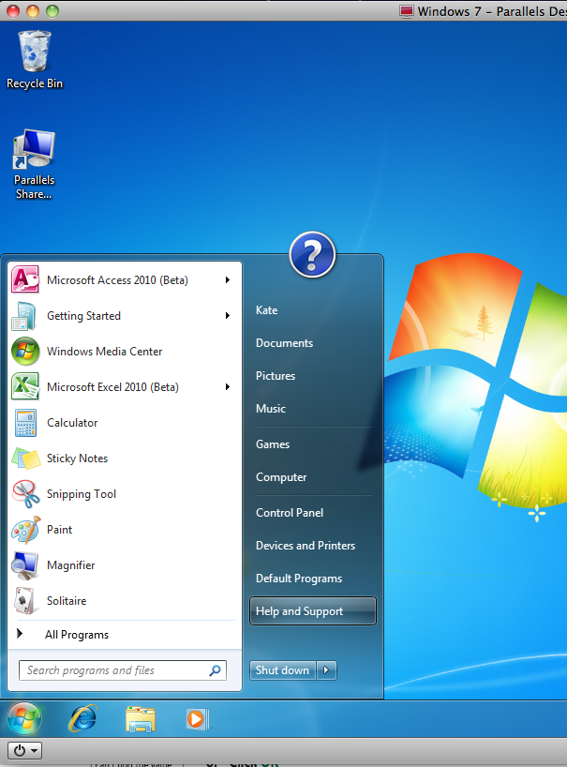
Help and Support
Windows 7 provides a robust Help system that can assist in answering all of your Windows 7 questions. To access Help and Support, go to the Start menu and click Help and Support.
Skills > Windows 7 > Navigating in Windows 7 > Help and Support

Slide 10
Windows 7 File Management
With Windows 7, you can perform a wide variety of tasks such as basic navigation, customizing and personalizing the interface, changing settings, searching for files and folders, and getting help.
In this section:
Files, Folders, and Libraries
Creating and Moving Files and Folders
Copying, Renaming, and Deleting
File Preview and Open With
Saving Files
Skills > Windows 7 > Windows 7 File Management

Slide 11
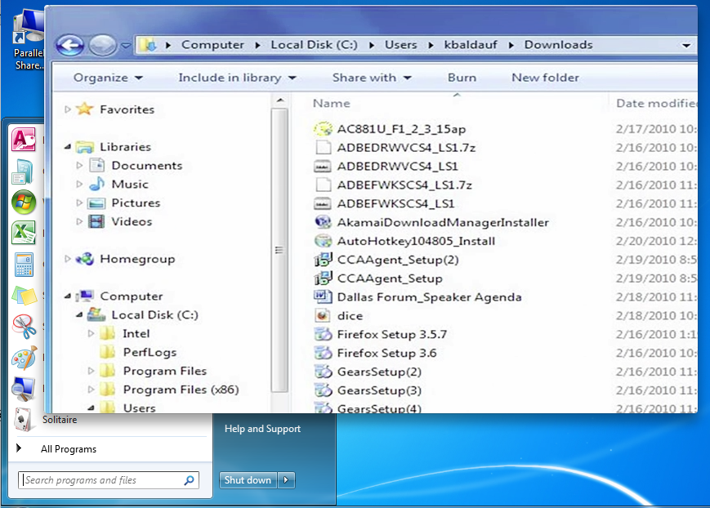
Files, Folders, and Libraries
Files, folders, and libraries can be accessed through the Start menu.
Skills > Windows 7 > Windows 7 File Management > Files, Folders, and Libraries
Notes:
Bullet 2 modified

Slide 12
Creating and Moving Files and Folders
Folders are used to organize similar or related files together in one location. Both folders and files are easily moved by dragging them to folders in the Navigation pane or main content area.
Skills > Windows 7 > Windows 7 File Management > Creating and Moving Files and Folders

Slide 13
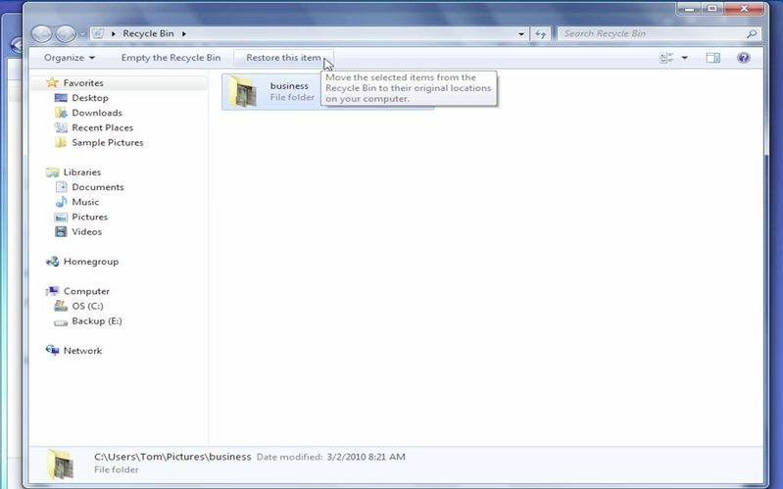
Copying, Renaming, and Deleting
In addition to moving them, you can also copy, rename, and delete files and folders.
Skills > Windows 7 > Windows 7 File Management > Copying, Renaming, and Deleting

Slide 14
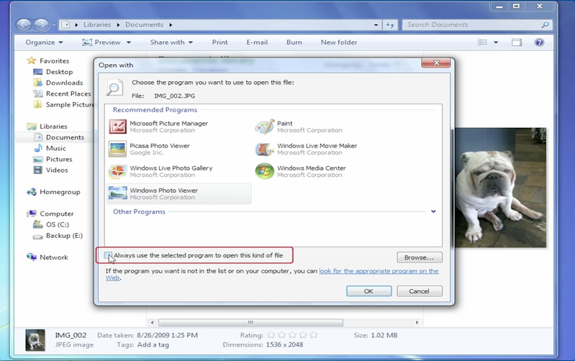
File Preview and Open With
The Preview pane allows you to see a file’s contents without having to open it. Open With allows you to choose the program to use to open a file.
Skills > Windows 7 > Windows 7 File Management > File Preview and Open With

Slide 15
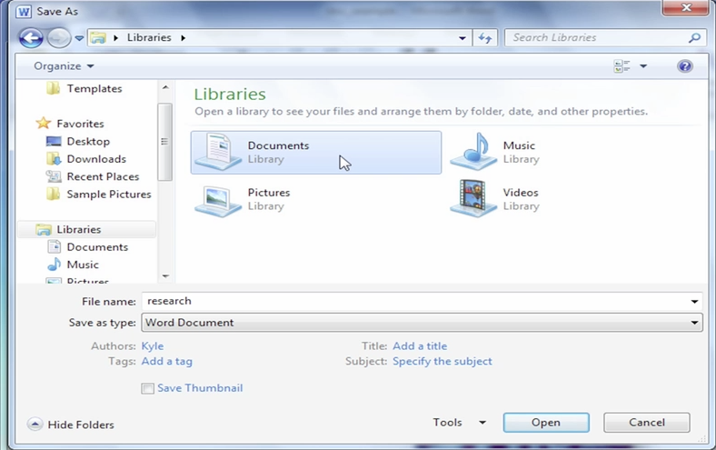
Saving Files
When you create a file, you can save it by going to the File menu and clicking Save As. When you’ve modified a file, you can save your changes by clicking Save.
Skills > Windows 7 > Windows 7 File Management > Saving Files

