Slide 1
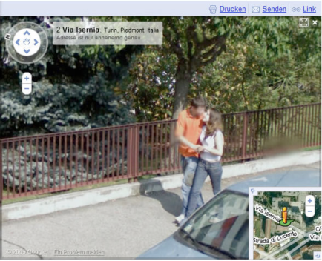
Privacy
…refers to being free from intrusion—the right to be left alone, to be free from surveillance, and to have control over the information collected and stored about yourself.
In this section:
U.S. Privacy-Protective Laws | Behavioral Targeting
U.S. Privacy-Invasive Laws | Traffic Shaping
Surveillance | Transparency
Issues > Privacy

Slide 2
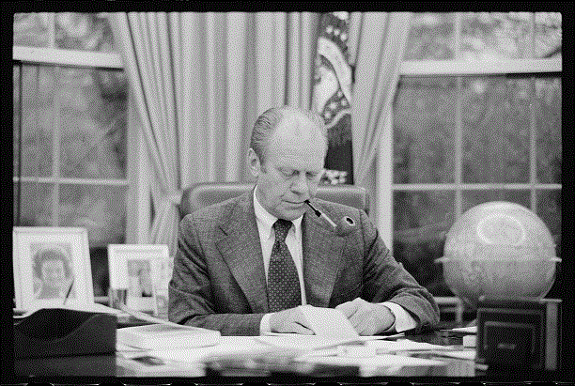
U.S. Privacy-Protective Laws
U.S. privacy-protective laws refer to legislation designed to protect the private information of U.S. citizens.
The right to privacy has been a hotly debated topic in countries around the world for generations. Many recent privacy laws focus on digital technology issues.
Links:
Video: Domestic Drones to Patrol Streets of Seattle
Issues > Privacy > U.S. Privacy-Protective Laws

Slide 3
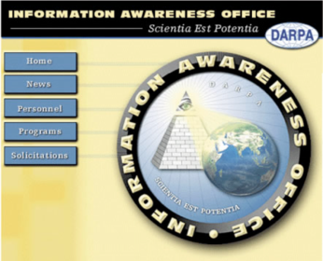
U.S. Privacy-Invasive Laws
U.S. privacy-invasive laws refer to legislation that is invasive to individual privacy for a perceived greater good of the country.
Links:
Video: Patriot Act Presentation
Issues > Privacy > U.S. Privacy-Invasive Laws

Slide 4
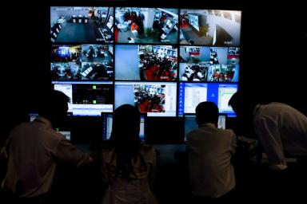
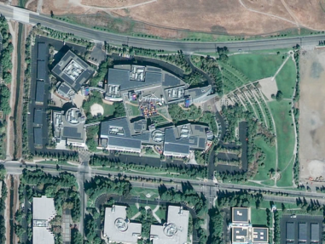
Surveillance
Surveillance is the close monitoring of behavior through electronic technologies such as wiretapping, data mining, remote video and audio monitoring, GPS, and RFID.
Who is monitoring those individuals doing the monitoring? Will the information gathered in electronic surveillance be used to invade our privacy?
Links:
Video: The Surveillance Society
Video: The Surveillance Hummingbird
Issues > Privacy > Surveillance

Slide 5
Behavioral Targeting
Behavioral targeting uses information about a person’s behavior to inform businesses and marketers so that they can offer products that are likely to be of interest to that person.
Much of the information gathered about individuals is collected without their knowledge.
Links:
Video: Ads That Track Your Web Activity
Video: Ordering Pizza in the Future
Issues > Privacy > Behavioral Targeting

Slide 6
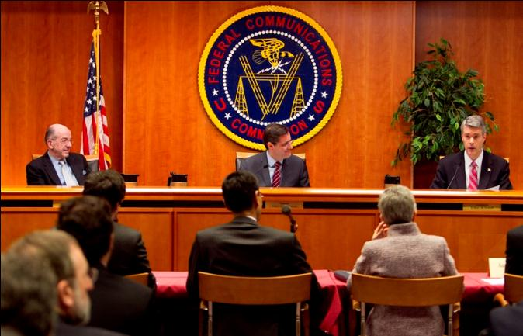
Traffic Shaping
Traffic shaping refers to controlling the flow of network traffic in order to optimize performance by delaying some data packets in favor of others.
The practice of traffic shaping impacts users in different ways. All users should be concerned about how traffic shaping is implemented and if any private information is being gathered in the process.
Links:
Video: Internet Traffic Shaping
Issues > Privacy > Traffic Shaping

Slide 7
Transparency
Transparency is when a person, business, organization, or government keeps little or nothing secret from the world – an approach that is supported by technologies such as lifestreaming, geo-location, and microblogging.
So what is the danger in having other people know about your life, the intricacies of your day-to-day dealings, and your secret thoughts? If you aren’t doing anything illegal, why should you care what other people know about you? Some individuals subscribe to this philosophy, have abandoned concerns over privacy, and are leading a transparent lifestyle.
Links:
Video: The narcissism is eating my soul
Issues > Privacy > Transparency

Slide 8
Privacy
Terms
Privacy
U.S. Privacy-Protective Laws
U.S. Privacy-Invasive Laws
Surveillance
Wiretapping
Data mining
Video and audio surveillance
GPS and RFID surveillance
Behavioral Targeting
Onsite behavioral targeting
Network behavioral targeting
Traffic shaping
Transparency
Lifestream
Issues > Privacy > See your eBook for more information about these terms

