Slide 1
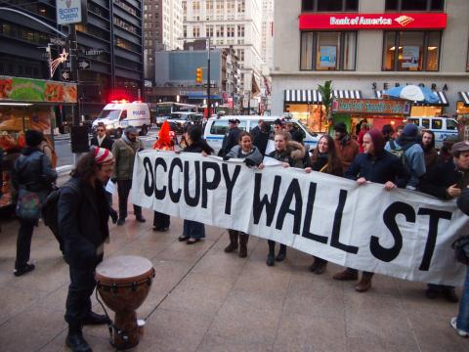
Freedom of Speech
… refers to the ability of a person to publicly speak or publish any thought without legal constraints or repercussions.
In this section:
Web Empowerment
Internet Censorship
Internet Decency
Computer-Based Violence
Network Neutrality
Links:
Video: Clinton on Internet Freedoms
Issues > Freedom of Speech

Slide 2
Web Empowerment
Web empowerment refers to the power that the web provides for individuals to express themselves, influence others, and affect the course of society.
People are taking advantage of the power to express dissatisfaction and offer constructive – and sometimes destructive – criticism to those in positions of power.
Links:
Video: Revolution Truth - WikiLeaks and a Truth Revolution
Issues > Freedom of Speech > Web Empowerment
Notes:
Bullet 2 modified

Slide 3
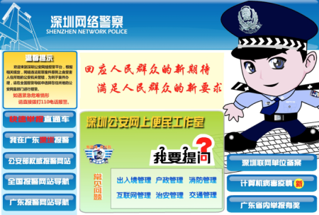
Internet Censorship
Finding the right balance between freedom of speech and censorship can mean the difference between a free democracy and totalitarian rule.
Internet censorship refers to the control of speech and other forms of expression over the Internet and web by a government or authority.
Links:
Video: It's dark behind 'the great firewall' of China
Video: How Internet Censorship Works
Issues > Freedom of Speech > Internet Censorship

Slide 4
Internet Decency
Internet decency refers to efforts by governments and others to rid the Internet and web of content that they consider indecent or to filter indecent content from some users.
Because the Internet does not have a rating system like motion pictures and television, theoretically, anyone who can connect to the Internet can view any content there.
Links:
Video: The Day the Internet Went Dark
Issues > Freedom of Speech > Internet Decency

Slide 5
Computer-Based Violence
Computer-based violence refers to acts of interactive simulated violence provided by computer games.
Are violent gamers more likely to be aggressive in the real world, transferring what they learn in the gaming environment to real life?
This is a hotly debated issue that involves many people and governments around the world.
Links:
Video: Can Violent Video Games Play a Role in Violent Behavior?
Issues > Freedom of Speech > Computer-Based Violence

Slide 6
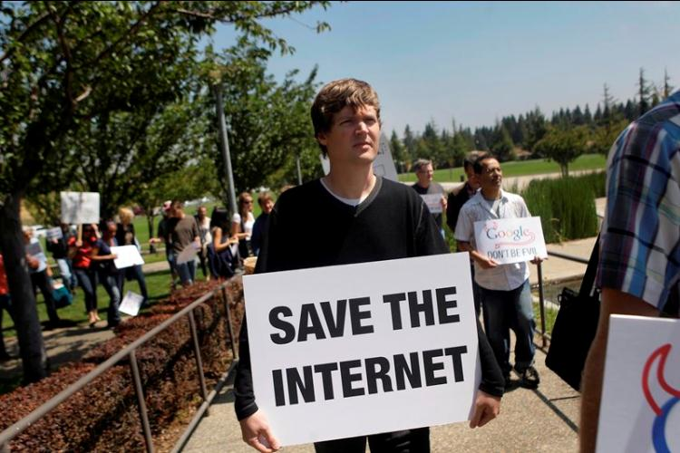
Network Neutrality
The Internet was designed to be a free and unfettered communications medium. Now that big telecom companies control access to the Internet, many worry that they may begin filtering Internet traffic and giving some traffic precedence.
Network neutrality refers to a principle applied to high-speed Internet services whereby all data is delivered to all users with equal priority.
Links:
Video: Net Neutrality Essential in Minority Communities
Issues > Freedom of Speech > Network Neutrality

Slide 7
Freedom of Speech
Freedom of Speech
Terms
Freedom of speech
Web empowerment
Internet censorship
Libel
Internet decency
Content-filtering software
Computer-based violence
Network neutrality
Issues > Freedom of Speech > See your eBook for more information about these terms

