Slide 1
Digital Life
… refers to the influence of digital technologies on the manner in which people live their lives.
In this section:
Information Overload | Flash Mob
Ubiquitous Computing | Repetitive Stress Injury
Etiquette | Ergonomics
Distracted Driving | Computer Addictions
Links:
Video: Memoto Lifelogging Camera
Issues > Digital Life

Slide 2
Information Overload
Information overload refers to individuals’ and organizations’ inability to cope with the huge and growing amount of information being collected, stored, analyzed, and delivered.
One of the greatest challenges of the information age is managing the huge and growing amount of data collected from every transaction and activity taking place online.
Links:
Video: Digital Junkie - Information Overload
Issues > Digital Life > Information Overload

Slide 3
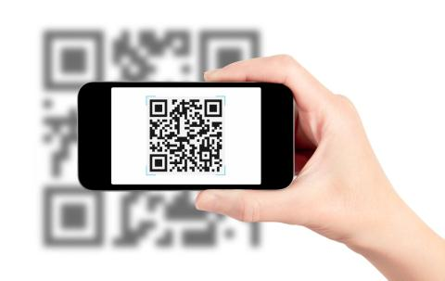
Ubiquitous Computing
Ubiquitous computing refers to a culture where digital technologies are embedded in the environment, making interaction with the technologies second nature.
Digital services of all kinds delivered by numerous Internet-connected devices are increasingly becoming part of our environment.
Links:
Video: Ubiquitous Computing
Video: What is RDIF & How RFID works
Issues > Digital Life > Ubiquitous Computing

Slide 4
Etiquette
Etiquette refers to using digital technologies in a manner that is respectful to others.
Interacting with each other through digital technologies brings opportunities for misunderstanding, rudeness, and hurt feelings.
Links:
Video: Social Media Etiquette / Photos
Issues > Digital Life > Etiquette

Slide 5
Distracted Driving
Distracted driving occurs when drivers focus on their cell phones or other distractions rather than on the road.
Many governments have passed laws prohibiting people from driving while using digital devices.
Links:
Video: Cell Phone while driving
Issues > Digital Life > Distracted Driving

Slide 6
Flash Mob
A flash mob is a group of people who utilize digital technologies to assemble suddenly in a public place, do something unusual, and then disperse, in order to gain attention or to create confusion and sometimes amusement.
Protests have been organized in a matter of minutes – an example of the capability of technology to empower individuals to combine their efforts with dramatic effects.
Links:
Video: Russian flash mob performs
Issues > Digital Life > Flash Mob

Slide 7
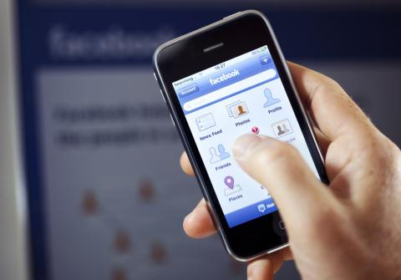
Repetitive Stress Injury
While engaged and interacting online, portions of the body are sometimes placed in awkward positions for extended periods of time, which can lead to repetitive stress injuries.
Repetitive stress injury (RSI) occurs when a particular physical motion is repeated frequently, to the point of injury.
Links:
Video: Remedies For Carpal Tunnel Syndrome
Issues > Digital Life > Repetitive Stress Injury

Slide 8
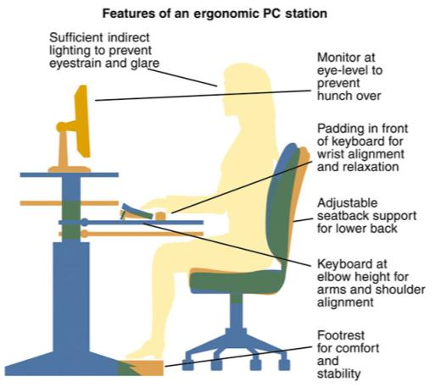
Ergonomics
Ergonomics is the study of designing the work environment and positioning computer equipment in a healthy manner.
Knowing how to address the strains and stresses on your body from using digital technologies will help you to lead a healthier digital lifestyle.
Links:
Video: Ergonomics important when using laptops
Issues > Digital Life > Ergonomics

Slide 9
Computer Addictions
Too much of any activity can lead to an unbalanced life and, sometimes, to a lack of control over your own actions. When a person is unable to control an impulse to engage in some activity, that person is addicted.
Computer addictions refer to the compulsive use of digital technologies such as the Internet, video games, online gambling, and pornography.
Links:
Video: Is Computer Addiction Real?
Issues > Digital Life > Computer Addictions

Slide 10
Digital Life
Terms
Digital Life
Information overload
Ubiquitous computing
Pervasive computing
Etiquette
Netiquette
Distracted driving
Flash mob
Repetitive stress injury (RSI)
Carpal tunnel syndrome (CTS)
Ergonomics
Computer addictions
Issues > Digital Life > See your eBook for more information about these terms

