Slide 1
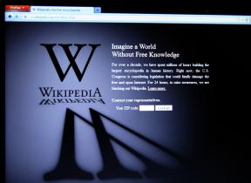
Intellectual Property Rights
… concern the legal ownership and use of intellectual property, such as software, music, movies, data, and information.
In this section:
Piracy
Plagiarism
Digital Rights Management (DRM)
Digital Millennium Copyright Act (DMCA)
Links:
Video: Too Much Copyright
Issues > Intellectual Property Rights

Slide 2
Intellectual Property Rights
Protection | Description
Copyright | Protects the words, music, and other expressions for the life of the copyright holder plus 70 years. The fair use doctrine describes when and how copyrighted material can be legally used. The Digital Millennium Copyright Act provides global copyright protection.
Trademark | Protects a unique symbol or word used by a business to identify a product or service.
Trade secret | Protects secrets or proprietary information of individuals and organizations as long as the trade secret is adequately protected.
Patent | Protects an invention by giving the patent holder a monopoly on the use of the invention for 20 years after the patent application was submitted.
Issues > Intellectual Property Rights

Slide 3
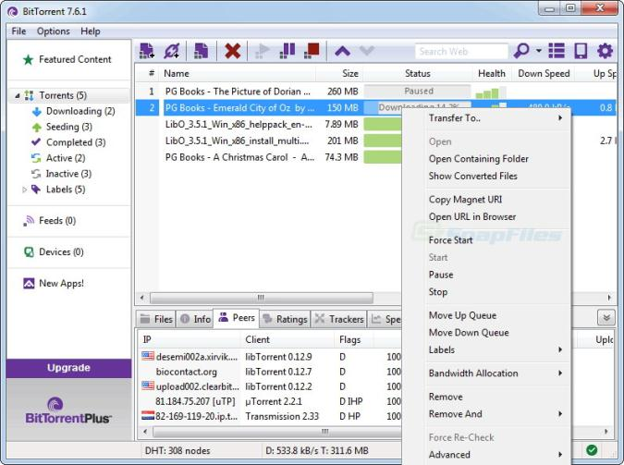
Piracy
Piracy involves the illegal copying, use, and distribution of digital intellectual property, such as software, music, and movies.
The prolific amount of piracy is forcing technology industries and governments to react with repressive technologies and legislation that some feel inhibit the natural evolution of culture.
Links:
Video: Fake Apple stores found in China
Issues > Intellectual Property Rights > Piracy

Slide 4
Plagiarism
Giving credit where credit is due and respecting intellectual property rights are foundational principles of ethical behavior.
Plagiarism involves taking credit for someone else’s intellectual property, typically a written idea, by claiming it as your own.
Links:
Video: A Quick Guide to Plagiarism
Issues > Intellectual Property Rights > Plagiarism

Slide 5
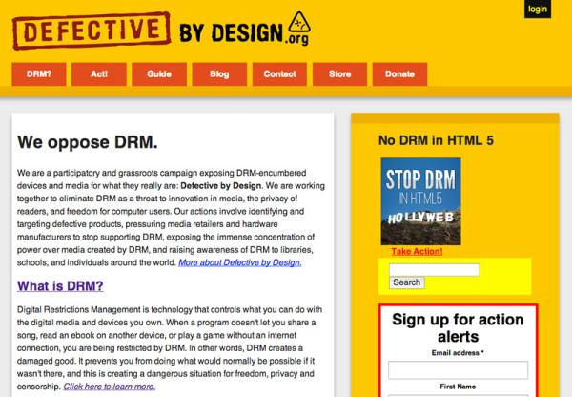
Digital Rights Management (DRM)
Digital rights management, or DRM, is technology that protects digital forms of intellectual property by restricting the number of devices and applications on which a file can be opened and the number of times that the file can be copied and burned to disk.
There is concern that restrictions on digital products may become tighter, pushing DRM onto hardware, so that it is impossible to make copies of any digital media.
Links:
Video: Defective by Design
Issues > Intellectual Property Rights > Digital Rights Management (DRM)

Slide 6
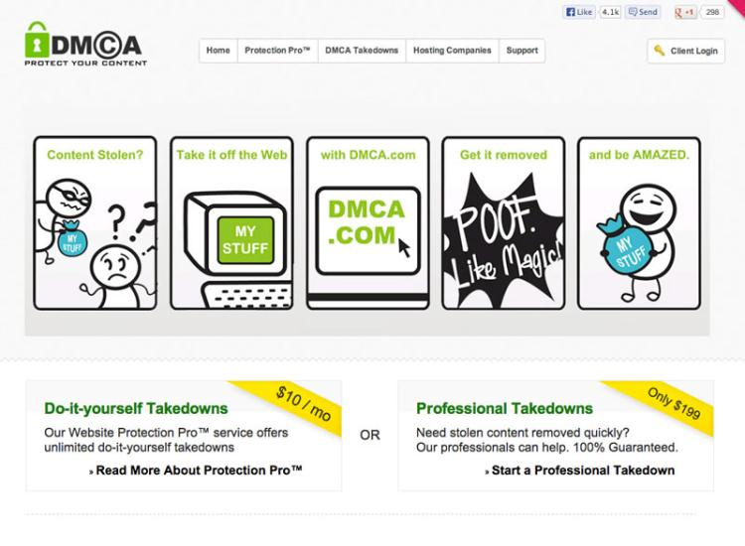
Digital Millennium Copyright Act (DMCA)
The Digital Millennium Copyright Act (DMCA) is a U.S. copyright law designed to reduce illegal digital media copying by criminalizing the production, distribution, and use of technologies designed to circumvent DRM technologies.
When laws oppose common public practice, it is common for public unrest to grow around the issue.
Issues > Intellectual Property Rights > Digital Millennium Copyright Act (DMCA)

Slide 7
Intellectual Property Rights
Terms
Intellectual Property | Piracy
Copyright | Plagiarism
Trademark | Digital Rights Management (DRM)
Trade secret | Digital Millennium Copyright Act (DMCA)
Patent
Issues > Intellectual Property Rights > See your eBook for more information about these terms

