Slide 1
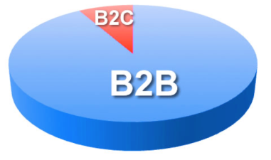
Ecommerce
… or electronic commerce refers to systems that support electronically executed business transactions.
B2C | B2B | C2C
In this section:
Ecommerce Implementation
Ecommerce Technologies
Links:
Video: Gene Alvarez, Gartner, Discusses the Impact of Mobility in Ecommerce
Concepts > Ecommerce

Slide 2
Ecommerce Implementation
… refers to the manner in which ecommerce addresses the needs of buyers and sellers.
In this section:
Etail | B2B Electronic Exchange
Online Auctions | Mcommerce
B2B Global Supply Management | Online Advertising
Some form of ecommerce is behind just about all business transactions today.
Links:
Video: Shopping Online? These Robots Will Fill Your Order
Concepts > Ecommerce > Ecommerce Implementation

Slide 3
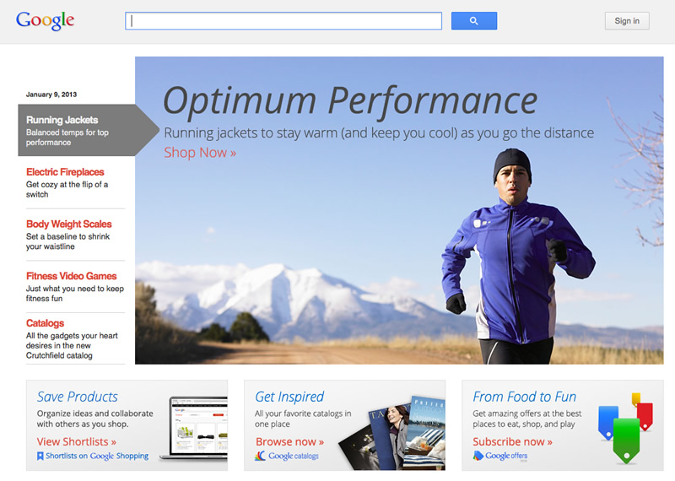
Etail
Etail refers to several forms of electronic retail business that make up B2C ecommerce.
Etail has dramatically influenced the way people shop by providing customers with product information and the ability to comparison shop online.
Links:
Video: Augmented Reality Online Shopping
Concepts > Ecommerce > Ecommerce Implementation > Etail

Slide 4
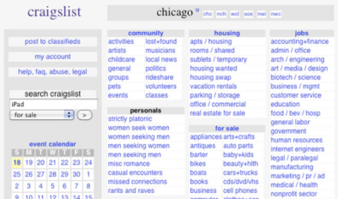
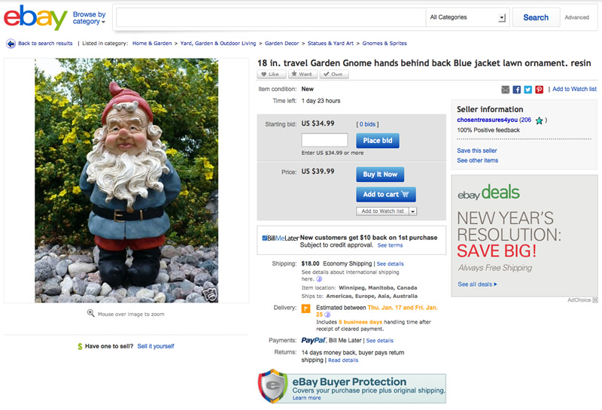
Online Auctions
Online auctions, clearinghouses, and marketplaces provide a platform for businesses and individuals to sell their products and belongings.
Links:
Video: Ebay Parody Song - Weird Al Yankovic
Concepts > Ecommerce > Ecommerce Implementation > Online Auctions

Slide 5
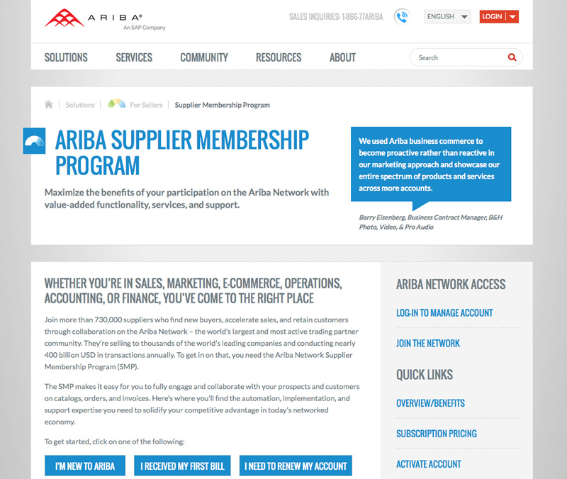
B2B Global Supply Management
A global supply management (GSM) service provides methods for businesses to find the best deals on the global market for raw materials and supplies needed to manufacture their products.
You know that the Internet serves as an ideal way for businesses to connect. The real challenge lies in organizing relationships between businesses.
Links:
Video: Alibaba.com Business Tips: Finding Suppliers and Manufacturers
Concepts > Ecommerce > Ecommerce Implementation > B2B Global Supply Management

Slide 6
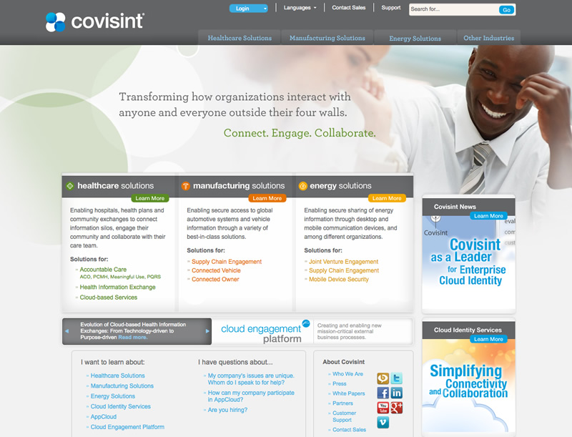
B2B Electronic Exchange
An electronic exchange is an industry-specific web resource created to provide a convenient centralized platform for B2B ecommerce among manufacturers, suppliers, and customers.
Businesses competing in the same industry sometimes find it beneficial to cooperate in order to advance the industry. Electronic exchanges are based on this philosophy and act as a bridge between competitors, buyers, and sellers within a specific industry.
Concepts > Ecommerce > Ecommerce Implementation > B2B Electronic Exchange

Slide 7
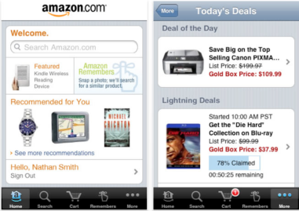
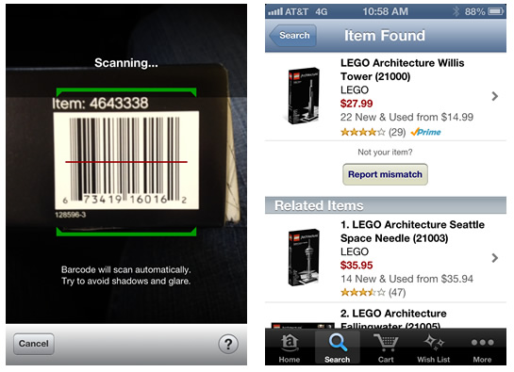
Mcommerce
Mcommerce, or mobile commerce, is a form of ecommerce that takes place over wireless mobile devices such as smart phones and tablets.
Mcommerce isn’t just about digital merchandise; today just about any product or service can be purchased from a mobile device.
Links:
Video: Zaarly: Buyer and Seller
Concepts > Ecommerce > Ecommerce Implementation > Mcommerce

Slide 8
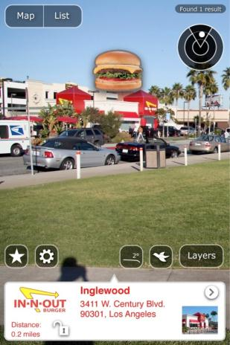
Online Advertising
Online advertising provides businesses with many options for informing the public about products and services on the Internet and web.
There are many methods for advertising online, including search engine optimization, online business partnerships, ad-sponsored websites, games and apps, pages on Facebook or Google+, email, social media, daily deals pop-ups, and location-based ads.
Links:
Video: What's YOUR Social Media Marketing Strategy?
Concepts > Ecommerce > Ecommerce Implementation > Online Advertising

Slide 9
Ecommerce Implementation
Cybermall
Online Auctions
B2B Global Supply Management (GSM)
Collaborative Business Commerce Solutions
Spend Management Services
B2B Electronic Exchange
Mcommerce
Proximity Payment System
Online Advertising
Search Engine Optimization
Reputation Management
Location-based advertising
Terms
Ecommerce
Business-to-consumer (B2C)
Business-to-business (B2B)
Consumer-to-consumer (C2C)
Ecommerce Implementation
Etail
Concepts > Ecommerce > Ecommerce Implementation > See your e-book for more information about these terms

Slide 10
Ecommerce Technologies
… include software and systems that support safe and secure transactions over networks and the Internet, and make ecommerce possible.
In this section:
Electronic Data Interchange (EDI)
Ecommerce Host
Ecash
Links:
Video: Square is for Everyone
Concepts > Ecommerce > Ecommerce Technologies

Slide 11
Electronic Data Interchange (EDI)
Electronic data interchange (EDI) uses private communications networks called value-added networks (VANs), as well as secure Internet technologies, to transmit standardized transaction data between business partners and suppliers.
Long before the birth of the Internet, electronic data interchange was developed to transfer funds electronically.
Links:
Video: Supply Chain Problems Solved with DiCentral
Concepts > Ecommerce > Ecommerce Technologies > Electronic Data Interchange (EDI)

Slide 12
Ecommerce Host
An ecommerce host is a company that takes on some or all of the responsibility of setting up and maintaining an ecommerce website and system for a business.
Setting up and maintaining the infrastructure necessary for ecommerce is a big job. Most companies choose to outsource these tasks to professional ecommerce hosting companies.
Links:
Video: Turn Your Idea Into an Online Business with Volusion
Concepts > Ecommerce > Ecommerce Technologies > Ecommerce Host

Slide 13
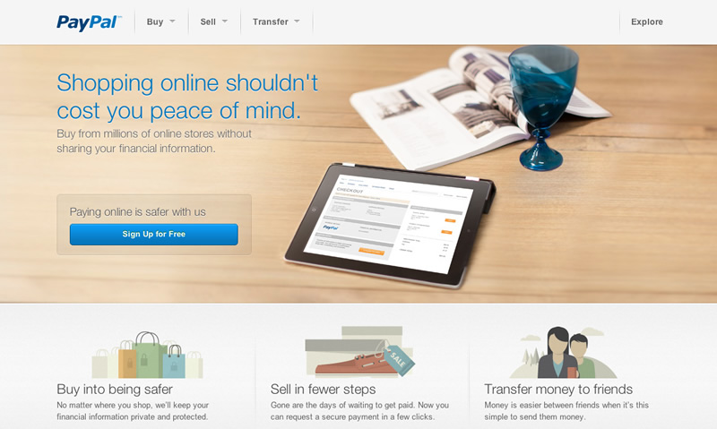
Ecash
Ecash or electronic cash is a web service that provides a private and secure method of transferring funds from a bank account or credit card to online vendors or individuals.
Ecash expands ecommerce to individuals who might not otherwise be able or willing to participate.
Links:
Video: Google Wallet Overview
Concepts > Ecommerce > Ecommerce Technologies > Ecash

Slide 14
Ecommerce Technologies
Terms
Ecommerce Technologies
Electronic Data Interchange (EDI)
Value-Added Network (VAN)
Ecommerce Host
Ecash
Concepts > Ecommerce > Ecommerce Technologies > See your e-book for more information about these terms

