Slide 1
Digital Media
… refers to digital technologies of all kinds that serve and support digital publishing and broadcasting, and digital audio, video, and graphics.
In this section:
Digital Publications | Digital Photography
Digital Audio | Digital Video
Digital Graphics | Interactive Media
Digital media is transforming how we access news and entertainment.
Concepts > Digital Media

Slide 2
Digital Publications
… include eBooks, electronic magazines, online newspapers, blogs, and other forms of traditional publishing that have moved online.
The popularity of the web provided a digital platform for print media that made it easier to distribute publications to more readers.
In this section:
eBooks
Online Newspapers and Magazines
Links:
Video: See Wired Magazine on iPad
Concepts > Digital Media > Digital Publications

Slide 3
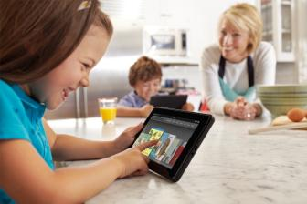
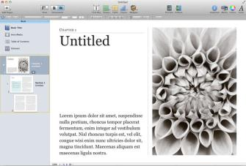
eBooks
eBooks are books published in a digital format viewed online or with special eBook software on a dedicated reading device – an eReader, smart phone, tablet, or PC.
Increasing numbers of old books and newly published books are going through a digitization process, transforming them into eBooks.
Links:
Video: Apple iPad Guided Tour - iBooks
Concepts > Digital Media > Digital Publications > eBooks
Notes:
Bullet 2 modified

Slide 4
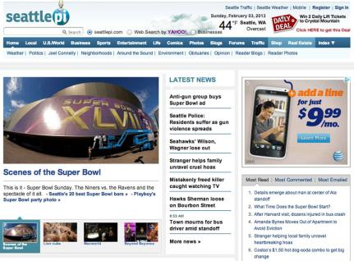
Online Newspapers and Magazines
Online newspapers and magazines include electronic versions of print newspapers and magazines as well as online-only publications that provide news and information in an increasingly multimedia format.
Links:
Video: iPad TIME Magazine Digital Magazine Creation
Concepts > Digital Media > Digital Publications > Online Newspapers and Magazines
Notes:
Bullet 2 modified

Slide 5
Digital Publications
Terms
Digital Media
On-demand Media
Digital Publications
Media
eBooks
Online Newspapers and Magazines
Concepts > Digital Media > Digital Publications > See your eBook for more information about these terms

Slide 6
Digital Audio
… is any type of sound, including voice, music, and sound effects, recorded and stored digitally as a series of 1s and 0s.
The ability to digitize sound has dramatically altered phone networks, radio, television, and the entertainment and music industries.
In this section:
Sampling | Audio File Formats | Digital Music Software
Digital Audio Production | Digital Music Player | Digital Music Distribution
Podcast
Links:
Video: deadmau5 - Strobe live @ SPACE
Concepts > Digital Media > Digital Audio

Slide 7
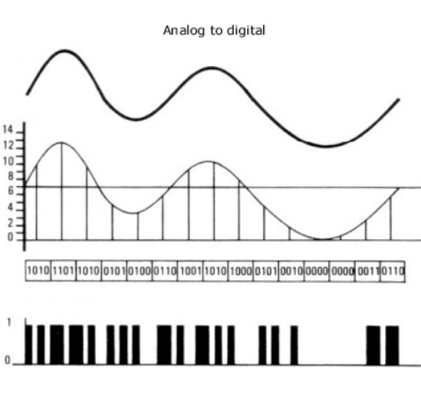
Sampling
Sampling is the process of capturing the value of a sound wave at regular intervals, typically thousands of times per second, to store sound and music digitally.
Links:
Video: Aphex Twin - Equation
Concepts > Digital Media > Digital Audio > Sampling
Notes:
Bullet 2 modified

Slide 8
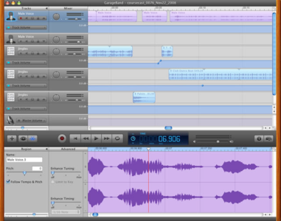
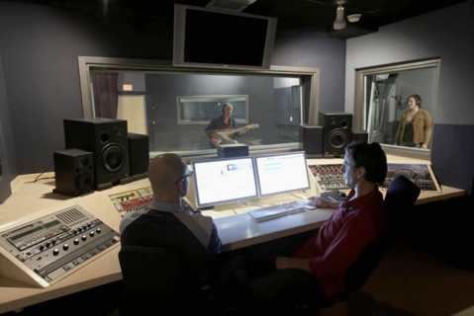
Digital Audio Production
Once in existence, a digital audio file can be copied and transferred to a variety of formats and media.
Digital audio production refers to methods of capturing, creating, editing, and enhancing digital audio.
Links:
Video: Digitrax Studio Tour
Concepts > Digital Media > Digital Audio > Digital Audio Production

Slide 9
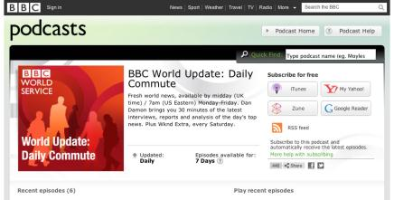
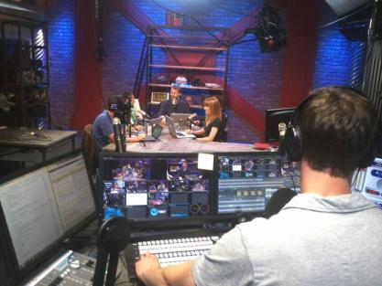
Podcast
A podcast is an audio file that contains a recorded broadcast distributed over the Internet.
Podcasting gets its name from the Apple iPod, but the technology can be used on any digital music player or digital music software that supports the MP3 format.
Concepts > Digital Media > Digital Audio > Podcast

Slide 10
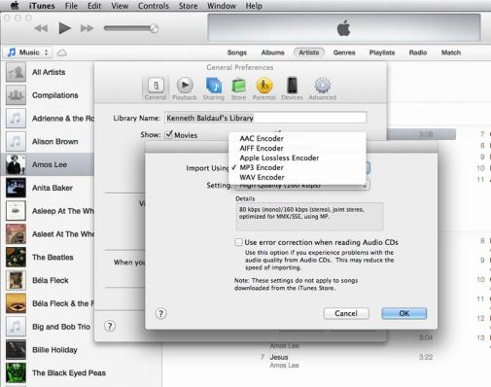
Audio File Formats
Digital audio file formats define the manner in which digital audio is stored in a digital file, offering varying benefits in compatibility, storage capacity, or sound quality, depending on the format.
.wav | .aiff | .mp3 | .wma | .aac, .m4a, .m4p
Concepts > Digital Media > Digital Audio > Audio File Formats

Slide 11
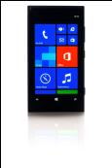
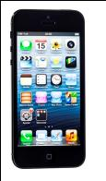
Digital Music Player
A digital music player is a portable or home electronics device that plays digital music that is stored on the device or streamed from a computer or the Internet.
Not all players work with all formats of digital music – understand the differences in players and music formats in order to choose the one that best suits your needs.
Links:
Video: Music on Google Play
Concepts > Digital Media > Digital Audio > Digital Music Player

Slide 12
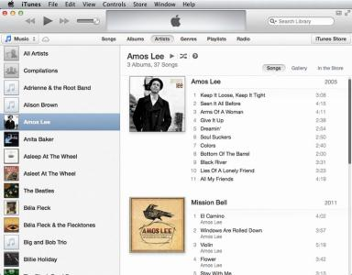
Digital Music Software
Digital music software is used to acquire, manage, and listen to digital music and to encode music to various audio formats.
Links:
Video: Spotify -- the story
Concepts > Digital Media > Digital Audio > Digital Music Software

Slide 13
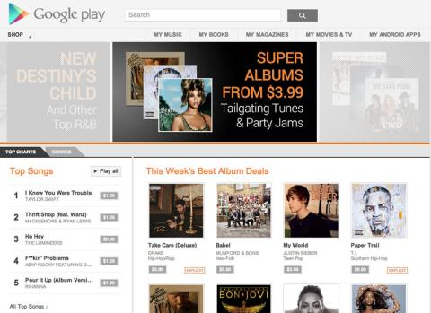
Digital Music Distribution
Digital music distribution takes many forms to address many listening environments, including CD, online music services, cell phone music services, podcasts, Internet radio, satellite radio, and HD radio.
Links:
Video: Xbox Music
Concepts > Digital Media > Digital Audio > Digital Music Distribution

Slide 14
Digital Audio
Jukebox Software
Ripping
Ripper Software
Encoder Software
Digital Music Distribution
Freemium
Internet Radio
Wi-Fi Radios
Satellite Radio
Terms
Digital Audio
Forensic Audio
Sampling
Analog Signal
Analog-to-Digital Conversion (ADC)
Digital-to-Analog Conversion (DAC)
Bit Rate
Digital Audio Production
Digital Voice Recorder
Musical Instrument Digital Interface (MIDI)
Podcast
Audio File Formats
Digital Audio Compression
MP3
Digital Music Software
Media Player Software
Concepts > Digital Media > Digital Audio > See your eBook for more information about these terms

Slide 15
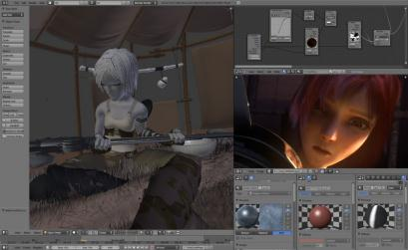
Digital Graphics
… refers to computer-based media applications that support creating, editing, and viewing 2D and 3D images and animation.
In this section:
RGB Color | Visualization
Vector Graphics Software | Computer-Aided Design (CAD)
Graphics File Formats | Animation
3D Modeling
Concepts > Digital Media > Digital Graphics

Slide 16
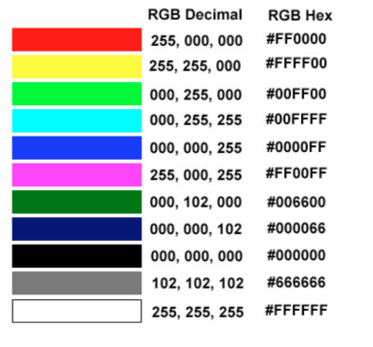
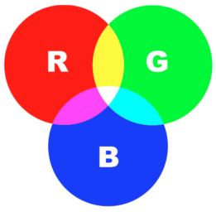
RGB Color
RGB color refers to a method of specifying color digitally using values for the intensity levels of red, green, and blue (RGB) as combined to create all colors.
Links:
Video: Sessions - Color Theory: Color Wheel
Concepts > Digital Media > Digital Graphics > RGB

Slide 17
Vector Graphics Software
Vector graphics software, sometimes called drawing software, provides tools to create, arrange, and layer graphical objects on the screen.
Vector graphics software allows graphic artists and designers to layer and arrange shapes and objects, drawn figures, and even photographed objects to create composite images for commercial and artistic uses.
Links:
Video: How to Design a Logo using Adobe Illustrator
Concepts > Digital Media > Digital Graphics > Vector Graphics Software

Slide 18
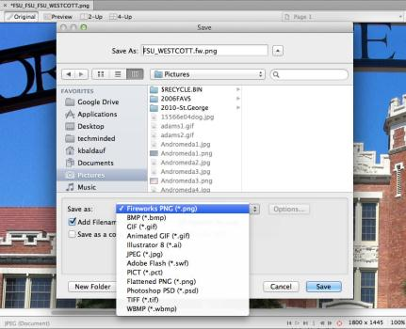
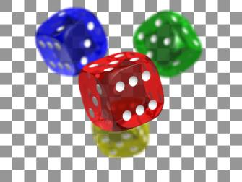
Graphics File Formats
Graphics file formats, such as .bmp, .gif, .jpg, and .tif, are designed to store various types of graphics images for varying purposes.
Concepts > Digital Media > Digital Graphics > Graphics File Formats

Slide 19
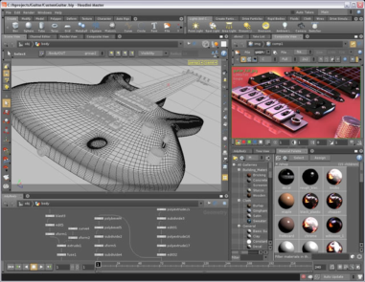
3D Modeling
3D modeling, also called ray tracing, utilizes sophisticated software graphics tools to create realistic 3D models that can be rotated and viewed from any angle in a virtual environment.
Engineers, architects, designers, video game designers, artists, animators, and motion picture producers all make use of 3D modeling software.
Links:
Video: NewTek's Lightwave 10
Concepts > Digital Media > Digital Graphics > 3D Modeling

Slide 20
Visualization
Visualization is a general term that refers to the use of imagery to communicate an idea.
Visualization enables people to present information in a more accessible and meaningful manner than text and numbers, and also to discover meaning in data.
Links:
Video: Cool-Amazing Scientific Computer Simulations
Concepts > Digital Media > Digital Graphics > Visualization

Slide 21
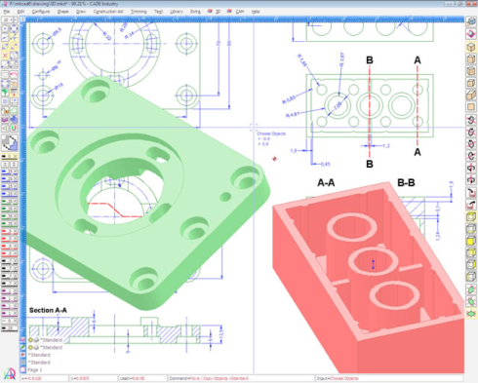
Computer-Aided Design (CAD)
Computer-aided design (CAD) uses software to assist designers, engineers, artists, and architects in designing two-dimensional and three-dimensional objects.
CAD software is the primary tool of design professionals, allowing them to build accurate models that reflect the physics of the real world.
Links:
Video: Autodesk Inventor Professional Simulation
Concepts > Digital Media > Digital Graphics > Computer-Aided Design (CAD)
Notes:
Bullet 2 modified

Slide 22
Animation
Animation involves displaying digital images in rapid succession to create the illusion of motion.
Advances in processing power and digital graphics technologies have allowed artists to render realistic worlds in virtual space. Computer animation plays an important role in today’s motion pictures and interactive media.
Links:
Video: Muffin City
Concepts > Digital Media > Digital Graphics > Animation
Notes:
Bullet 2 modified

Slide 23
Digital Graphics
Lossless Compression
Lossy Compression
3D Modeling
Ray Tracing
Rendering
Visualization
Scientific Visualization
Computer-Aided Design (CAD)
Animation
Animated GIF
3D Computer Animation
Terms
Digital Graphics
Pixels
Bitmapped/Raster Graphics
Vector Graphics
RGB Color
Bit Depth
CMYK Color Model
Color Theory
Vector Graphics Software
Graphics File Formats
Concepts > Digital Media > Digital Graphics > See your eBook for more information about these terms

Slide 24
Digital Photography
… is a form of photography that captures, stores, and manipulates photographs digitally as a series of 1s and 0s.
Digital photography and digital photo editing are sometimes referred to collectively as digital imaging.
In this section:
Digital Camera | Photo Printing
Photo Editing | Online Photo Album
Links:
Video: Photography Tips, Essential Skills
Concepts > Digital Media > Digital Photography

Slide 25
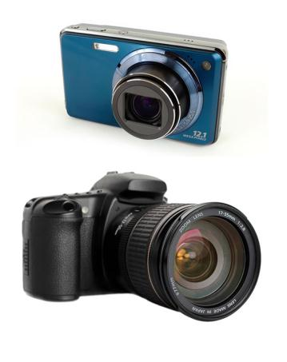
Digital Camera
Considerations
Resolution | Lens & Sensor | Price
Camera size | Display size & quality | Lens type
Storage media | Photo file format | Interfaces
Exposure controls | Focus controls | Flash modes
Software | Multimedia | Battery
A digital camera is a camera that captures photographs, and sometimes video, and stores them digitally rather than on film.
Links:
Video: Canon PowerShot G1 X
Concepts > Digital Media > Digital Photography > Digital Camera

Slide 26
Photo Editing
Photo editing is the process of altering digital photographs, using software tools.
Photo editing software allows you to:
Alter hue & saturation
Smooth surfaces & remove flaws
Remove “red eye”
Smooth edges & sharpen focus
Crop & realign photos
Links:
Video: Is Instagram the Best Thing to Ever Happen to Photography?
Concepts > Digital Media > Digital Photography > Photo Editing

Slide 27
Photo Printing
Photo printing refers to the methods and resources available for transforming digital images into printed images.
There are several options for printing digital photos. Choosing the right one can save time, effort, and money.
Links:
Video: How to Print Instagram at Walgreens
Concepts > Digital Media > Digital Photography > Photo Printing

Slide 28
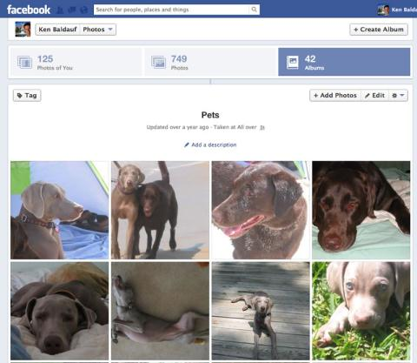
Online Photo Album
An online photo album is typically hosted by a service that allows members to upload photos to web servers to share with individuals or the entire web population.
The most popular online photo album services are Yahoo!’s Flickr, Google’s Picasa, Shutterfly, SmugMug, Snapfish, and Photobucket. Social networks like Twitter and Facebook also have photo album capabilities.
Links:
Video: Why Photographers Love SmugMug Pro
Concepts > Digital Media > Digital Photography > Online Photo Album
Notes:
Bullet 2 modified

Slide 29
Digital Photography
Terms
Digital Photography
Digital Imaging
Digital Camera
Megapixels
Photo Editing
Photo Printing
Online Photo Album
Concepts > Digital Media > Digital Photography > See your eBook for more information about these terms

Slide 30
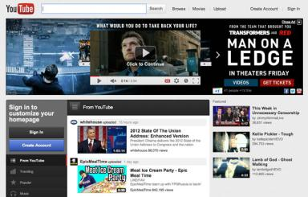
Digital Video
… stores a progression of digital photographs and displays them at 24 to 30 photos, or frames, per second (fps) to give the illusion of a smoothly flowing scene.
In this section:
Camcorder
Video Editing
Links:
Video: Video Tips: Using Your Webcam
Concepts > Digital Media > Digital Video

Slide 31
Camcorder
A camcorder is a digital video camera.
Camcorders allow ordinary people to create professional-looking videos in regular-definition, high-definition, and 3D formats.
Links:
Video: Panasonic debuts first consumer 3D camcorder
Concepts > Digital Media > Digital Video > Camcorder

Slide 32
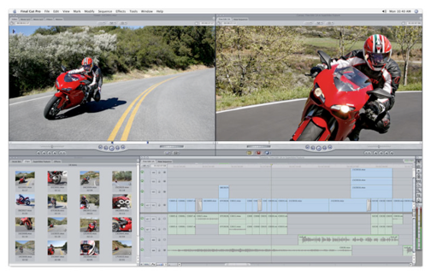
Video Editing
Video editing makes use of special software that allows professionals and amateurs to edit video footage by deleting scenes, combining scenes, and adding transitions and other effects to create a professional-style video production.
Links:
Video: Apple iMovie - One-step Effects
Concepts > Digital Media > Digital Video > Video Editing
Notes:
Bullet 2 modified

Slide 33
Digital Video
Terms
Digital Video
Forensic Graphics
Camcorder
Video Editing
Concepts > Digital Media > Digital Video > See your eBook for more information about these items

Slide 34
Interactive Media
… refers to digital media that involve user interaction for education, training, or entertainment.
Interactive media allow users to enter and manipulate virtual objects and to interact with other users in a virtual space.
In this section:
Video Game
Virtual Reality
Augmented Reality
Links:
Video: InDex by Digital ArtForms
Concepts > Digital Media > Interactive Media

Slide 35
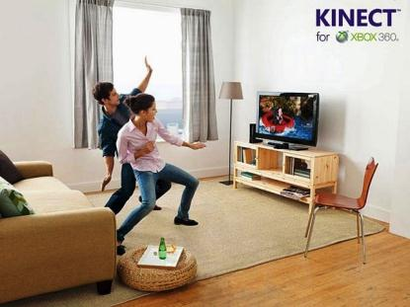
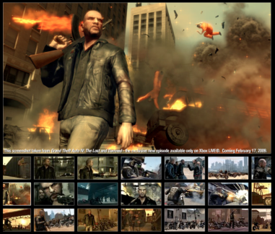
Video Game
A video game uses 2D or 3D interactive digital media to provide gaming entertainment for individuals or groups using handheld devices, game consoles, computers, and the Internet.
Links:
Video: Introducing the PlayStation Move
Concepts > Digital Media > Interactive Media > Video Game
Notes:
Bullet 2 modified

Slide 36
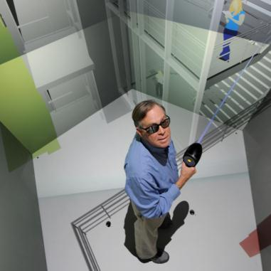
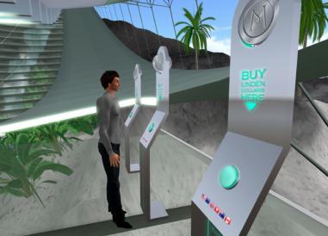
Virtual Reality
Virtual reality is a computer-simulated, three-dimensional environment that can be explored and manipulated by a user.
Links:
Video: Solders Get VR Therapy for Burn Pain
Concepts > Digital Media > Interactive Media > Virtual Reality
Notes:
Bullet 2 modified

Slide 37
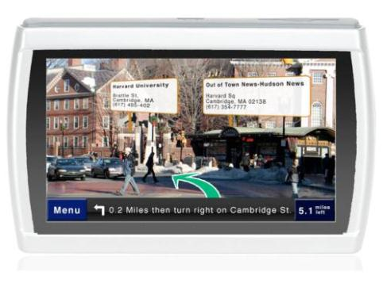
Augmented Reality
Augmented reality displays computer-generated information over objects viewed in real time and space.
One of the benefits of the information revolution is the ability to access information anywhere, anytime. Augmented reality takes this to the extreme by literally layering information over whatever your smartphone’s camera is looking at.
Links:
Video: Layar, worlds first mobile AR browser
Concepts > Digital Media > Interactive Media > Augmented Reality
Notes:
Bullet 2 modified

Slide 38
Interactive Media
Terms
Interactive Media
Video Game
Virtual Reality
Immersive Virtual Reality
Augmented Reality
Concepts > Digital Media > Interactive Media > See your eBook for more information about these terms

