Slide 1
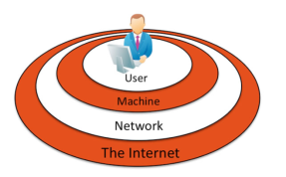
Information Security
… refers to the protection of information systems and the information they manage against unauthorized access, use, manipulation, or destruction, and against the denial of service to authorized users.
Information security is a growing concern as increasing amounts of important and private information are stored digitally on systems connected to public networks and wireless private networks.
In this section:
Machine-Level Security
Network Security
Internet Security
Links:
Video: Straight Talk on Cyber
Concepts > Information Security

Slide 2
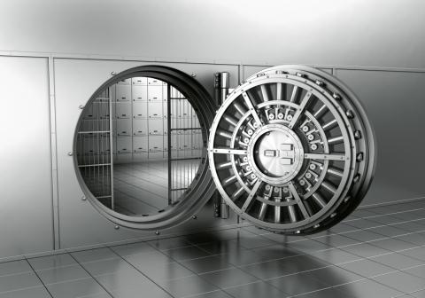
Machine-Level Security
… refers to actions taken to protect information on a computer that may or may not be connected to a computer network or the Internet.
In this section:
Authentication
Encryption
Data Backup
By learning how to protect stand-alone PCs, you also learn about the first line of defense for the networks to which those PCs may be connected.
Concepts > Information Security > Machine-Level Security

Slide 3
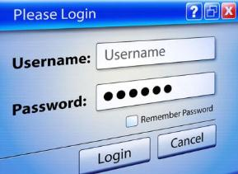
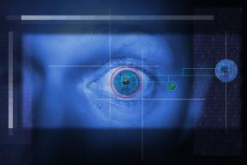
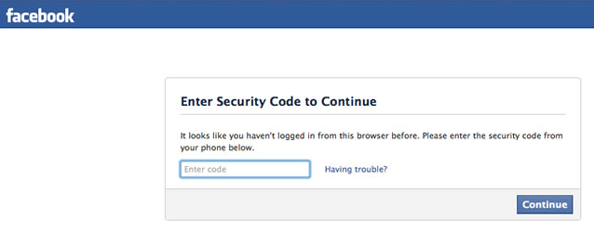
Authentication
Authentication is a security process in which the identity of a person is verified.
Something:
You know
You have
About you
Links:
Video: Galaxy Nexus and Face Unlock
Concepts > Information Security > Machine-Level Security > Authentication

Slide 4
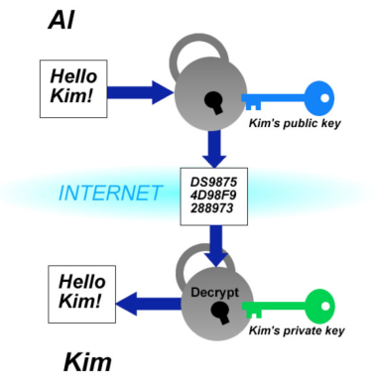
Encryption
Encryption is a security technique that uses high-level mathematical functions and computer algorithms to encode data so that it is unintelligible to all but the sender and recipient.
Encryption techniques help safeguard data that is stored or traveling over a network.
Links:
Video: Lest We Remember
Concepts > Information Security > Machine-Level Security > Encryption

Slide 5
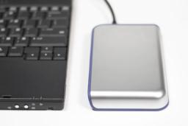
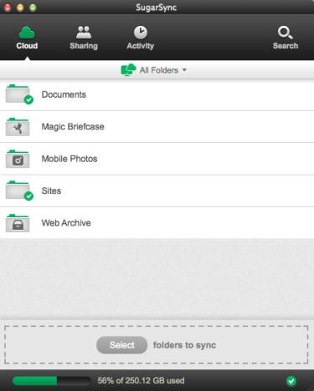
Data Backup
Data backup is a process in which copies of important computer files are stored in a safe place to guard against data loss.
Data may be lost due to hardware failure, human error, software corruption, hackers, malware, or natural disasters.
Links:
Video: Backing Up Your Mac With Time Machine
Video: Create a Bootable System Recovery USB
Concepts > Information Security > Machine-Level Security > Data Backup

Slide 6
Machine-Level Security
Terms
Information security
Total information security
Machine-level security
Authentication
Username
Password
Token
Biometrics
Fingerprint scan
Facial pattern recognition
Retinal scanning
Encryption
Decryption
Wired equivalent privacy (WEP)
Wi-Fi protected access (WPA)
WPA2
Data backup
System recovery disk/recue disk
Full backup
Incremental backup
Mirroring
Redundant array of independent disks (RAID)
Concepts > Information Security > Machine-Level Security > See your eBook for more information about these terms

Slide 7
Network Security
… is concerned with addressing vulnerabilities and threats in computer networks that may or may not be connected to the Internet.
The primary challenge in securing a computer network is keeping user data private and accessible only by authorized persons.
In this section:
Permissions
Interior Threats
Network Usage Policy
Wireless Security
Links:
Video: Protect your IT Network from Internal Network Security Threats
Concepts > Information Security > Network Security

Slide 8
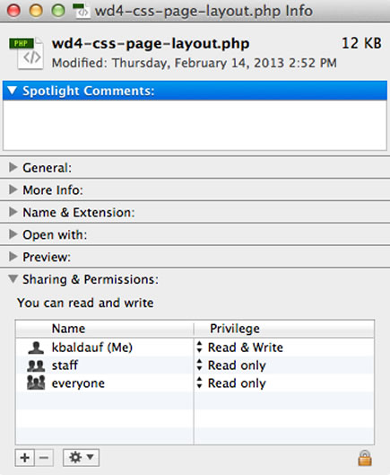
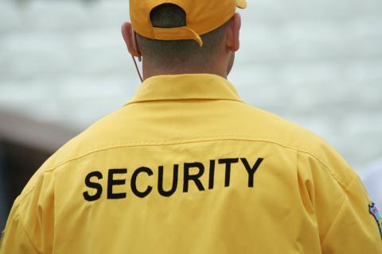
Permissions
Permissions, or file system permissions, refers to the specific access privileges afforded to each network user and each system resource in terms of which files, folders, and drives each user can read, write, and execute.
Concepts > Information Security > Network Security > Permissions

Slide 9
Interior Threats
Data-entry errors
Errors in computer programming
Improper installation and setup of computer systems
Mishandling of computer output
Uninformed dangerous computer activity
Inadequate planning for and control of equipment malfunctions
Inadequate planning for and control of environmental difficulties
Interior threats are network security threats that originate from within a network, typically from registered users.
Links:
Video: Bad day in the Office
Concepts > Information Security > Network Security > Interior Threats

Slide 10
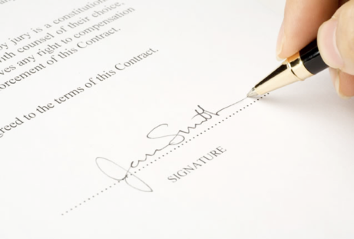
Network Usage Policy
A network usage policy is a document, agreement, or contract that defines acceptable and unacceptable uses of computer and network resources for a business or organization.
Users are held liable for upholding the policies and can lose their network account or job if they violate the rules.
Links:
Video: How to set up an Internet usage policy
Concepts > Information Security > Network Security > Network Usage Policy

Slide 11
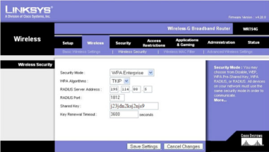
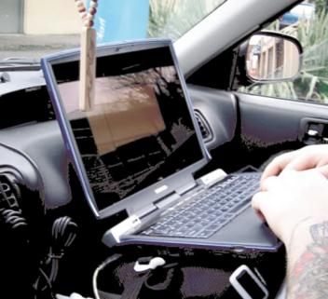
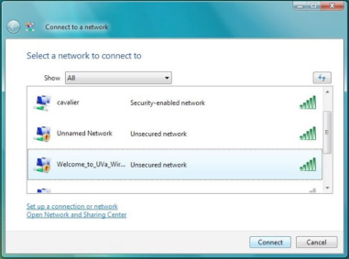
Wireless Security
Wireless security refers to the unique threats and defenses associated with wireless computer networks.
Links:
Video: Dangers of Free WiFi
Concepts > Information Security > Network Security > Wireless Security
Notes:
Bullet 2 modified

Slide 12
Network Security
Terms
Network security
System administrator
Permissions
Multiuser system
User permissions
Interior threats
Network usage policy
Wireless security
War driving
Concepts > Information Security > Network Security > See your eBook for more information about these terms

Slide 13
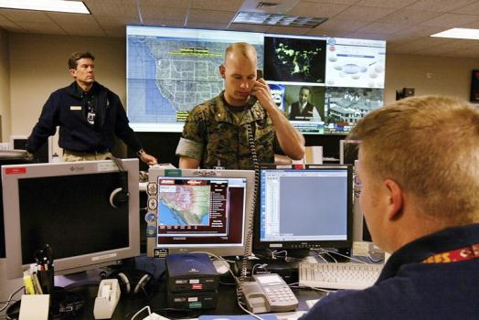
Internet Security
… refers to the unique threats and defenses associated with computers connected to the Internet.
In this section:
Hacker | Antivirus Software | Internet Fraud
Firewall | Botnet | Digital Certificate
Software Patch | Cyber Warfare | Phishing Scam
Malware | Identify Theft
Links:
Video: Facts about Cybercrime
Concepts > Information Security > Internet Security

Slide 14
Hacker
A hacker is an individual who subverts computer security without authorization.
Key-logging software
Packet-sniffing software
Wireless network scanning software
Port-scanning software
Social engineering
Concepts > Information Security > Internet Security > Hacker

Slide 15
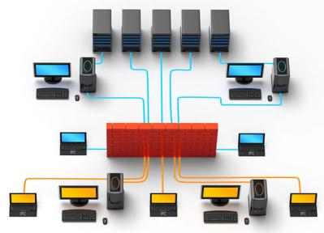
Firewall
A firewall is network hardware or software that examines data packets flowing in and sometimes out of a network or computer in order to filter out packets that are potentially dangerous.
Using a firewall is one of the four pillars of information security, the others being installing software patches, using security software, and practicing safe, cautious online behavior.
Links:
Video: Windows Firewall Complete Guide for Windows 8
Concepts > Information Security > Internet Security > Firewall

Slide 16
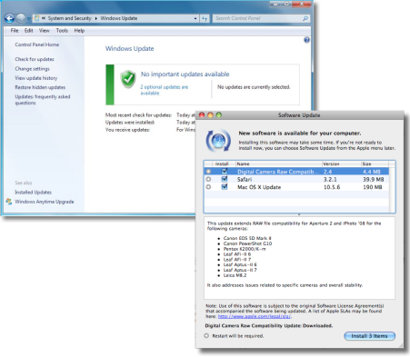
Software Patch
A software patch, sometimes called a security patch, fixes software bugs and flaws and is typically distributed to software users through online software updates.
Software bugs in operating systems, web browsers, and other Internet software can create security holes that hacks may exploit to gain full control of a computer.
Concepts > Information Security > Internet Security > Software Patch

Slide 17
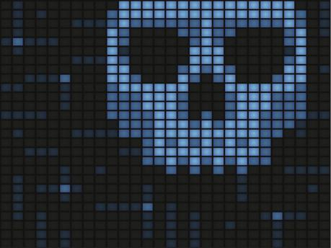
Malware
Malware is short for “malicious software” and includes any software designed to damage, corrupt, or illegally manipulate computer resources. Common forms include viruses, worms, and spyware.
Although sending malware as email attachments used to be the preferred method of distribution, today most malware is spread from webpages.
Links:
Video: Sophos maps malware and spam with Google Earth
Concepts > Information Security > Internet Security > Malware

Slide 18
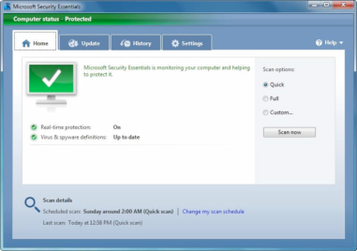
Antivirus Software
Antivirus software, also known as virus scan software, uses several techniques to find viruses, worms, and spyware on a computer system; remove them if possible; and keep additional viruses, worms, and spyware from infecting the system.
Implementing some form of virus protection is a necessity on all types of PCs: Windows and Macs. Without some form of virus protection, it is almost assured that an Internet-connected PC is—or will soon become—infected.
Links:
Video: 'Ransomware' virus locks computer, demands money
Concepts > Information Security > Internet Security > Antivirus Software
Notes:
Bullet 2 modified

Slide 19
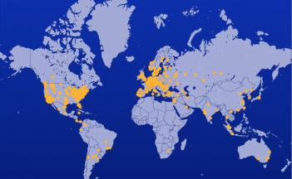
Botnet
A botnet, or botnet army, refers to a collection of computers autonomously or automatically working together toward some goal; these are often zombie computers that are synchronized to perform illegal activities on the Internet.
It is possible that your computer is a soldier in a botnet army. Understanding botnets will help you to free your computer if it has been enslaved and protect your computer from becoming a zombie.
Links:
Video: Symantec Guide to Scary Internet Stuff - Botnets
Concepts > Information Security > Internet Security > Botnet

Slide 20
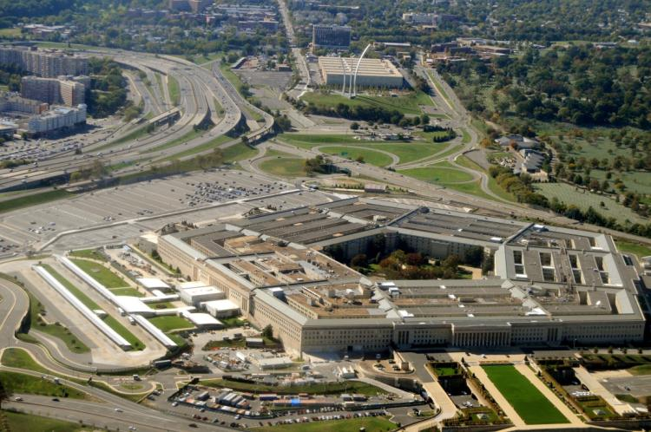
Cyber Warfare
Cyber warfare extends traditional forms of warfare to the Internet and the web, including espionage, psychological warfare, and attacks.
Cyberterrorism extends traditional forms of terrorism to the Internet and the web.
Links:
Video: Obama announces complete overhaul of Cyber Security
Concepts > Information Security > Internet Security > Cyber Warfare
Notes:
Bullet 2 modified

Slide 21
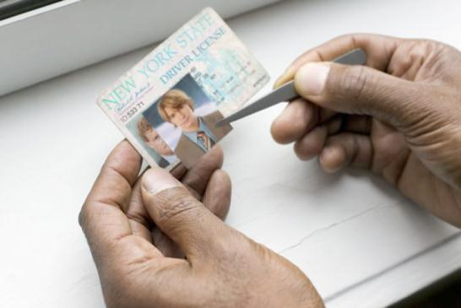
Identity Theft
Identity theft is the criminal act of stealing information about a person to assume that person’s identity in order to commit fraud or other crimes.
Individuals between the ages of 18 and 29 are hardest hit by ID theft.
Links:
Video: Notebook: Identity Theft
Concepts > Information Security > Internet Security > Identity Theft

Slide 22
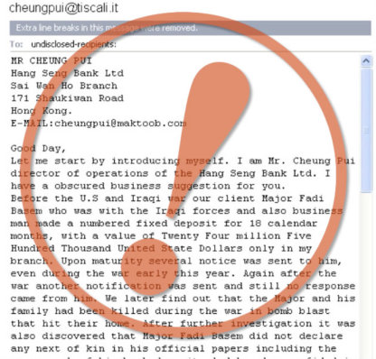
Internet Fraud
Internet fraud is the crime of deliberately deceiving a person over the Internet in order to damage them or to obtain property or services unlawfully.
Hundreds of millions of dollars are stolen each year by online criminals. It is essential to be able to recognize common types of fraud and to protect yourself against them.
Links:
Video: SCAM ALERT: Fake Online Shoe Stores
Concepts > Information Security > Internet Security > Internet Fraud

Slide 23
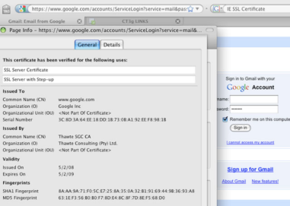
Digital Certificate
A digital certificate, also called an SSL certificate, is a type of electronic business card that is attached to Internet transaction data to verify the sender of the data.
Transaction data must be accessed only by intended parties, and not be intercepted by outsiders.
Links:
Video: VeriSign SSL Certificates
Concepts > Information Security > Internet Security > Digital Certificate

Slide 24
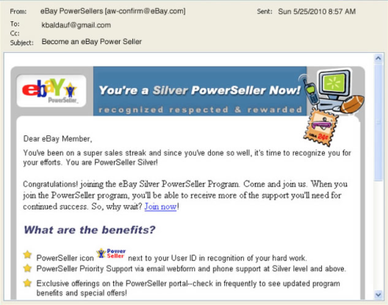
Phishing Scam
A phishing scam combines both fraudulent email and websites in order to trick a person into providing private information that can be used for identity theft.
Phishing scams are some of the most difficult forms of Internet fraud to detect.
Links:
Video: Web of Deceit: Internet Fraud
Concepts > Information Security > Internet Security > Phishing Scam

Slide 25
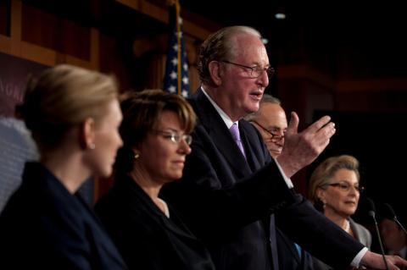
Laws
Information security laws seek to protect the civil rights of populations from abuses of information systems and the Internet.
Securing networks and the information they store takes effort by individuals, businesses, and governments.
Links:
Video: Internet Privacy & Antipiracy Laws
Concepts > Information Security > Internet Security > Laws

Slide 26
Internet Security
Software updates
Malware
Virus
Trojan horse/Trojan/ backdoor Trojan
Virus hoax
Ransomware
Worm
Spyware
Zombie
Drive-by downloads
Terms
Internet security
https://
Hacker
System penetration
Cracker/attacker/ intruder
Key-logging software
Packet-sniffing software
Wireless network scanning software
Wireless sniffing software
Port-scanning software
Social engineering
Dumpster diving
Firewall
Software/security patch
Critical software flaws
Concepts > Information Security > Internet Security > See your eBook for more information about these terms

Slide 27
Internet Security
Spoofing
Digital certificate
Certification authorities
Secure sockets layer (SSL)
Transport layer security (TLS)
Phishing scam
Spear phishing
Pharming
Internet security laws
Terms – continued
Antivirus software
Botnet/botnet army
Distributed denial-of-service attacks (DDoS)
Cyber warfare
Cyberterrorism
Internet theft
Internet fraud
Concepts > Information Security > Internet Security > See your eBook for more information about these terms

