Slide 1

Internet
… is the world’s largest public computer network, a network of networks that provides a vast array of services to individuals, businesses, and organizations around the world.
In this section:
Internet Technologies | Cloud Computing
Web Technologies | Web Resources
Links:
Video: Did You Know - The power of the internet
Concepts > Internet

Slide 2

Internet Technologies
… work together to provide information and services over the Internet, including a variety of protocols, hardware, and software.
In this section: | Internet Service Provider (ISP) | Domain Name System (DNS)
Internet History | Client/Server | Port
Internet Backbone | Peer-to-Peer (P2P) | Voice over IP (VoIP)
TCP/IP | Router | Internet2
Links:
Video: IT Crowd: The Internet
Concepts > Internet > Internet Technologies

Slide 3
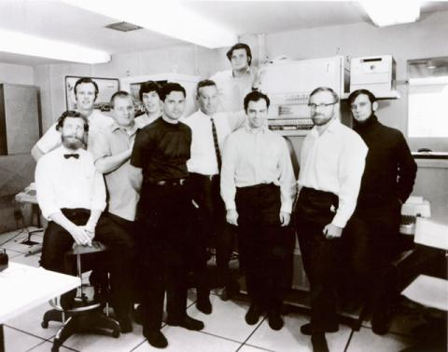
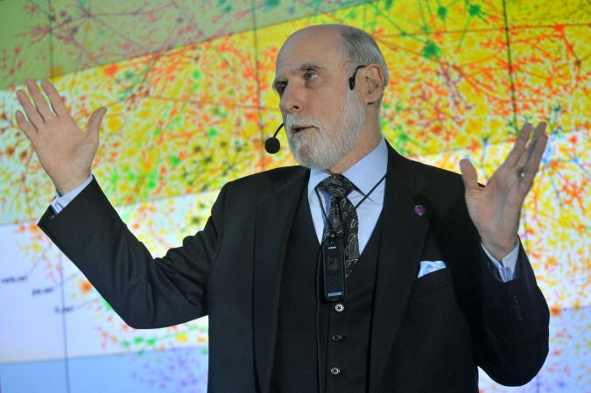
Internet History
Internet history is relatively short, dating back only to around 1970. In that time, the Internet has had as great an impact as any invention, and its story has only just begun.
Links:
Video: Internet & Web Pioneers: Joseph Hardin
Concepts > Internet > Internet Technologies > Internet History

Slide 4
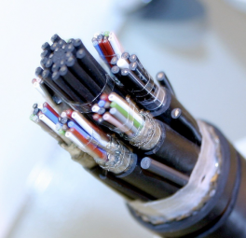
Internet Backbone
The Internet backbone refers to the main Internet pathways and connections, made up of the many national and international communication networks that are owned by major telecom companies such as Verizon, AT&T, and Sprint—the same companies and networks that provide telephone service.
Concepts > Internet > Internet Technologies > Internet Backbone

Slide 5
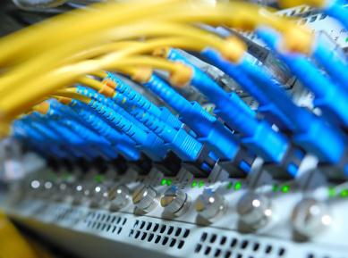
TCP/IP
The protocols on which the Internet is based are the Transmission Control Protocol (TCP) and Internet Protocol (IP); together referred to as TCP/IP.
Although Internet hardware and software are the most visible components, TCP/IP works behind the scenes to allow many different types of networks and devices to join together in an immense global network.
Links:
Video: Kleinrock: TCP/IP and packet switching
Concepts > Internet > Internet Technologies > TCP/IP

Slide 6
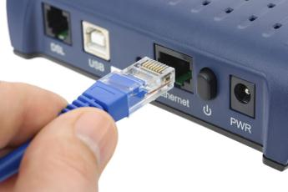
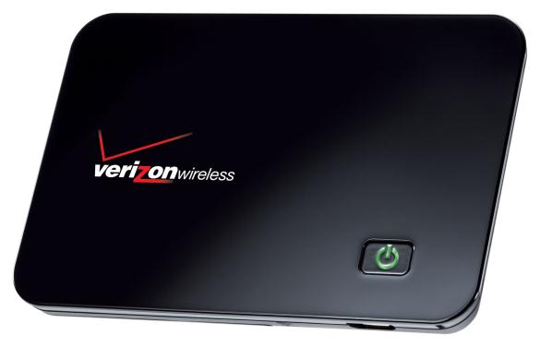
Internet Service Provider (ISP)
A company that provides individuals and organizations with access to the Internet is called an Internet service provider (ISP).
ISPs work as liaisons between Internet users and the telecommunications companies that own the Internet backbones, providing a variety of services at varying monthly rates.
Concepts > Internet > Internet Technologies > Internet Service Provider (ISP)

Slide 7
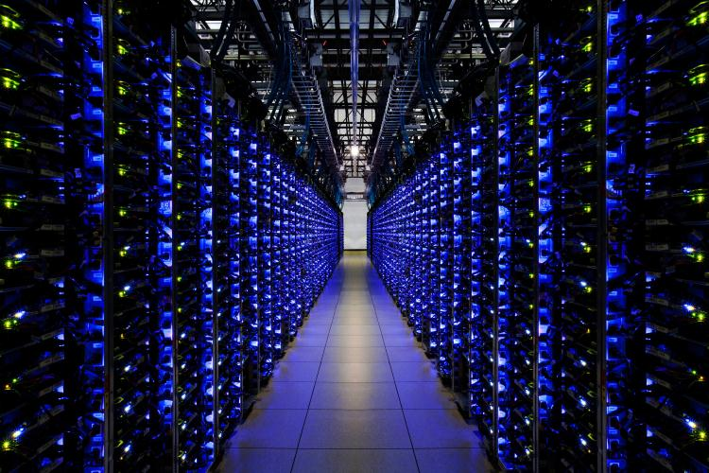
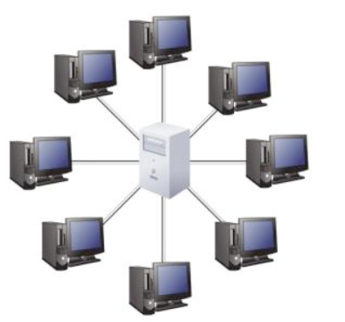
Client/Server
Client/server is a network architecture in which one computer or program (the client) makes a service request from another computer or program (the server), which provides the service.
Concepts > Internet > Internet Technologies > Client/Server

Slide 8
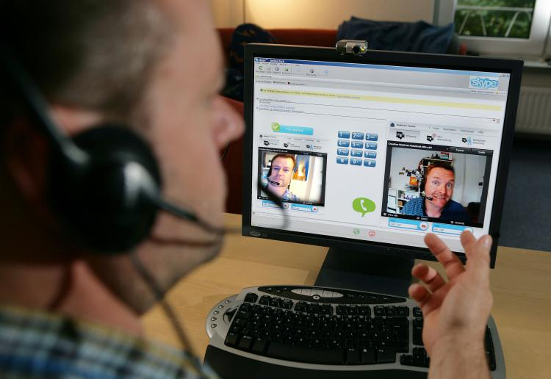
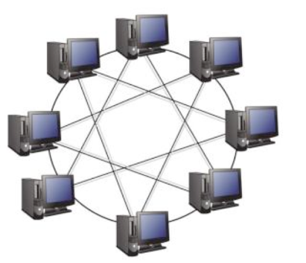
Peer-to-Peer (P2P)
Peer-to-peer (P2P) is a network architecture that does not utilize a central server but facilitates communication directly between clients with computers acting as both client and server.
Concepts > Internet > Internet Technologies > Peer-to-Peer (P2P)

Slide 9

Router
A router is a network device that manages network traffic by evaluating messages and routing them over the fastest path to their destination.
Each packet makes its way across the Internet by traveling from router to router, each router examining incoming data packets and intelligently sending them toward their destination.
Links:
Video: How the Internet Works in 5 Minutes
Concepts > Internet > Internet Technologies > Router

Slide 10
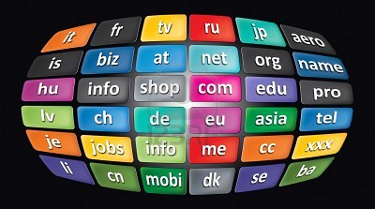
Domain Name System (DNS)
The Internet is a vast and complex system with billions of addresses, names, and servers. Keeping track of all the names and numbers is the responsibility of the DNS.
The Domain Name System (DNS) maintains a database of all domain names and IP addresses used on the Internet and acts like a phonebook, supplying information to Internet nodes and routers working to get data packets to their destination.
Links:
Video: DNS "Domain Name System" Basics
Concepts > Internet > Internet Technologies > Domain Name System (DNS)

Slide 11

Port
In a computer network context, a port is an address used by clients and servers that is associated with a specific service.
Port numbers can be used to track user activity on the Internet and can also be used by hackers to gain access to computer systems.
Concepts > Internet > Internet Technologies > Port

Slide 12
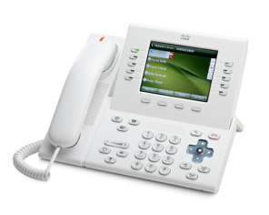
Voice over IP (VoIP)
Voice over IP (VoIP) refers to technologies that support voice communications using the Internet Protocol over data networks.
Businesses are migrating to VoIP, combining voice and data networks into one easy-to-manage digital network. Home users are saving money with VoIP by connecting to phone services provided over high-speed Internet connections. Mobile phone users are able to save monthly minutes by talking over Wi-Fi connections.
Links:
Video: Cisco Unified Communications
Concepts > Internet > Internet Technologies > Voice over IP (VoIP)

Slide 13
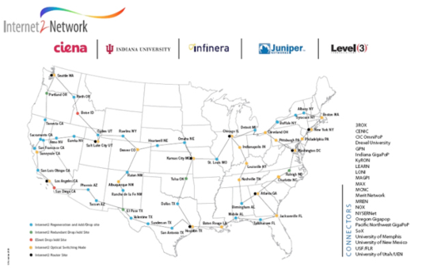
Internet2
Scientists and network engineers are exploring new technologies to develop the next generation Internet to support increasing numbers of users and applications at higher speeds.
Internet2 is a research and development consortium led by more than 200 U.S. universities and supported by partnerships with industry and government to develop and deploy advanced network applications and technologies for tomorrow’s Internet.
Links:
Video: ARTS: Internet2 and Music Distance Education
Concepts > Internet > Internet Technologies > Internet2

Slide 14
Internet Technologies
Transmission Control Protocol (TCP)
Internet Protocol (IP)
Packet
Packet-switching network
IP address
Internet Service Provider (ISP)
Cable modem
Terms
Internet
Internet hosts
Internet Technologies
Internetwork
Internet backbone
Network service providers (NSPs)
Points of presence (POPs)
Concepts > Internet > Internet Technologies > See your eBook for more information about these terms

Slide 15
Internet Technologies
BitTorrent
Router
Domain Name System (DNS)
Port
Voice over IP (VoIP)
Unified communications
Internet2
National LambdaRail (NLR)
Terms – continued
Cellular data connection
Digital subscriber line (DSL)
Dial-up
Digital satellite service (DSS)
Broadband over power line (BPL)
Client/Server
Peer-to-Peer (P2P)
Concepts > Internet > Internet Technologies > See your eBook for more information about these terms

Slide 16

Web Technologies
… are the hardware, software, and protocols that allow the web to exist. The web, short for World Wide Web, is an Internet service that provides convenient access to information and services through hyperlinks.
In this section: | Hypertext Markup Language (HTML) | Cookie
Web Browser | Extensible Markup Language (XML) | Plug-in
Web Server | Cascading Style Sheets (CSS) | Web Programming
Uniform Resource Locator (URL) | Web Development Software | Really Simple Syndication (RSS)
Links:
Video: World Wide Web in Plain English
Concepts > Internet > Web Technologies

Slide 17
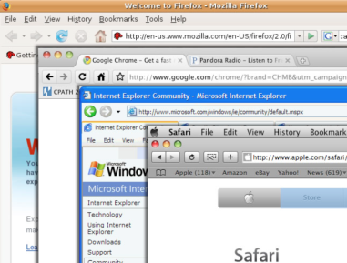
Web Browser
A web browser, or just browser (sometimes called a web client), such as Chrome, Internet Explorer, Safari, or Firefox, is used to request webpages from web servers, interpret the HTML code in the webpage that is delivered, and display the content onscreen.
Links:
Video: What is a browser?
Concepts > Internet > Web Technologies > Web Browser
Notes:
Bullet 2 modified

Slide 18
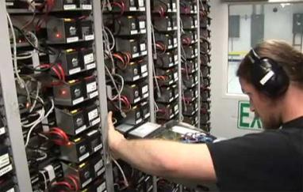

Web Server
The term web server refers to software that fulfills webpage requests from web clients and to the computers that run such software.
The client/server architecture is fundamental to providing Internet-based services. Without web servers, your web browser window would always be empty.
Links:
Video: Facebook's new energy efficient data center
Concepts > Internet > Web Technologies > Web Server

Slide 19

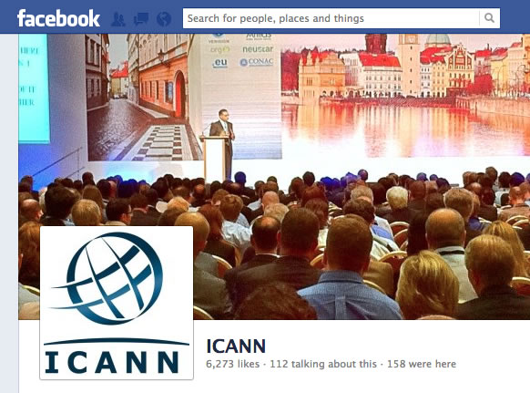
Uniform Resource Locator (URL)
A Uniform Resource Locator, more commonly called a URL, acts as a webpage address, incorporating the domain name of the web server and the location of the webpage file on the server.
Concepts > Internet > Web Technologies > Uniform Resource Locator (URL)

Slide 20
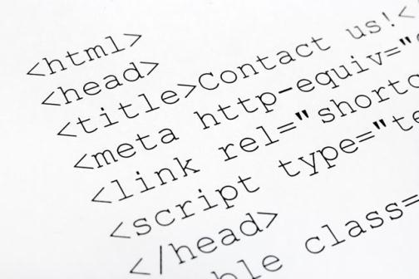
Hypertext Markup Language (HTML)
Hypertext Markup Language (HTML) is the primary markup language used to specify the formatting of a webpage.
Links:
Video: HTML Tutorial for Beginners
Concepts > Internet > Web Technologies > Hypertext Markup Language (HTML)

Slide 21
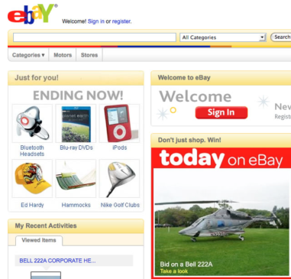
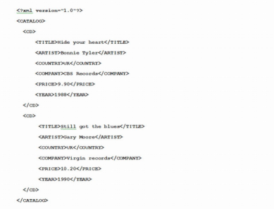
Extensible Markup Language (XML)
XML (Extensible Markup Language) provides a method for describing and classifying Internet-delivered data so that it is easier to organize and manage.
XML code used to catalogue a collection of CDs
Links:
Video: XML Tutorial - Introduction
Concepts > Internet > Web Technologies > Extensible Markup Language (XML)

Slide 22

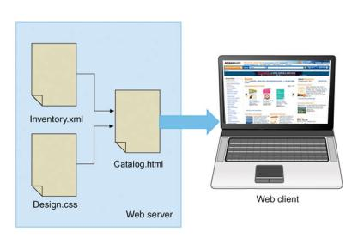
Cascading Style Sheets (CSS)
Cascading Style Sheets or CSS allows easy application of visual styles for fonts, colors, layouts, and other page attributes to create visual themes for webpages and sites.
Concepts > Internet > Web Technologies > Cascading Style Sheets (CSS)

Slide 23
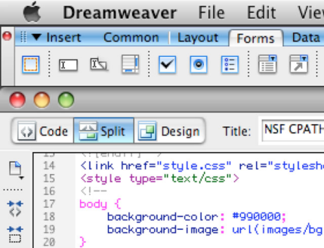
Web Development Software
Web development software allows developers to create webpages more easily using a word-processing-style environment and automating complex coding activities.
WYSIWYG (pronounced “wizzie-wig”) implies that the webpage you design with the web development software will look the same when published on the web.
Concepts > Internet > Web Technologies > Web Development Software
Notes:
Bullet 2 modified

Slide 24
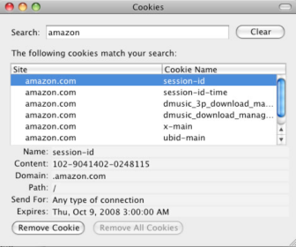
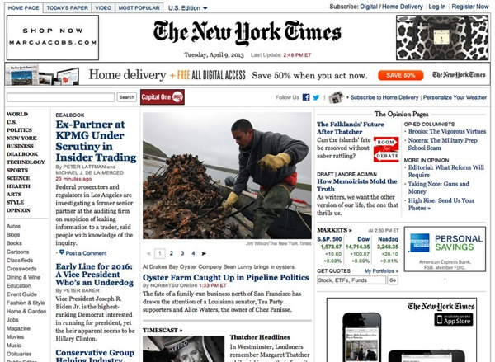
Cookie
A cookie, sometimes called an HTTP cookie, is a small text file placed on a user’s computer by a web server in order to identify the user whenever he or she returns to visit a website.
Cookies enable a web server to identify visitors to websites—but this ability can also be seen as a threat to a user’s security and privacy.
Links:
Video: Cookies 101
Concepts > Internet > Web Technologies > Cookie
Notes:
Bullet 2 modified

Slide 25
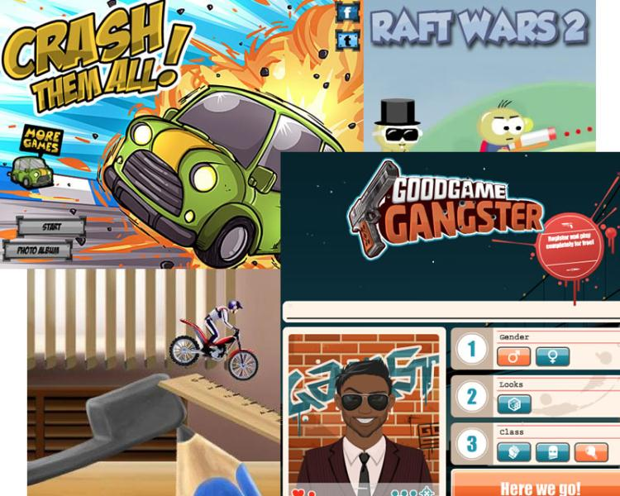
Plug-in
A plug-in, also called an extension or add-on, works with a web browser to offer extended services such as audio players, video, animation, 3D graphics viewers, and interactive media.
Concepts > Internet > Web Technologies > Plug-in

Slide 26
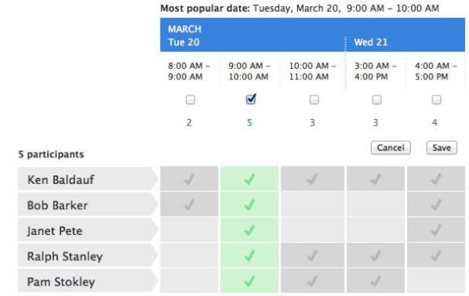
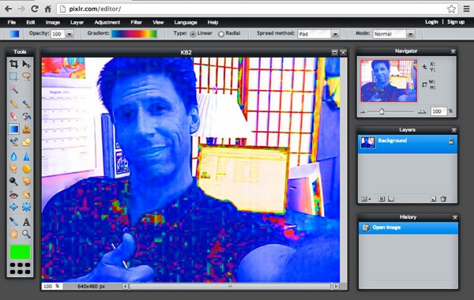
Web Programming
Web programming refers to the development of software written to run either in a web browser or on a web server, using web-based input and output.
Concepts > Internet > Web Technologies > Web Programming

Slide 27
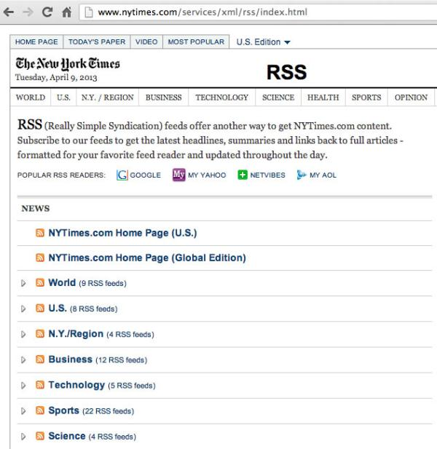
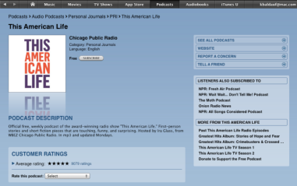
Really Simple Syndication (RSS)
Really Simple Syndication, or RSS, is a web technology used to automatically deliver frequently updated web content, such as blogs, podcasts, and news, in a standardized fashion.
Concepts > Internet > Web Technologies > Really Simple Syndication (RSS)

Slide 28
Web Technologies
Uniform Resource Locator (URL)
Top-level domain (TLD)
Internet Corporation for Assigned Names & Numbers (ICANN)
Hypertext Markup Language (HTML)
HTML tag, XHTML, HTML5
Extensible Markup Language (XML)
Semantic Web
Terms
Web Technologies
Web (World Wide Web)
Hyperlink
Hypertext Transfer Protocol (HTTP)
Web browser
Web server
Web hosting company/host
Concepts > Internet > Web Technologies > See your eBook for more information about these terms

Slide 29
Web Technologies
Content streaming
Web programming
Java/JavaScript
Asynchronous JavaScript and XML (Ajax)
Client-side programs
Server-side programs
Really Simple Syndication (RSS)
Podcast aggregator/ manager
Terms – continued
Cascading Style Sheets (CSS)
Web development software
WYSIWYG
Cookie
Stateless protocol
Third-party cookies
Plug-in
Concepts > Internet > Web Technologies > See your eBook for more information about these terms

Slide 30
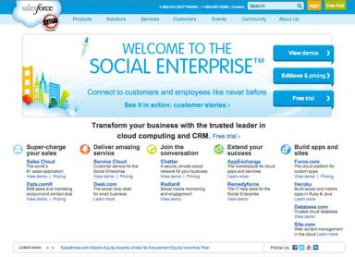
Cloud Computing
… delivers a variety of computing resources from the Internet as a service for free or for a fee, to relieve users from the burden of installing, maintaining, and securing those resources themselves.
In this section:
Cloud Services
Cloud Models
Links:
Video: What is Cloud Computing?
Concepts > Internet > Cloud Computing

Slide 31
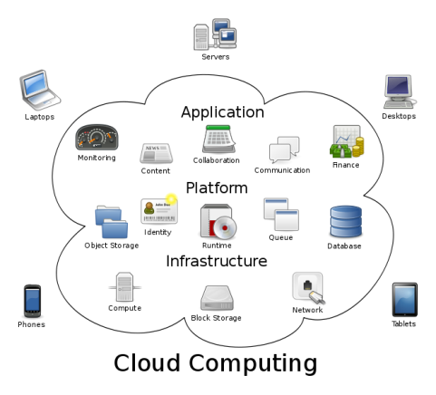
Cloud Services
Cloud Services include computing services provided over the Internet in three categories: infrastructure, platform, and software.
Cloud computing has been around in business environments for over a decade, referred to as Software as a Service or SaaS.
Links:
Video: Software as a Service overview
Concepts > Internet > Cloud Computing > Cloud Services

Slide 32
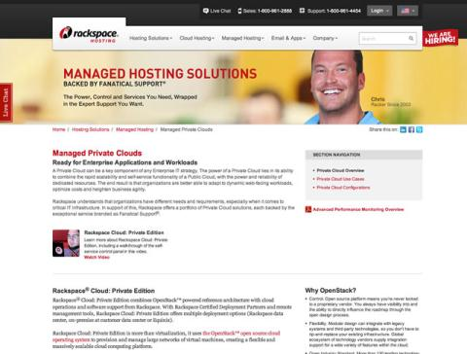
Cloud Models
There are several cloud models that serve various environments, including private clouds, community clouds, public clouds, and hybrid clouds.
While most users are familiar with public cloud services like Google Docs or iCloud, they may not be familiar with other models of importance to businesses and organizations.
Concepts > Internet > Cloud Computing > Cloud Models

Slide 33
Cloud Computing
Terms
Cloud computing
Cloud services
Cloud models
Concepts > Internet > Cloud Computing > See your eBook for more information about these terms

Slide 34
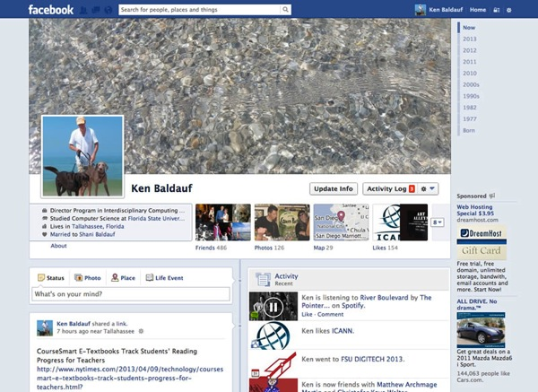
Web Resources
… are many and varied, assisting individuals, businesses, and organizations with all facets of life.
In this section: | Online News | Online Employment Support
Search Engine | Financial Services | Online Music
Portal | Online Education | Online TV and Video
Internet Communications | Online Travel | Online Games
Online Information | Maps & Geolocation | Social Media
Concepts > Internet > Web Resources

Slide 35
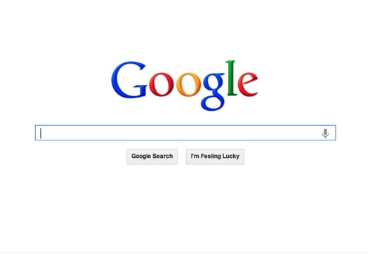
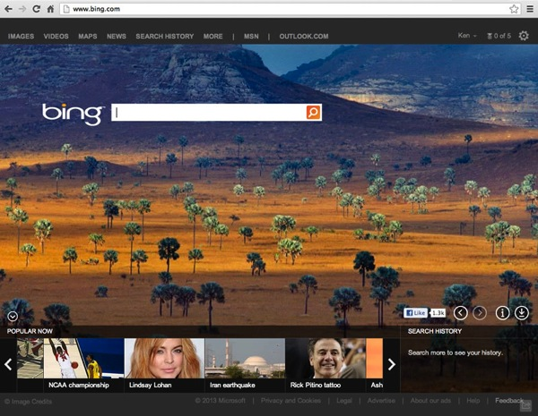
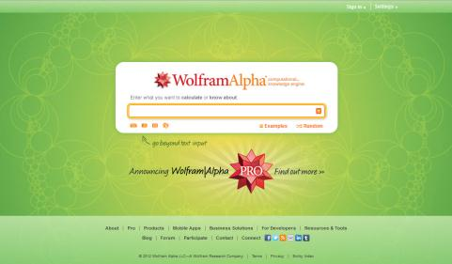
Search Engine
A search engine is a valuable software tool that enables users to find information on the web by specifying words that are key to their topics of interest—keywords.
Links:
Video: Introducing Bing - A Decision Engine from Microsoft
Concepts > Internet > Web Resources > Search Engine

Slide 36
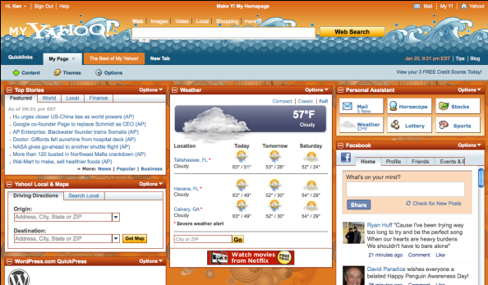
Portal
A web portal is a webpage that combines useful information and links, and acts as an entry point to the web—the first page you open when you begin browsing the web at home or at work.
Links:
Video: iGoogle: A Mini Product Tour
Concepts > Internet > Web Resources > Portal

Slide 37
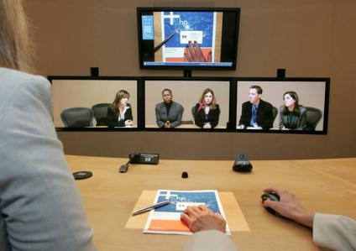


Internet Communications
Internet communications include text-based communications like email and instant messaging, voice communications like Voice over IP (VoIP), video communications, and a variety of group and community forums.
Links:
Video: Second Life - The Online 3D Virtual World
Concepts > Internet > Web Resources > internet Communications

Slide 38
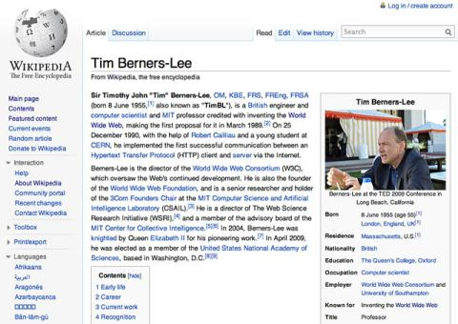
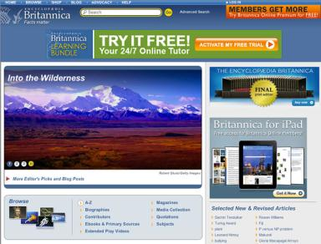
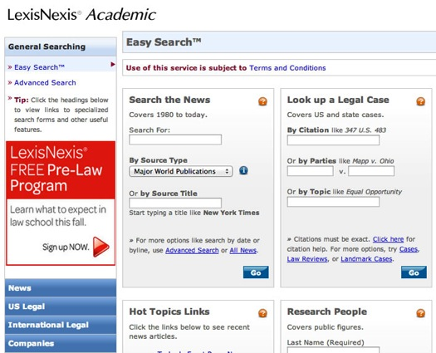
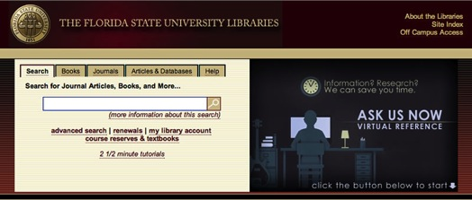
Online Information
Online information refers to information of all kinds—business, personal, governmental, factual, opinionated, and even inaccurate—that is delivered over the Internet and web.
Concepts > Internet > Web Resources > Online Information

Slide 39
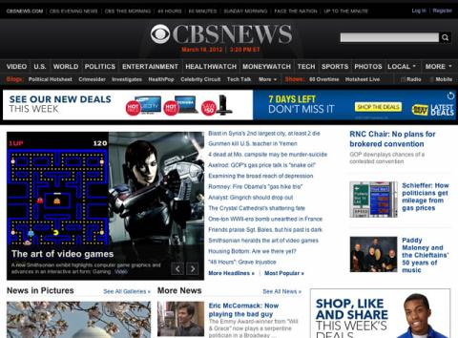
Online News
Online news refers to newspapers, magazines, journals, news radio and television, and blogs that deliver news and information about current events on the web.
Links:
Video: Behind the Citizen Journalism Revolution
Concepts > Internet > Web Resources > Online News

Slide 40
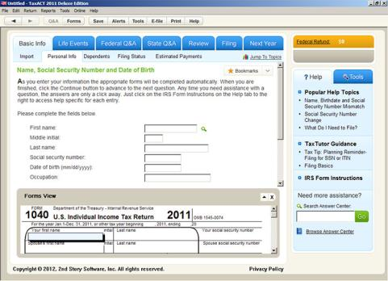
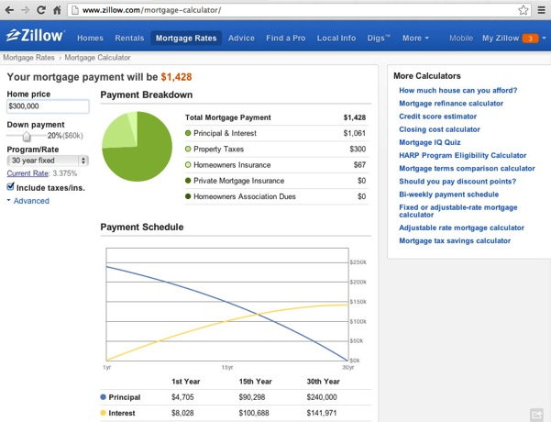
Financial Services
Online financial services support money management, loans, investments, and transactions for individuals, businesses, and organizations.
Links:
Video: What is Kiva?
Concepts > Internet > Web Resources > Financial Services

Slide 41
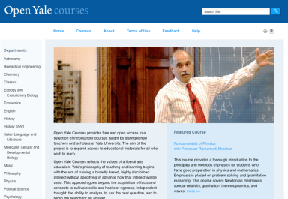
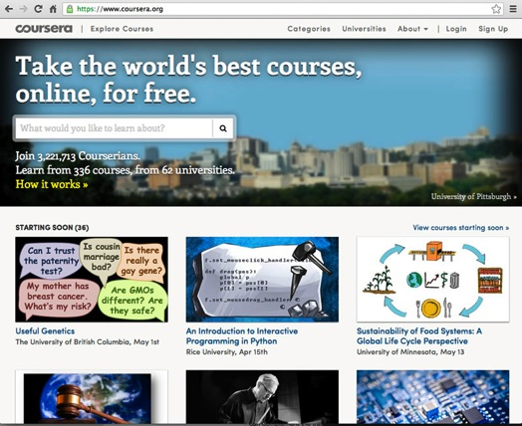
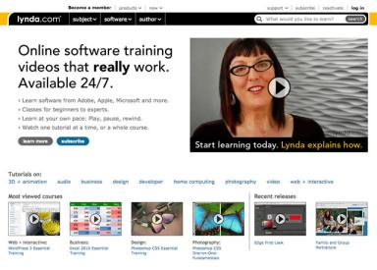
Online Education
Online education refers to websites designed to educate or support education and training.
Links:
Video: The Khan Academy
Concepts > Internet > Web Resources > Online Education

Slide 42
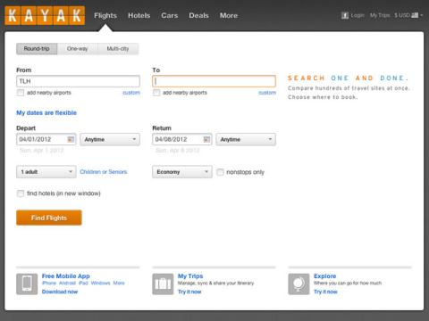
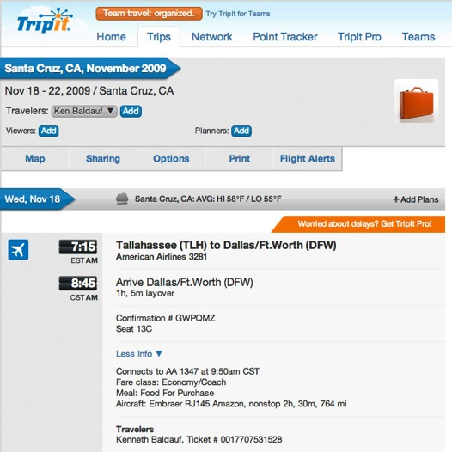
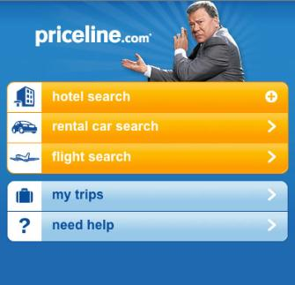
Online Travel
Online travel refers to websites and services that support various travel activities, such as preparing for travel, finding your way around new environments, reserving flights and lodging, booking tours and activities, and renting vehicles.
Concepts > Internet > Web Resources > Online Travel

Slide 43


Maps & Geolocation
Online maps & geolocation technologies provide geographic services for finding your way around, finding people and places, or finding information related to specific locations.
Links:
Video: Google Latitude
Concepts > Internet > Web Resources > Maps & Geolocation

Slide 44


Online Employment Support
Online employment support refers to web-delivered information and services that support researching employment options and finding employment.
Select a career.
Discover who the players are.
Learn about companies.
Network with others.
View job listings (general websites).
View job listings (industry-specific websites).
Create an impressive website to represent yourself.
Concepts > Internet > Web Resources > Online Employment Support

Slide 45



Online Music
Online music refers to music delivered through Internet-based or web-based services and includes Internet radio, music subscription services, and music download services.
Concepts > Internet > Web Resources > Online Music

Slide 46


Online TV and Video
Online TV and video refers to television programming, motion pictures, movies, and user-generated video available on the web.
Concepts > Internet > Web Resources > Online TV ad Video

Slide 47

Online Games
Online games include the many different types of single-user, multiuser, and massively multiuser games played on the Internet and the web.
Multiplayer online games can be categorized into the following genres: Action, Board, Card, Flight Simulation, MultiUser Dimension or MultiUser Dungeon (MUD), Role-Playing Games (RPG), Sims (Simulations), Social, Sports, Strategy, Trivia/Puzzle.
Links:
Video: Xbox LIVE with Kinect
Concepts > Internet > Web Resources > Online Games

Slide 48


Social Media
Social media refers to online services that support social interaction and publishing.
Concepts > Internet > Web Resources > Social Media
Notes:
Bullet 2 modified

Slide 49
Web Resources
Terms
Web Resources
Search Engine
Information overload
Human-powered search
Meta search engine
Portal
Horizontal portals
Widgets
Vertical portals
Corporate portals
Internet communications
Pervasive communication
Online information
Online news
Social/Citizen journalism
Financial services
Online education
Distance education
Online travel
Maps & Geolocation
Concepts > Internet > Web Resources > See your eBook for more information about these terms

Slide 50
Web Resources
Terms – continued
Geographic information systems (GIS)
Geo-tagging
Augmented reality
Online employment support
Online music
Internet radio
Online TV & video
Online games
Massively multiplayer online role- playing games (MMORPG)
Social media
Blogs
Wiki
Crowdsourcing
Social networking
Micro-blogging
Media sharing
Folksonomy/collaborative tagging
Tag cloud
Social bookmarking
Concepts > Internet > Web Resources > See your eBook for more information about these terms

