Slide 1
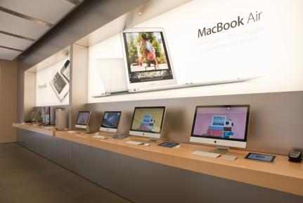
Hardware
… refers to the tangible parts of a computer or digital device, and typically includes support for processing, storage, input, and output.
By learning about these underlying processes and their components, you can develop a better understanding of what computing devices are capable of and how you can benefit from those capabilities.
In this section:
Processing
Storage
Input/Output (I/O)
Links:
Video: Jonathan Ive explaining Unibody-Design
Concepts > Hardware

Slide 2
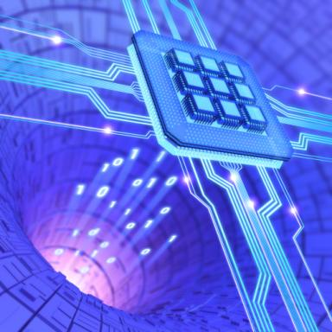
Processing
… carries out the instructions provided by software using specially designed circuitry and a well-defined routine to transform data into useful outputs.
In this section:
Transistor | Multicore Processor | Motherboard
Integrated Circuit | Moore’s Law | Bus
Central Processing Unit | Multiprocessing | Machine Cycle
Links:
Video: Intel - We Can't Wait
Concepts > Hardware > Processing

Slide 3
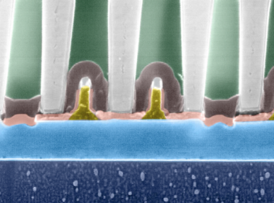
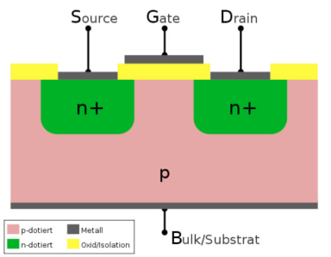
Transistor
A transistor is an electronics component typically composed of silicon that opens or closes a circuit to alter the flow of electricity to store and manipulate bits.
  When electricity is flowing through a transistor, it represents a 1; when it is not flowing, it represents a 0.
Links:
Video: MAKE presents: The Transistor
Concepts > Hardware > Processing > Transistor
Notes:
Bullet 2 modified

Slide 4
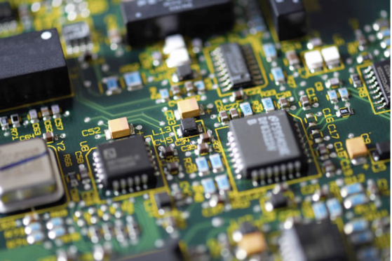
Integrated Circuit
An integrated circuit (processor or chip) connects tiny transistors and other electronics components on a thin piece of semiconductive material such as silicon.
Links:
Video: MAKE presents: The Integrated Circuit
Concepts > Hardware > Processing > Integrated Circuit

Slide 5
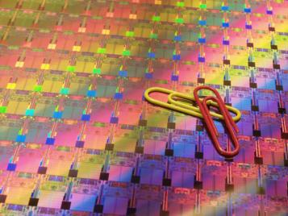
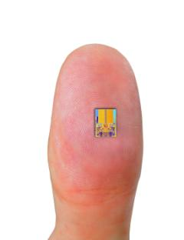
Central Processing Unit
The central processing unit (CPU) is a group of circuits that perform the processing in a computer, typically in one integrated circuit called a microprocessor.```````
CPU Components
Control unit
Arithmetic/Logic Unit (ALU)
Registers
Cache
Clock Speed
Links:
Video: Mark Bohr Gets Small
Concepts > Hardware > Processing > Central Processing Unit

Slide 6
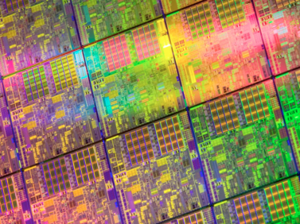
Multicore Processor
A multicore processor, such as a dual-core, triple-core, or quad-core processor, combines multiple CPUs on one chip to share the workload and speed up processing.
The latest generations of smartphones are equipped with quad-core or even 8-core processors that offer desktop processing speeds for mobile gaming and other demanding applications.
Links:
Video: Intel Atom Processor HD
Concepts > Hardware > Processing > Multicore Processor

Slide 7
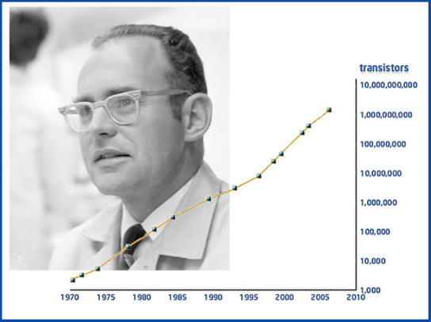
Moore’s Law
Moore’s Law states that the number of transistors on a chip will double about every two years.
New Processing Technologies
High-k materials
Optical computing
3D processing
Quantum computing
DNA computing
Links:
Video: What is Moore's Law
Concepts > Hardware > Processing > Moore’s Law

Slide 8

Multiprocessing
Multiprocessing is processing that occurs using more than one processing unit to increase productivity and performance.
From the Mac Pro PC, which can be configured with two 6-core processors, to Japan’s K supercomputer, which utilizes over 7 million processors, multiprocessing defines ultimate processing power.
Links:
Video: Jaguar: World's Most Powerful Computer
Concepts > Hardware > Processing > Multiprocessing

Slide 9
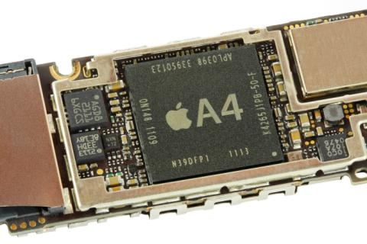
Motherboard
The motherboard is the primary circuit of a computer to which all components are connected, including the CPU.
The motherboard connects all of a computer’s components and enables them to communicate. Both general-purpose and special-purpose computers utilize motherboards.
Links:
Video: Toshiba Notebook Disassembly
Concepts > Hardware > Processing > Motherboard

Slide 10
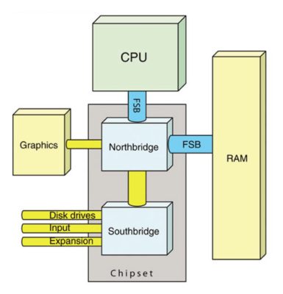
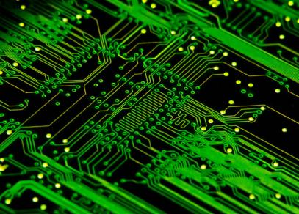
Bus
The bus is a subsystem on the motherboard that transfers data among system components.
Concepts > Hardware > Processing > Bus

Slide 11
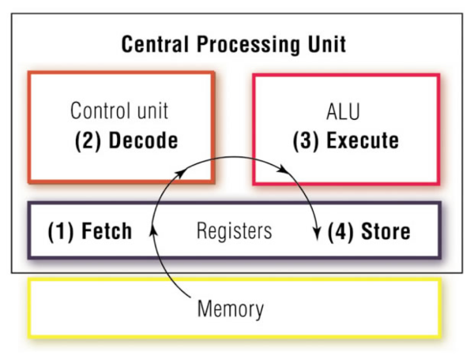
Machine Cycle
The machine cycle provides a CPU with an orderly method of processing software instructions.
Concepts > Hardware > Processing > Machine Cycle
Notes:
Bullet 2 modified

Slide 12
Processing
Qubit
DNA computing
Multiprocessing
Parallel processing
Massive parallel processing
Motherboard
Bus
Front side bus (FSB)
PCI bus
LPC bus
Machine Cycle
Terms
Hardware
Processing
Transistor
Integrated Circuit
Microchips (chips)
Processors
Central Processing Unit (CPU)
Control unit
Arithmetic/logic unit (ALU)
Registers
Cache
Clock speed
Multicore Processor
Moore’s Law
High-k materials
Optical computing
Optical processors
Three-dimensional processing
Quantum computing
Concepts > Hardware > Processing > See your eBook for more information about these terms

Slide 13
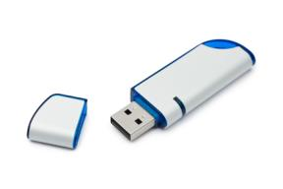
Storage
In computing and digital technologies, … refers to the ability to maintain data within the system temporarily or permanently.
In this section:
Random Access Memory (RAM) | Magnetic Storage
Video Memory | Optical Storage
Read Only Memory (ROM) | Solid-State Storage
Concepts > Hardware > Storage

Slide 14
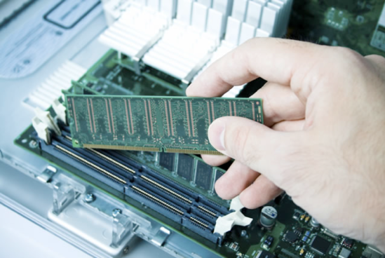
Random Access Memory (RAM)
Random access memory (RAM) is temporary, or volatile, memory that stores bytes of data and program instructions for the processor to access.
Links:
Video: Install More Memory in Your Laptop
Concepts > Hardware > Storage > Random Access Memory (RAM)

Slide 15
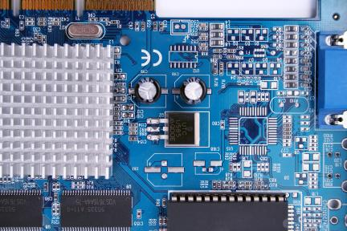
Video Memory
Video memory, sometimes called video RAM, VRAM, or graphics memory, is used to store image data for a computer display in order to speed the processing and display of video and graphics images.
Microsoft Windows, Mac OS X, and today’s demanding 3D computer games require high-capacity video memory and sophisticated graphics support to provide a rich and realistic graphics environment for work and play.
Links:
Video: NVIDIA Booth Tour @ MWC 2013
Concepts > Hardware > Storage > Video Memory

Slide 16

Read Only Memory (ROM)
Read-only memory (ROM) provides permanent storage for data and instructions that do not change, such as firmware — programs and data from the computer manufacturer, including the boot process used to start the computer.
ROM stores data, using circuits with states that are fixed. Therefore, the data represented by this combination is not lost if the power is removed.
Concepts > Hardware > Storage > Read Only Memory (ROM)

Slide 17
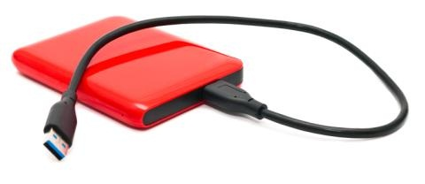
Magnetic Storage
Magnetic storage is a storage technology that uses the magnetic properties of iron oxide particles rather than electric charges to store bits and bytes more permanently than RAM.
Magnetically stored data lasts years, even decades, before deteriorating. Magnetic storage, in the form of a hard disk drive, provides an inexpensive, high-capacity form of permanent storage that acts as the main storage medium for most computer users.
Links:
Video: Inside of Hard Drive
Concepts > Hardware > Storage > Magnetic Storage

Slide 18
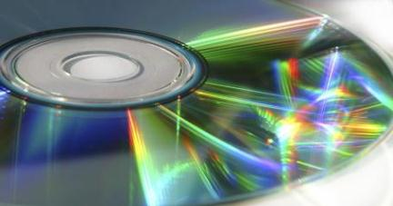
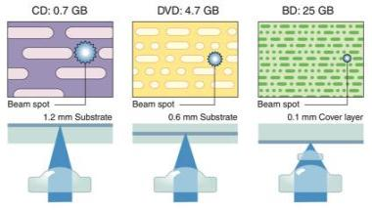
Optical Storage
Optical storage media, such as CDs, DVDs, and Blu-ray discs, store bits by using an optical laser to burn pits into the surface of a highly reflective disc.
Although optical storage does not match the high capacity and data access rates of magnetic and solid-state storage, it is ideal for storing music, movies, photos, software, and data for mobile access and sharing.
Links:
Video: InPhase Technologies/Nintendo
Concepts > Hardware > Storage > Optical Storage
Notes:
Bullet 2 modified

Slide 19

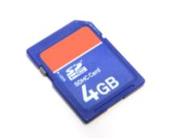
Solid-State Storage
A solid-state storage device stores data using solid-state electronics such as transistors, and unlike magnetic and optical media, does not require any moving mechanical parts.
Solid-state storage offers fast access times, is increasing in capacity each year, and the cost continues to decrease.
Links:
Video: Samsung SSD vs HDD
Concepts > Hardware > Storage > Solid-State Storage

Slide 20
Storage
Read only memory (ROM)
Firmware
BIOS, Flash BIOS
Magnetic storage, disks, tape
Direct access
Microdrives
Sequential access
Storage area network (SAN)
Optical storage
Burning
Recordable (R)
Rewritable (RW)
Compact disc read-only memory (CD-ROM)
Digital video disc read-only memory (DVD-ROM)
Blu-ray discs (BDs)
Solid-state storage
Flash memory, memory card
Media cards
Flash drive/USB drive/thumb drive
Terms
Storage, device, media
Local storage
Network storage
Random access memory (RAM)
Single in-line memory module (SIMM)
Dual in-line memory module (DIMM)
Video memory
Graphics processing unit (GPU)
Concepts > Hardware > Storage > See your eBook for more information about these terms

Slide 21

Input/Output (I/O)
… the manner in which data is received into a computer system, and the manner in which information and the results of processing are provided to the user.
In this section:
Input Device | Output Device | Printer
General-Purpose Input Device | Video Card | Audio and Special Media Output
Special-Purpose Input Device | Display | Expansion
Links:
Video: Introducing the Leap Motion
Concepts > Hardware > Input/Output (I/O)

Slide 22
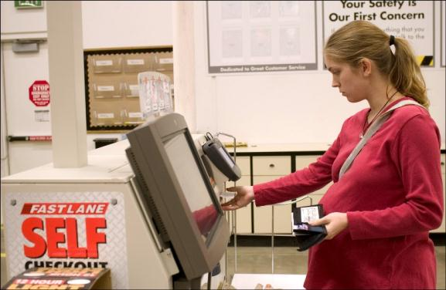
Input Device
An input device assists in capturing and entering data into a computer system.
Links:
Video: Siri Can You Hear Me?
Concepts > Hardware > Input/Output (I/O) > Input Device
Notes:
Bullet 2 modified

Slide 23
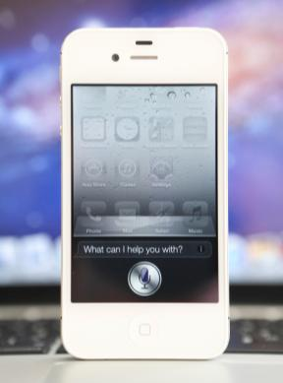
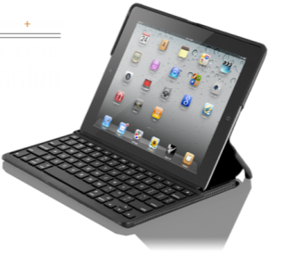

General-Purpose Input Device
A general-purpose input device is one that is designed to be used for a wide variety of computing activities.
Links:
Video: Logitech Ultrathin Keyboard Cover for iPad
Concepts > Hardware > Input/Output (I/O) > General-Purpose Input Device
Notes:
Bullet 2 modified

Slide 24

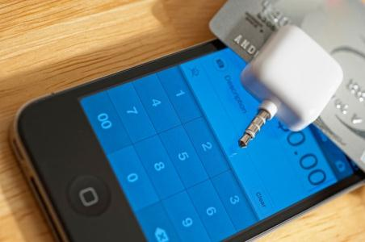
Special-Purpose Input Device
A special-purpose input device is designed to provide input for one specific type of activity.
Links:
Video: Dance Central 3
Concepts > Hardware > Input/Output (I/O) > Special-Purpose Input Device
Notes:
Bullet 2 modified

Slide 25

Output Device
An output device allows a user to observe the results of computer processing with one or more senses.
A good output device delivers information—visual, audio, or other—in a manner that allows the information to be interpreted easily and, in some situations, enjoyably.
Links:
Video: Cisco Telepresence - Video Data Sheet
Concepts > Hardware > Input/Output (I/O) > Output Device

Slide 26
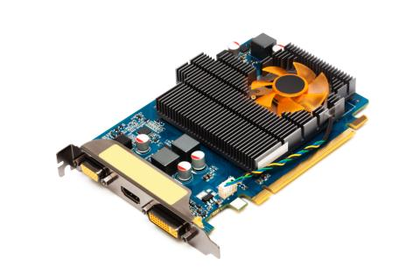
Video Card
A video card (graphics card) combines video processing and storage onto an expansion card, or integrates them onto the motherboard to manage video images for display.
Graphics support specifications are often listed third in computer ads, after processor and memory, because so many users enjoy 3D graphics animations and video games.
Links:
Video: Fable III trailer
Concepts > Hardware > Input/Output (I/O) > Video Card

Slide 27
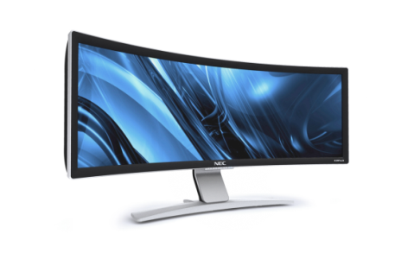

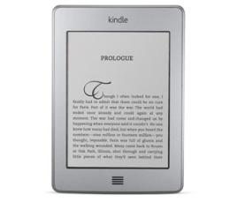
Display
A display provides visual computer output for observation on a monitor or screen.
Links:
Video: Dallas Cowboys Giant Stadium TV
Concepts > Hardware > Input/Output (I/O) > Display

Slide 28
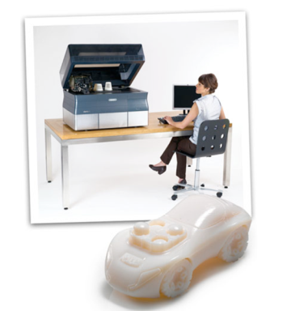
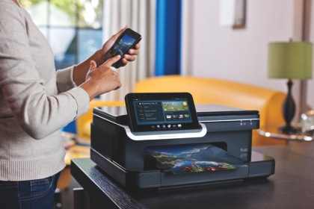
Printer
A printer is an output device dedicated to providing computer output on paper or three-dimensional output in plastic.
Links:
Video: MakerBot Replicator 2
Concepts > Hardware > Input/Output (I/O) > Printer

Slide 29

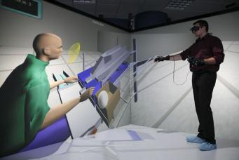
Audio and Special Media Output
There are a number of audio and special media output devices designed to provide output to all of the senses.
When you silence your mobile phone, you may set it to vibrate to alert you to arriving calls. Output that you can feel is referred to as haptic output.
Concepts > Hardware > Input/Output (I/O) > Audio and Special Media Output

Slide 30
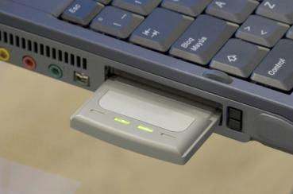
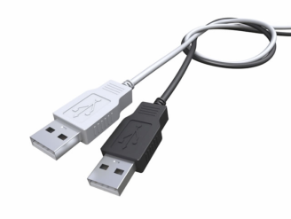
Expansion
Expansion refers to a computer’s capacity to interface with a variety of external devices such as I/O devices, network devices, and storage devices by connecting through ports, slots, and wireless technologies.
  Expansion allows computer users to enjoy computing benefits above and beyond those provided by the computer alone.
Links:
Video: Understanding expansion slots
Concepts > Hardware > Input/Output (I/O) > Expansion

Slide 31
Input/Output (I/O)
Optical character recognition (OCR)
Point-of-sale (POS) devices
Output device
Video card
Display
Pixels
Display resolution
Responsive designs
High definition TV (HDTV)
Special-purpose input device
Game controller
Joystick
Webcam
Page scanners
Handheld scanners
Magnet ink character recognition (MICR)
Optical mark recognition (OMR)
Terms
Input device
Human-readable
Machine-readable
Source data automation
General-purpose input device
QWERTY keyboards
Pointing devices
Touch screens
Multitouch displays
Concepts > Hardware > Input/Output (I/O) > See your eBook for more information about these terms

Slide 32
Input/Output (I/O)
Flexible display
Cathode ray tube (CRT) display
Heads Up display (HUD)
Printer
Hard copy
Pages printed per minute (PPM)
Multifunction printer
Laser printer
Ink-jet printer
3D printer
Audio & special media output
Haptic output
Expansion
Universal serial bus (USB)
Expansion board/card/slot
Terms (continued)
3D displays
LCD projectors
Liquid crystal diode (LCD) display
Plasma display
Light emitting diode (LED) display
Organic light-emitting diode (OLED) display
Electronic paper (e-paper)
Concepts > Hardware > Input/Output (I/O) > See your eBook for more information about these terms

